Slide 1
Teaching pLan & Policy brief
Implementation Policies and Strategies

Slide 2
Teaching Plan!
Estimated Time for Teaching:
45 mins
Supplies and Resources:
Pamphlets, awareness campaign, etc.
Community and Target Aggregate:
Young Adults
Location of Teaching:
Community Center
Estimated Cost:
$1000
Topic: CAUTI and Environmental Factors/Implications

Slide 3
Goals and Objectives
Accompanying is a portion of the exploration questions that have been endeavored:
Explain how catheter use is a significant predictor of catheter associated urinary tract infection (CAUTI).
Describe the etiology and diagnosis of a CAUTI.
Discuss how physical and virtual reminders for catheter removal play a role in the prevention and treatment of CAUTI.
List the implications for nursing and health informatics.

Slide 4
Problem Statement
The interest in this part of the therapeutic health exists since CAUTI has been pronounced as a standout amongst the most normal manifestations of infections spreading from inside the hospitals.
According to an evaluation the CAUTI is answerable for over 40% of the nosocomial infections.
80% of the nosocomial infections throughout the intense care hospitalization settings are spread because of the Indwelling CAUTI.
Declining the scenario, the studies show that around 30% of the aggregate doctors are completely ignorant of the explanations of spread of CAUTI inside their particular patients. Furthermore, “The total annual cost of treating a CAUTI is approximately $424 million” (Foxman, 2002).
Having such critical and alerting statistics under thought for the health care facilitates within the United States, the specialists were roused to form the exploration study on these unfamiliar and uninformed components.

Slide 5
Topic Rationale
The motivation for the selection of the topic is the cost based problem for treating the Catheter Associated Urinary Tract Infection (CAUTI).
It needed hospitalization plus the costly medication methodology that were demanding to be taken in by the patients.
It is this explanation for why that the particular paper is being formed with the intention that the clinicians may be guided by way of the variable – innovation mediations to dispense with the potential outcomes of CAUTI spreading inside the hospitals.
The examination was rotated around examination of the different mediations that can accommodate counteract the spread of CAUTI inside the hospitalized patients because of the carelessness of the clinicians and RNs.

Slide 6
Teach-Back Theory

Slide 7
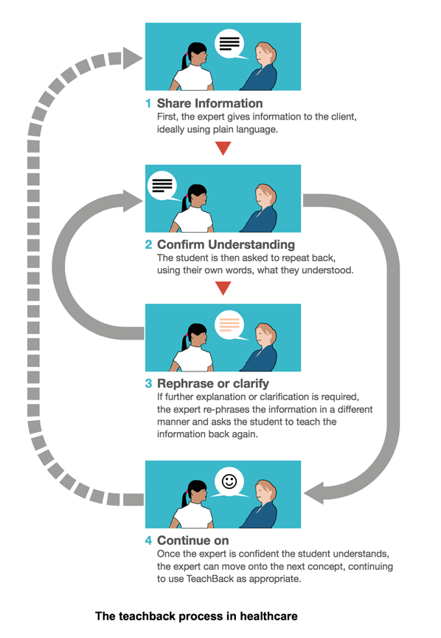
Interactive Process

Slide 8
Communication Strategy

Slide 9
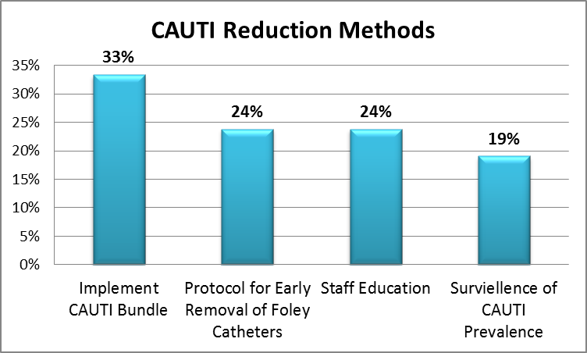
Findings AND Results

Slide 10
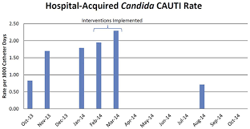
Cont…

Slide 11
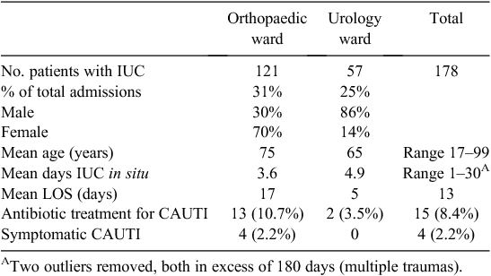
Cont…
Prevalence….

Slide 12
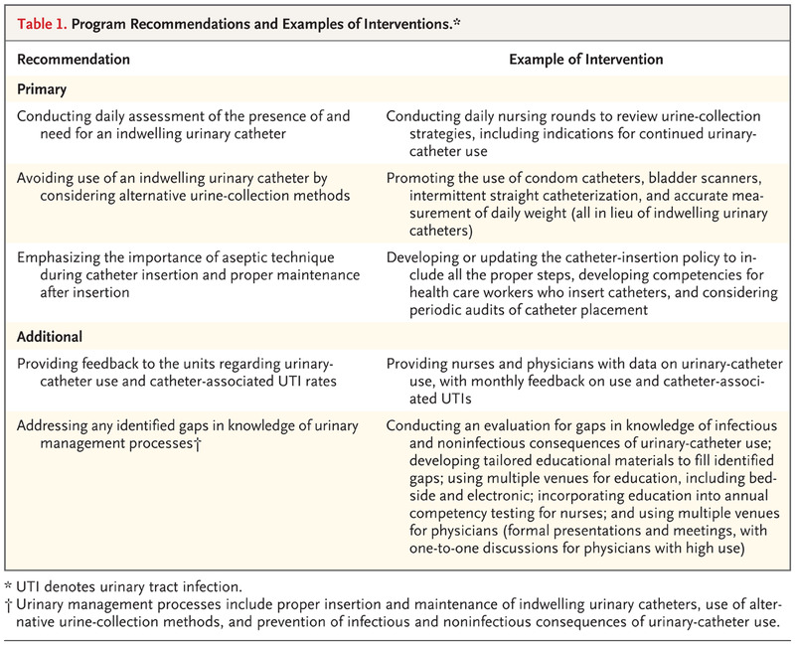
Strategies and Implementation Policies

Slide 13
Theoretical Framework
As the initial point of the research study, author did adopt the specific perspective that helped him formulate his line of argument as well.
His major perspective concentrated upon the expenses invested in the treated of CAUTI and inefficiency of the hospitals due to which they are becoming the ultimate causes of the spread of CAUTI.
Lastly, in order to enclose his study within a specific framework or the boundary, the author took help of the tables that not only defined the scope of the paper but also bounded his study from stopping it to deviate from actual focal point.

Slide 14
Conclusion
A one of a kind test to expect when executing urinary catheter expulsion methodologies is hesitance by certain RNs to evacuate the catheter, notwithstanding when the nurse is 'enabled' to do as such.
Sometimes, RNs might be dynamic resisters because of conflict with the catheter arrangement or potentially a craving to stay away from the burdens and expanded recurrence of patient required (Curran & Murdoch, 2009).
There is likewise a contending weight on RNs to relieve advancement of medical clinic gained weight ulcers—prompting observation that UCs could diminish danger of skin breakdown notwithstanding being indicated for patients with incontinence and open sacral injuries.

Slide 15
Conc…
Different RNs report they just don't feel comfortable expelling the catheter without express requests from the doctor, which is unexpected thinking about that numerous RNs submit catheters without requests.
Nursing solace with catheter expulsion can be increased with friend backing and training and might be encouraged by straightforwardly tending to the remaining task at hand concerns related with the evacuation of inhabiting catheters.
Without a doubt, an overview of RNs during execution of a nurse-engaged catheter evacuation convention showed expanded nursing and patient fulfillment, in spite of the normal increment in remaining burden.
Later fruitful and practical multimodal mediations to diminish catheter use including nurse-driven endeavors had bedside RNs who, by survey, saw themselves as in charge of assessment of catheter nearness and need, believed in their insight, and saw doctors as open to their solicitations with respect to catheter expulsion (Capezuti et al. 2012).

Slide 16
References
Stone, P. W., Hughes, R., & Dailey, M. (2008). Creating a safe and high-quality health care environment. In Patient safety and quality: An evidence-based handbook for RNs. Agency for Healthcare Research and Quality (US).
Curran, E., & Murdoch, H. (2009). Aiming to reduce catheter associated urinary tract infections (CAUTI) by adopting a checklist and bundle to achieve sustained system improvements. Journal of Infection Prevention, 10(2), 57-61.
Capezuti, E., Boltz, M., Cline, D., Dickson, V. V., Rosenberg, M. C., Wagner, L., ... & Nigolian, C. (2012). RNs Improving Care for Healthsystem Elders–a model for optimising the geriatric nursing practice environment. Journal of Clinical Nursing, 21(21-22), 3117-3125.
Dexheimer, J.W., Talbot, T.R., Sanders, D.L., Rosenbloom, S.T., & Aronsky, D. (2008). Prompting clinicians about preventive care measures: A systematic review of randomized controlled trials. Journal of the American Medical Informatics Association, 15, 311-320.
Foxman, B. (2002). Epidemiology of urinary tract infections: Incidence, morbidity, and economic costs. American Journal of Medicine. 113(1), S5-S13.

