Slide 1
Value-added Care Processes
Adding value is one of the national framework for nursing and healthcare. A nurse could add a lot when it comes to take care of patients. Value should be added while taking care of patients who are bed stricken.
It is one of the significant improvement that should be made for restructuring healthcare facilities provided to the patients.
An ideal nurse would adopt this change for improving various areas that are related to nursing profession such as quality, safety, evidence-based medicine, satisfaction of patient and specifically giving moral support to patient.
Notes:
Value added is one of the change that medical staff member could bring about. This is a non-conventional way of treating patients and by using this framework, care staff gets opportunity of demonstrating those values which would bring beneficial outcomes for patient.

Slide 2
Reason for selecting value-added care processes:
For closing gaps, nurses have to play a crucial role that could be done by assuring those activities that would be having high values.
A nurse as a leader would be most interested in changing the way patients are treated while they are under observation (Porter,et,al,2008).
Being a leader, when one wanted to change conventional ways of attending patients, this fact should be realized that patients need real care and concern. While being on the bed they passes through a critical phase of their life (Bradley,et,al,2016).
As a whole it could be said that as per the change is concerned, there should be a change in the attitude of dealing patients.
Notes:
There are many changes that responsible medical staff bring for improving outcomes of patients and one of these important changes is selection of value-added care processes (Bradley,et,al,2016). There are many reason for selecting this change in framework project and few reasons are given as, better outcomes, best experiences, best use of resources and satisfaction of patients (Porter,et,al,2008).

Slide 3
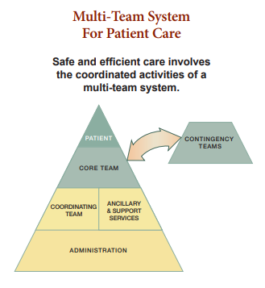
Team steps for enhancing performance and patient safety
When there is need of implementation of value-added care processes efforts of whole team are needed. For achieving expected outcomes all the working members of healthcare should have following characteristics:
Team structure
Communication
Leadership
Situation monitoring
Mutual support
Following goals are achieved by following above
mentioned things:
Accuracy
Productivity
Efficiency
Safety
Adaptability
Notes:
Coordination among workers is very important for accomplishing set goals. Team structure would define who would be the part of team. Communication should be strong so that the set goals could be achieve easily. Good leadership is crucial for efficient working, as coordinator would lead the care provider for taking certain steps. Situation should be monitored by some senior member. Mutual support is another important thing for bringing about a change, as in the selected change patient would be supported by caregiver and in response of good care, patient would prove, a great support for caregiver.

Slide 4
Context of selected change
Change that a nurse would induce as a leader, would have social context. This change is about adding values to the process that is being offered by nurses so that patient would have fast recovery.
Physically this change is going to take place in the room of patient , clinic or hospital.
Patients and staff are going to be affected by this change, if patients and staff would give positive feedback, this change would be implemented for long terms.
There is a need of approval from many concerned people for bringing about selected change such as patients, attendants, staff, coordinator and authorities etc.
Notes:
This type of change is somehow social and economical as the patients are going to have better dealing by the caregiver who would not claim fee for performance only but would claim fee for value care as well.

Slide 5
Setting where selected change would take place:
This change of adding value to the processes of taking care is going to take place at various places, such as clinics, hospitals and home healthcare where there would be patient and nurse.
Notes:
This change is going to take in all those settings where there would be patients. But commonly value-added care processes would take place in home healthcare, hospitals and clinics.

Slide 6
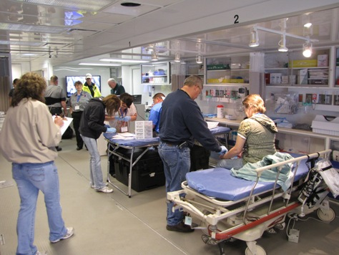
People affected by the change
Value-added care processes are going to affect patients, nurses, organization and stalk holders of the any organization that would offer its services for improving health of its patients.
Patient
Healthcare unit
Nurse
Notes:
There is no doubt that this change is going to have a positive impact on all the figures who would be directly and indirectly linked to this change. But mainly this change would have a strong affect on patients, care staff and atmosphere of the unit where this change would take place.

Slide 7
Value-added care process needs an approval specifically from the coordinator of the nurses. Authorities hire coordinators and assign such tasks to them.
Staff nurse would first ask the coordinator then would take further steps.
Notes:
Field of healthcare is one of the most sensitive field and no one is allowed to bring about any change without having an approval from the concerned authorities. When it comes to value-added care processes, mainly staff nurses being agents of change need approval from hospital authorities. Specifically coordinator of nurses is going to approve this change.

Slide 8
Solutions:
In the case of value based care processes, outcomes matter more than ever. Nurse by adding value to the processes could improve outcomes that become vital for the survival of hospital. Solutions are listed below:
Value-added care processes promote well-informed diagnosis.
It supports optimal treatment planning.
Taking care of the clinicians is of great importance.
Value-added care processes would improve outcomes by having greater transparency in all affairs related to patient.
It also ensures continuity of care following the discharge.
Value care would give much importance to engage and support patients even after their discharge.
It would also include usage of connected care for better outcomes.
Notes:
There are many solutions that have been observed in case of value-added processes used by nurses in healthcare field. There are many things that have been benefited by the implementation of this change. It has multiple advantages for patient and care provider.

Slide 9
Evidences
All successful treatments begin with correct and timely diagnosis, but there may occur errors in diagnosis, such as human error or error of tools being used for diagnosis.
Diagnosis would be followed by decision about the treatment (Winegar,et,al,2018). Selection of right approach for treatment of the diagnosed issue would have considerable impact on the overall outcome.
Working conditions and atmosphere of hospital would have a strong impact on patient’s health as the study of nurse practitioners has provided a strong correlation between better environment of healthcare units and reduced mortality rate of patients.
Transparency of results after treatment of patients is of great importance in the increasing competitive environment of the healthcare world.
Notes:
Solutions that have been provided by implementing selected change, promoted by care staff has many visible evidences as well (Winegar,et,al,2018). These evidences have proved that value-added care processes play a constructive role in lives of patients and gives best experience to the care staff.

Slide 10
There are many evidences that value added care processes are helping a lot to patients in achieving expected results and after being discharge. Patients feel more secure when they are given guidance in written form about future health warning. But as many changes have been brought in medical field, nurses being a leader becomes an agent for bringing about this change of adding value to their profession, contributed for engaging and supporting patients. But care providers may have many challenges because of various socioeconomic factors.
Latest technology should be used for maintaining healthy connection between provider and patient. For example, VHA is the biggest health network in USA that has encouraged use of smartphone and tablets so that patient and provider could stay in touch. Studies have shown that in economically developed countries, this sort of connection has helped a lot for improving treatment of chronic diseases.
Previously, there was a conception that responsibility of caregiver ends with patient’s discharge. But after the recognition of value in care processes, care providers contributed in the outcome of patient beyond the day of his discharge. 2010 Affordable Care Act has been launched for giving incentives to only those providers who would help their patients in having better outcomes even after being discharged.
Notes:
There are many evidences that would support the conception of adding values in healthcare processes. Evidences have proved that there is a considerable change in the new paradigms of treating patient and old conventional ways of handling the patients.

Slide 11
Best practice at present
Change of adding value to the processes has been accepted worldwide and there are plenty of practices at present that support this value-added care process. One of the best practices is for patients of dementia with improved outcomes (French,et,al,2016). There has been a variation in amount and quality of time that nurses spend with attendants and patients because of cultural and workload factors.
But nurse leader wants to assure delivery of high quality of care by adding value to care process.
Initiatives highlight many factors about the staff nurse such as knowledge, understanding and confidence of acting appropriately by using a dementia best practice framework.
This would surely encourage learning and would ensure improvements.
Staff members are provided with the feedback report as well at the end.
Notes:
Value-added processes are being used at a wide range and there are many examples that show the implementation of this change on practical level (French,et,al,2016). At present, it is being used worldwide and is benefitting many patients not only by giving them best outcomes but also securing them economically.

Slide 12
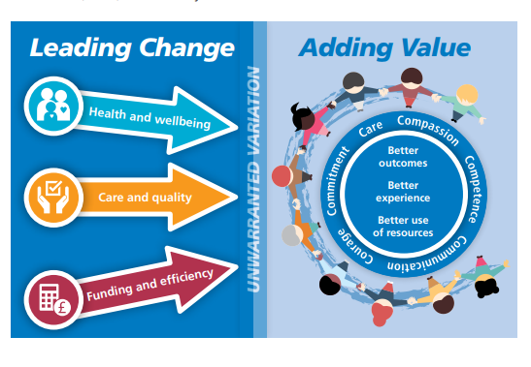
Improved outcomes
Productivity of nurses should be evaluated in terms of value added care that’s a vision which goes beyond the direct activities of care. These activities include collaboration among team members, communication, patient centeredness and all these things are crucial for well being of a patient.
It has been seen that patients have shown great improvement when nurses utilized strategies of adding value. Improved outcomes have been seen in following:
Promoting culture where health of
population would be core component.
Patients have been given self confidence
which helps them improving their health.
Health and well-being.
Care and quality
Funding and efficiency.
Notes:
In healthcare, only those changes are accepted that would have better outcomes and changes that would have no considerable differences are not appreciated. So this change of adding value has been appreciated and implemented worldwide because of its improved outcomes that are working exceptionally well in healthcare units.

Slide 13
Implementation of value-added care processes
Implementation of the value-added care processes have been observed in many areas and treatments. Now a day, mostly healthcare processes involve value-added for having beneficial outcomes. For example, in case of recovery of older persons who passes through treatment of rehabilitation. Nurses try to pay more attention to these patients by giving them a moral support and wanted to give them a morale support so that they would fight back with the situation and could cross all the hurdles courageously.
Nursing staff has been seen showing concerns about ways how older people quickly lost their independence. By implementing value added processes, nurses are trying to have healthy outcomes of treating that have been provided to the clients.
In diabetes, implementation of value added processes have been seen playing a constructive role and bringing beneficial outcomes.
Notes:
Value added care processes are seen being implemented in many areas such as recovery of older persons taking into account rehabilitation and moral support of patients. Nurses try to show concern about lost independence of old patients and playing of constructive role for patients suffering from diabetes.

Slide 14
Approval from coordinator
The care staff, specifically nurses who wanted to implement this change of value-added care process needs approval so that they could practically practice this change.
Nurses have a leader nurse, known as coordinator nurse. If the coordinator is not happy with the change that a nurse wants to make in the framework then care staff (nurse) cannot implement that change.
Notes:
Nurses when want to have a change that they think would be beneficial for the healthcare unit and patient, for looking into such matters where the nurses need approval higher authorities of the health unit used to hire the head nurses or the coordinator.

Slide 15
Identification, change and effect
Value added care processes are identified when the care staff gets new opportunities for demonstrating healthy and beneficial outcomes. It could be easily recognized by looking at the response of the patient and his family even after being discharged from the healthcare unit.
Many changes have been observed when value is added in the care processes. Most visible changes are higher level of patient satisfaction, reduced risks, reduced healthcare expenditure and better health outcomes.
Positive and healthy effects have been seen in the outcomes of the patients for whom nurses used value added care processes by letting go the conventional ways of treating patients.
Notes:
It is quite easy to identify working and implementation of value-added care processes as they would have unusual and advanced influence on patients. Changes that come in the life of patients are works as evidences that would cast healthy effects on the overall condition of the patient.

Slide 16
References:
Porter, M. E. (2008). Value-based health care delivery. Annals of surgery, 248(4), 503-509.
Winegar, A. L., Moxham, J., Erlinger, T. P., & Bozic, K. J. (2018). Value-based Healthcare: Measuring What Matters—Engaging Surgeons to Make Measures Meaningful and Improve Clinical Practice. Clinical Orthopaedics and Related Research®, 476(9), 1704-1706.
French, K. E., Guzman, A. B., Rubio, A. C., Frenzel, J. C., & Feeley, T. W. (2016, September). Value based care and bundled payments: anesthesia care costs for outpatient oncology surgery using time-driven activity-based costing. In Healthcare (Vol. 4, No. 3, pp. 173-180). Elsevier.
Bradley, S. M., Rumsfeld, J. S., & Ho, P. M. (2016). Incorporating health status in routine care to improve health care value: the VA patient reported health status assessment (PROST) System. Jama, 316(5), 487-488.

