Slide 1
Regulation for Nursing Practice
Student name

Slide 2
Boards of nursing
These deal with matters that affect public health, protection and wellbeing.
Boards of nursing also standardize nursing practices.
These are jurisdictive governmental agencies.
(BONs)are present in all 50 states.
These are Member Boards of NCSBN.
Their responsibility is to ensure the safety of patients.

Slide 3
Goal of boards of nursing
Prop up regulatory usefulness.
Guarantee efficient and well-timed retorts to nursing issues
Assist board and staff growth.
Connecticut board of nursing Fees Initial licensing fee, RN: $180 License renewal (annual), RN: $100
(“National Council of State Boards of Nursing,” n.d.)

Slide 4
Professional nursing organization
A professional nursing organization sets the standards of practice.
It reviews and updates the code of ethics.
It advocates and supports nurses.
It advances the interests of its membership and the public.
Inform members and get feedback on issues.
It provides continuing education and certification opportunities to its members.

Slide 5
American Nurses Association (ANA)
It is a national professional organization.
The organization is for all registered nurses in the US.
It is situated in Washington.
Nurses can join it either individually or through their state nurses associations.

Slide 6
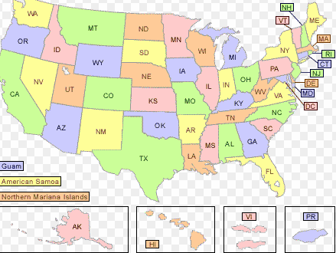
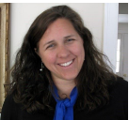
Details of members of board of Connecticut
The Connecticut Board of Nursing is responsible for licensures and nursing practice information.
Executive Director Kim Sandor, Executive Director
STEPHANIE R. PAULMENO, MS, RN, NHA, CDP, CCM, CDP= PRESIDENT (a certified dementia practitioner and has two degrees in gerontology)
CYNTHIA HOLLE, DNP, MBA, RN VICE PRESIDENT ( a post-doctoral Advanced Health Services Research Fellow)
(“Nursing Licensure,” n.d.)

Slide 7
Membership of board
The board consists of these members;
Registered Nurses
Advanced registered nurse practitioner
Nurse executive
Nurse educator member
Licensed Practical Nurses
Consumer members
These can join the board if they are residents of state and at least 60 years old.

Slide 8
Occupational Safety and Health Administration
It is a part of the United States Department of Labor.
Guide employers and employees about how to prevent occupational injuries and illnesses.
It develops and enforces mandatory job safety and health standards.
Uses different programs such as Voluntary Protection Programs and OSHA Strategic Partnerships for promoting safe and healthful work environments.
Works in partnership with states for occupational safety and health programs.
OSHA was created in 1970 and changes everyday to address the changing needs of safety.
Recently the change is in the form of OSHA 300A Electronic Record keeping that requires the electronic submission of forms.
(“American nurses association,” n.d.)

Slide 9
State regulations
The Nurse Practice Act
The Nursing Practice Act (NPA) direct the Board to commence the extent of practice and tasks for RNs.
Nurses have to comply with law to maintain their licenses.
This act is about:
Qualifications for licensure
Nursing titles
Scope of practice
Actions in case of non compliance
(Bhanbhro et al., 2011)

Slide 10
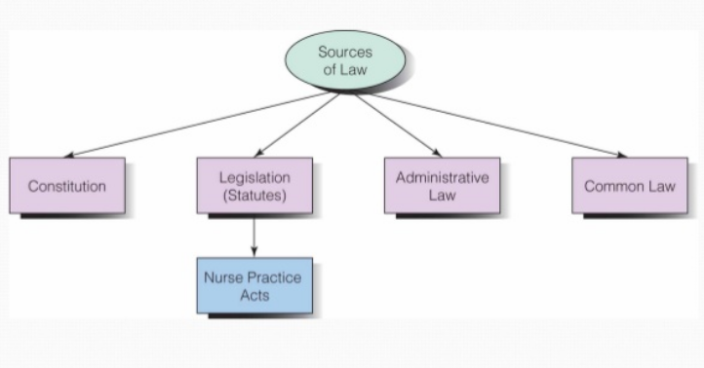
The Nurse Practice Act
Independent prescribing
Advanced practice registered nurses (APRNs) prescribe, without restraint.
They do not require collaboration with a physician.

Slide 11
References
American nurses association. (n.d.). Retrieved from https://www.nursingworld.org/
Bhanbhro, S., Drennan, V. M., Grant, R., & Harris, R. (2011). Assessing the contribution of prescribing in primary care by nurses and professionals allied to medicine: a systematic review of literature. BMC health services research, 11(1), 330.
National Council of State Boards of Nursing. (n.d.). Retrieved from https://www.ncsbn.org/index.html
Nursing Licensure. (n.d.). Retrieved from https://www.nursinglicensure.org/state/nursing-license-connecticut.html

