Slide 1
Media Analysis
1999-2009

Slide 2
Introduction
The project focuses on the three types of media prominent in the decade 1999-2009
Film – Fight Club
Drama/Thriller
David Fincher
Television – The Simpsons
Animated sitcom
Matt Groening
Computer – Twitter
Social networking site
Jack Dorsey, Noah Glass, Biz Stone, and Evan Williams

Slide 3
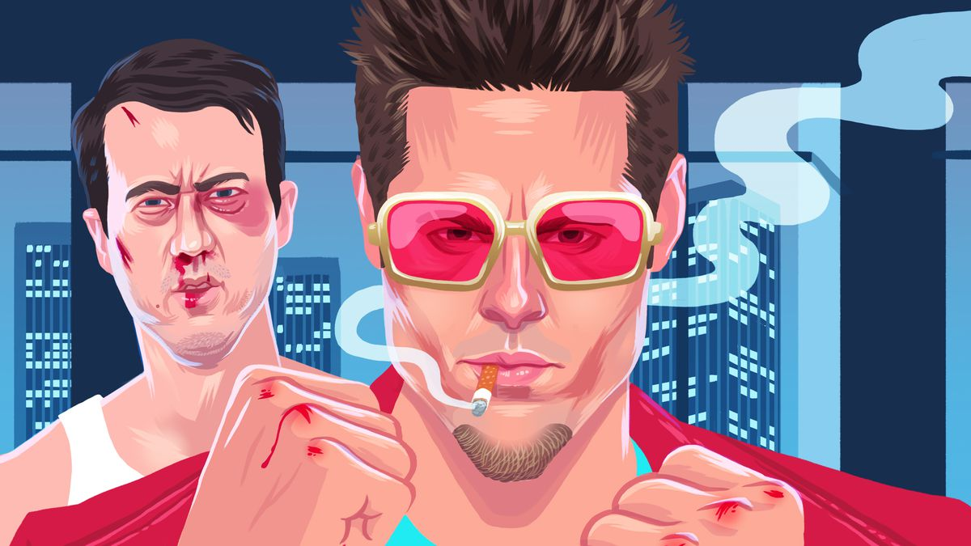
Film – Fight Club
Most controversial film of the decade
Synopsis
A grumpy man with insomnia befriends an odd soap seller called Tyler Durden and eventually finds himself residing in his dilapidated mansion since his flawless condo has been annihilated. A pair of bored individuals create an illegal club under strict regulations and battle against other people who are frustrated with their superficial existence.

Slide 4
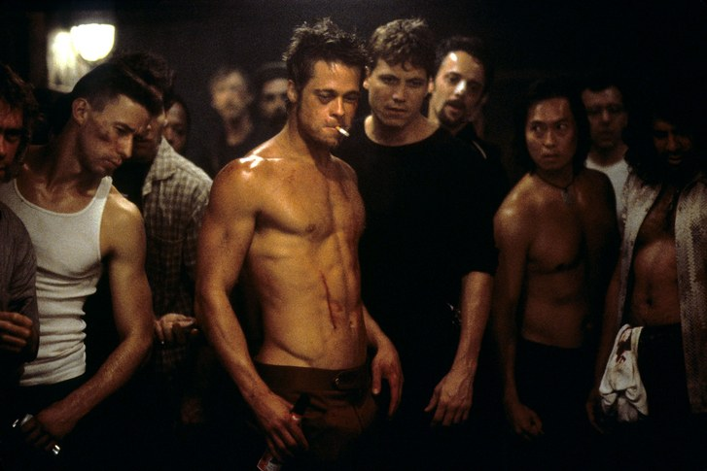
Fight Club
Impact on Society
Negative Impact
Multiple fighting clubs were revealed to have launched throughout the America
2000 - a "Gentleman's Fight Club" was launched in Menlo Park, California, with participants from the heavy-tech industry.
2002 - Luke Helder, a university student placed homemade bombs in letter boxes
2006 - reluctant junior high student was wounded in a battling club in Texas, and six teenagers were arrested on DVD sales of the battle.

Slide 5
Fight Club
2009 – a teenage owner of a fight club was arrested after detonating a homemade bomb outside the café located in New York City under the influence of “Mayhem project”
Teenagers in Texas, New Jersey, Washington, and Alaska also launched fighting clubs and published online video clips of their duels.

Slide 6
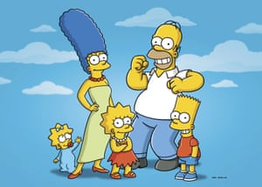
Television – The Simpsons
Created in the year 1989
Currently ongoing with a 27th season
After the first 10 seasons, the series reached its climax
Synopsis
The Simpsons are a family that is politically wrong. Homer appears to work with dignity in operating a nuclear power plant with greater profit-making consideration than security. His spouse is a perfect mom, Marge. They have got three children: Bart, a loser, a responsible Lisa and Maggie.

Slide 7
The Simpsons
Impact on Society
Virtually defined comedy and satire
convinced Americans that animation
could be for adults too.
Increased individual’s liking for Beavis & Butt-head, South Park, Family Guy and innumerable comedy shows
General public correlated to the characters in the show since they were the complete embodiment of normal citizens.
Many academic institutions such as the fraser valley university started having a class to analyze voicing methods used in “The Simpsons” and explore “The Simpsons” social aspects.

Slide 8
The Simpsons
“The Simpsons” catchphrases helped
intellectuals studying linguistics, in particular scholars
studying colloquialism.
Individuals got aware of political strategies with the help of political satires depicted in the show.
Due to the positive portrayal of homosexuality, “The Simpsons” compelled a gay men to come out of closet.
The chapter "Bart Sells His Soul" in 1995 was often used as a learning tool in hymns and Catholic schooling.

Slide 9
Computer –Twitter
Social networking site that rapidly gained popularity since it’s creation.
Allowed users to communicate with each other using messages known as ‘tweets’.
Initially used MySQL database
2007- 400,000 tweets posted per quarter
2008 -100 million tweets posted per quarter
2010- 50 million tweets per day

Slide 10
Twitter
In early adapting technology obsessed individuals, twitter provoked mixed feelings.
Some people recognized it as a good medium to stay in touch with friends.
However, most people started to feel too occupied with the check-in messages and believed that it hindered their productivity during the day.
It was recognized as a powerful learning tool in the field of research and education.

Slide 11
Twitter
According to study, it was indicated that people were in favor of using twitter because they believed it enhanced their relationship with faculty and stimulated collaborative learning.
Ninety two percent of population deemed it worthy due to it’s user friendly nature.
Public figures and world leaders immediately started using twitter and eventually it emerged as a leading platform for them to convey their thoughts.

Slide 12
Conclusion
Film
Negative impact via provoking teen and young generation to actively involve in the violent acts.
Television
Positive impact by making people rethink over their entertainment choices.
Emerged as an epitome of individual, national and political realities.
Computer
Positive impact via initiating active communication among individuals
Emerged as a tool of learning in education and research.

Slide 13
References
Dorsey, J. (2009). Twitter.
Fincher, D. (1999). Fight Club [Drama/Thriller, DVD]. 20 Century Fox.
Groening, M. (1989, Current). The Simpsons [DVD]. Fox Broadcasting Company.

