Slide 1
Unit 4: The Executive Branch Project

Slide 2
The President (Executive branch)
Considered as one of the most powerful elective offices in the contemporary world
Responsible for enforcing and administering the laws of the country
Described in the article II of the constitution
Qualifications
Born citizen of the U.S., must be 35 years old, should be a resident of America 14 years before the presidential election, political and societal acceptability, should have experience of government affairs and public policies
7 hats/roles/duties associated to the President
1.Chief of state 2.Chief diplomat 3. Party chief 4. Chief executive 5.Chief legislator 6.Commander-in-chief 7.Chief citizen

Slide 3
Chief of State
This title alludes to the President’s duties as the head of government
Refers to all ceremonial responsibilities e.g., nationalist speeches on 4th July, meeting visitors in the White House, awarding laurels to military and war heroes and honoring astronauts who are back from space missions
These roles are not fully related to the dynamics of the government but signify the honor associated with the President
Chief executive
Refers to the President’s capacity as an executive for millions of people in various government departments and agencies
As a chief executive, the President has to oversee the enforcement and administration of the state legislations as passed by the Congress (Thrower)
This is a power implied by the Constitution and as an executive, President also has some tools of influence which he can use e.g., amnesty, reprieve and pardon from federal crimes (judicial powers)

Slide 4
Chief diplomat
Representation of U.S. to other countries
Meetings with diplomats
Resolution of foreign conflicts
Determination of the level of U.S involvement in foreign events (Carter)
Negotiations and signatures on treaties and formal agreements between the governments of two or more countries. (the approval of senate is key for this)
Chief legislator
Recommendation, approval, and disapproval of legislations
Proposal for legislations the President wants to see implemented
After the description of the legislative program by the President in the Union Address, the President’s staff writes legislation and sends it to Congress for further progress
The President as a chief legislator can also urge the passage of top priority bills

Slide 5
Commander-in-chief
The Constitution (Article II, section 2) specifies that “The President shall be Commander in Chief of the Army and Navy of the United States, and of the Militia of the several states when called into the actual Service of the United States (Yoo, and Delahunty).”
The President heads the military of the United States and has the power to declare war against any country
Responsibilities: making all the military strategies, defense of the territories, boundaries, and possessions of the United States
Party chief
The President of the United States is largely in charge of laying down the legislative manifesto of his political party.
“Titular head” of his political party (Mooijman et al.)
Expectations from the President as party chief: support of the party’s platform, raising funds for party campaigns, taking stands on issues of controversial nature, e.g., abortion, welfare spending, etc.

Slide 6
Chief citizen
The U.S. President is expected to be a guiding light for the nation and a moral leader, smoothing the grounds for religious piety, integrity, and exemplary honesty.
The President must be an epitome of the American ideals which are laid down in the Declaration of Independence and is supposed to be the true representation of the American nation.
Even though this hat has no constitutional basis, the idea is taught in civics, and the President is expected to put the nation’s interest above his own.

Slide 7
The Presidential Establishment
Comprised of multiple advisors and federal agencies immediately serving the executive office, the Presidential establishment helps make public policies:
The cabinet is not mandated and consists of heads of all federal agencies and bureaucratic departments
EoP includes the Security Council, Economic Advisory Council and the Vice President Office
Staff in the White House comprises of personal assistants, security and senior aides
The First Lady acts as an informal advisor to the President and organizes and attends many events of multi-faceted nature during the President’s term
Cabinet
Executive Office of the President
Staff of the White House
First Lady

Slide 8
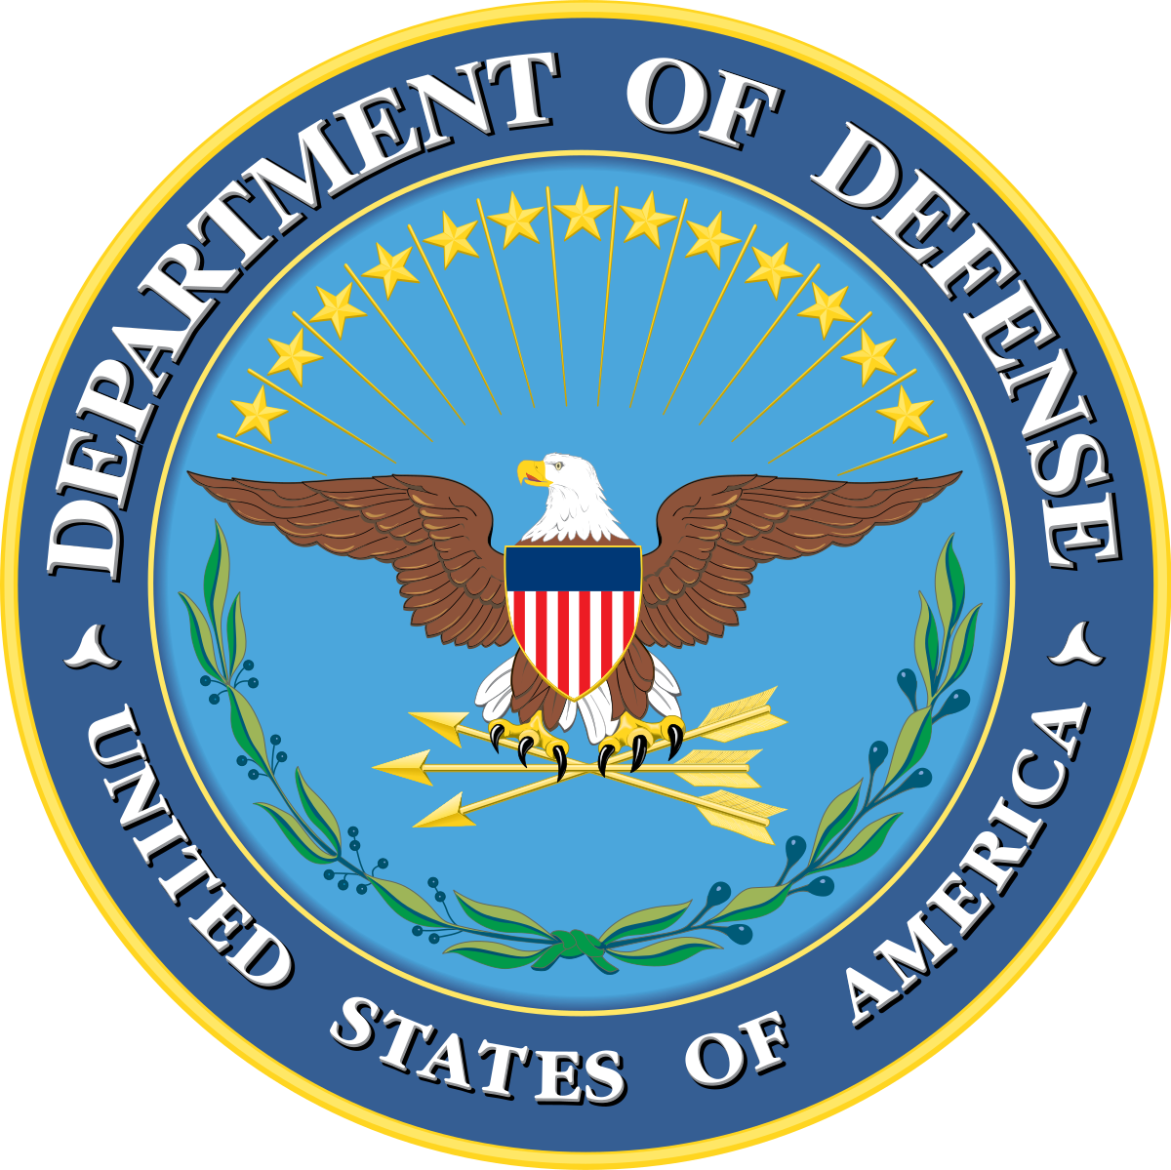
U.S Department of Defense

Slide 9
U.S Department of Defense
The federal Defense Department is America's earliest and the largest agency, and evolves with changing times and ideals of the American nation
It oversees the following:
Army (Nickelsburg, and Norpoth)
Marine Corps
Air Force
Navy
Coast Guard
President of the United States, under the hat of a commander-in-chief shape military strategies and policies with the defense department, and his command over the U.S armed forces are established in the Constitution of the United States of America.
Pentagon, headquarters of the department, is among the largest office buildings in the world, and statistically, it is also the largest employer of America with over 1.3 million personnel on active duty, as of 2016.
Mission of this federal department is to secure American land and provide troops in the wake of a war declaration, along with launching and testing missile systems and nuclear arms, maintaining America’s position as the world’s biggest economy with military technology

Slide 10
Works Cited
"National Security Council". The White House, 2019, https://web.archive.org/web/20161103111019/https://www.whitehouse.gov/administration/eop/nsc. Accessed 29 Oct 2019.
Carter, Ralph G. Making US Foreign Policy: The Essentials. Lynne Rienner Publishers, Incorporated, 2019.
Mooijman, Marlon, et al. "Leader power, power stability, and interpersonal trust." Organizational Behavior and Human Decision Processes 152 (2019): 1-10.
Thrower, Sharece. "The Study of Executive Policy Making in the US States." The Journal of Politics 81.1 (2019): 364-370.
Yoo, John C., and Robert J. Delahunty. "The President's Constitutional Authority To Conduct Military Operations Against Terrorist Organizations And The Nations That Harbor Or Support Them". SSRN Electronic Journal, 2002. Elsevier BV, doi:10.2139/ssrn.331202.
Nickelsburg, Michael, and Helmut Norpoth. "Commander-In-Chief Or Chief Economist?". Electoral Studies, vol 19, no. 2-3, 2000, pp. 313-332. Elsevier BV, doi:10.1016/s0261-3794(99)00054-2.

