Slide 1
United States Economy
Name of the Student
Name of the University

Slide 2
United States Economy Overview
United States economy is the highly developed and mixed economy
In terms of the nominal GDP, it is the largest economy in the world
United States dollars are being used as a major currency around the world in terms of the trading
Throughout during the course of the last 50 years, United States economy has become more and more open.

Slide 3
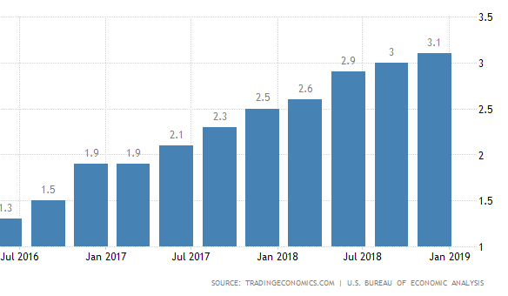
Gross Domestic Product Trend
Trade has always been a major force behind the Gross Domestic Period of the United States.
Services sector almost contributes towards 80 % of the Gross Domestic Product
GDP growth has been sluggish by 3.5 % that has increased in the last few years.

Slide 4
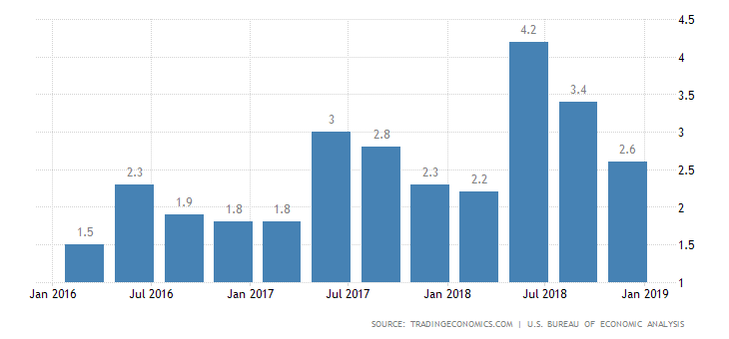
United States GDP Growth Rate

Slide 5
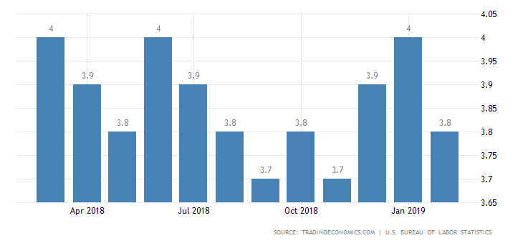
Unemployment and Inflation Statistics
Inflation in the United States has been increase by 2.5 %
At the moment, the labor force constitutes of 162 million people and the labor force occupancy is highest in farming, foresting and fishery
Unemployment rate is estimated to be around 4 %

Slide 6
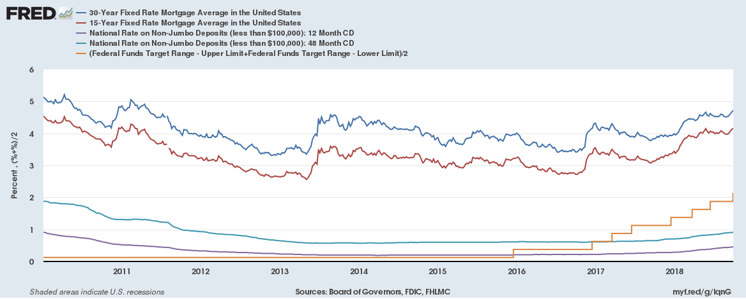
Interest Rate Trend in United States
United States has been constantly increasing its interest rate during the course of the last few years
From 0.25 % in the last Five years, it has gone to 2.5 %
Recession and effort on the part of the FED to control inflation is oen of the most important rationales behind it.

Slide 7
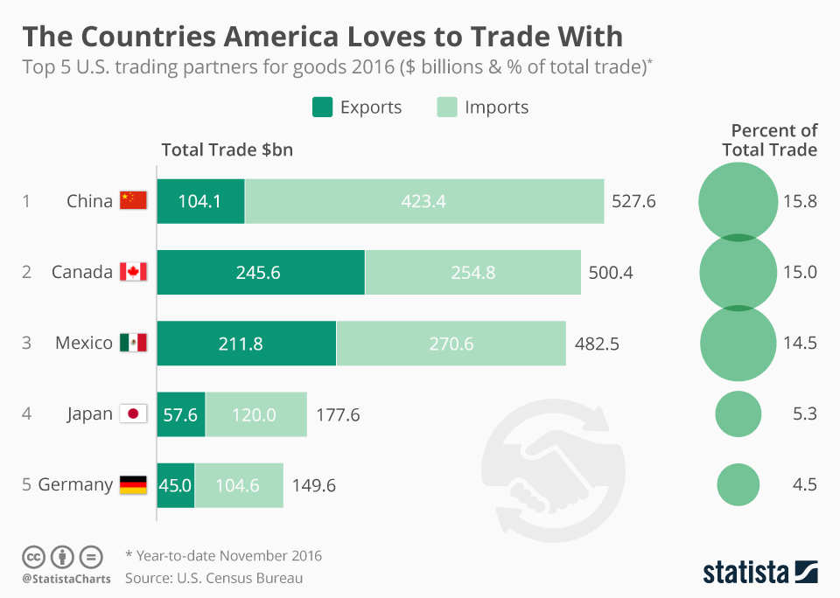
Trading Trend of the United States
Exports of the United States stand at about % 1.60 trillion whereas the imports stand at 2.35 trillion
European Union, China, Canada and Mexico are some of the broader trading partners of the United States
Manufacturing, fuel and agricultural products are key trading goods for the United States

Slide 8
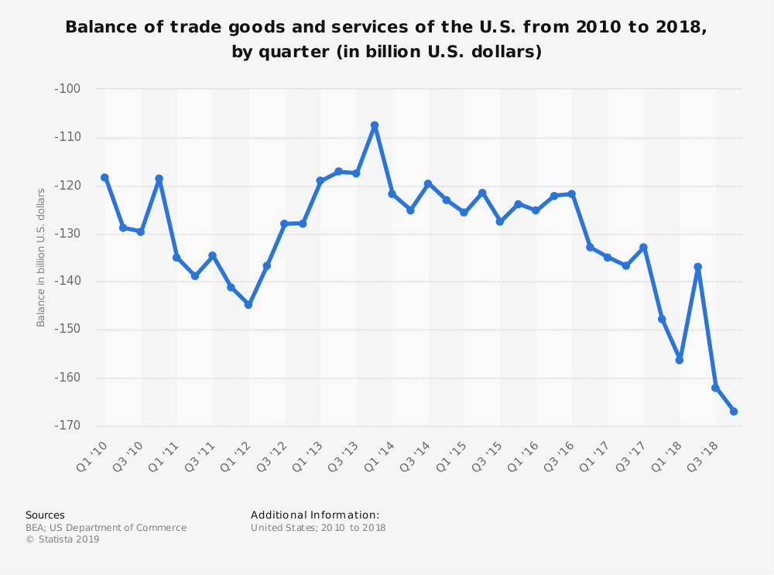
Trade and Balance of Payment

Slide 9
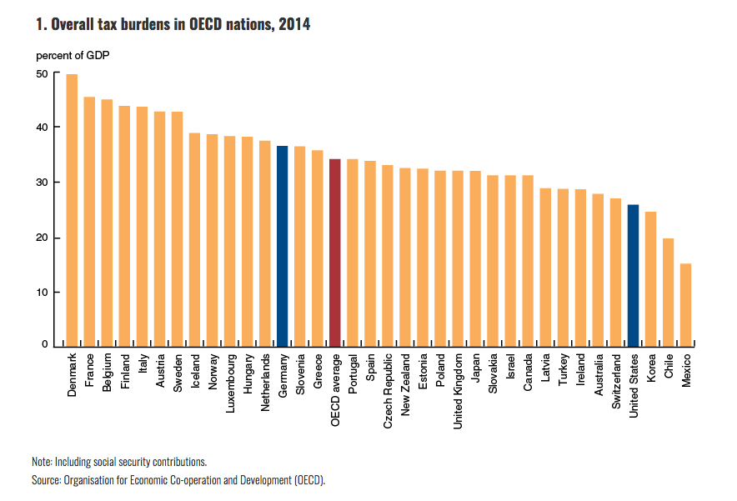
Fiscal Policy of the United States
Taxation in the United States comprise of a complicated system where about four governments are going to be levying tax on an individual
Income tax, property tax and sales tax are some of the more common tax denominations
Estates and Gifts are some of the other example of Tax
Total tax percentage is estimated to be about 25 % of the total GDP

Slide 10
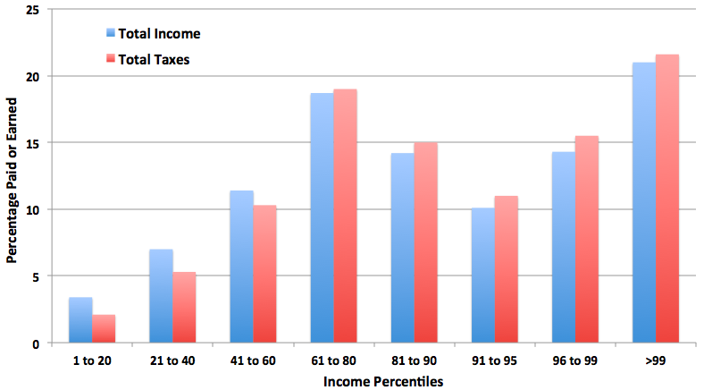
Fiscal Policy Impact
The taxation system in the United States is quite progressive in its nature.
Efforts are being made to make sure that the whether the tax system should be more progressive or not.
The share of the black market economy in the United States is about 0.25 % of the total GDP is which is quite minimal

Slide 11
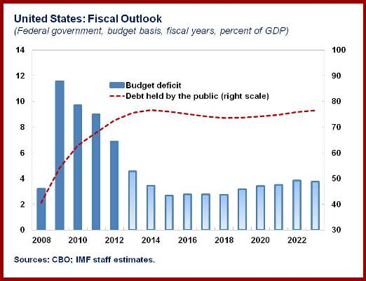
Monetary Policy of the United States
The monetary policy is controlled and governed by the FED
Almost 75 % of the currency reserves are being held in the form of the United States dollar
Banking industry is regulated at both the state and the Federal level

Slide 12
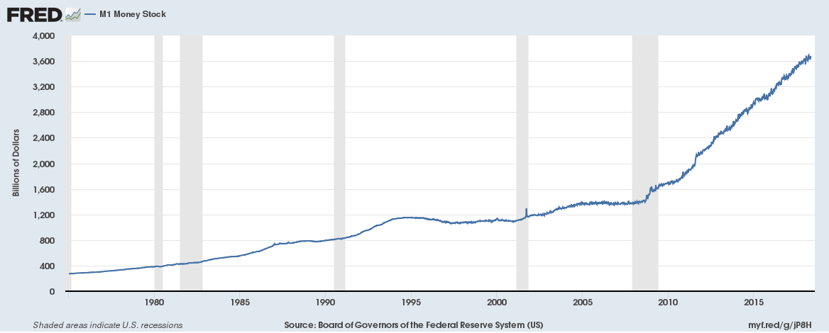
Monetary Policy Impact
One of the reasons that the monetary policy has been successful is due to the fact that how there is diversity in terms of the financial instruments in the United States
As United States dollar is the premier currency in the world, they have been able to control their money supply and demand quite effectively
The presence of the SECP and other regulatory bodies makes sure that the money market is kept in check

Slide 13
Conclusion
United States is one of the largest economies in the world
One of the reasons that they have been able to operate at such a level is due to the fact that they have kept the necessary controls in place
The strength of the United States currency, the regulatory environment and the strong tax system is also one of the key feature of the United States economy

Slide 14
References
Greene, D. L., & DeCicco, J. (2000). Engineering-economic analyses of automotive fuel economy potential in the United States. Annual Review of Energy and the Environment, 25(1), 477-535.
Chaloupka, F. J., Tauras, J. A., & Grossman, M. (2000). The economics of addiction. Tobacco control in developing countries, 107-129.
Tobin, P. C., Bai, B. B., Eggen, D. A., & Leonard, D. S. (2012). The ecology, geopolitics, and economics of managing Lymantria dispar in the United States. International Journal of Pest Management, 58(3), 195-210.
Carnoy, M., Loyalka, P., Dobryakova, M., Dossani, R., Kuhns, K., & Wang, R. (2013). University expansion in a changing global economy: Triumph of the BRICs?. Stanford University Press.

