Slide 1
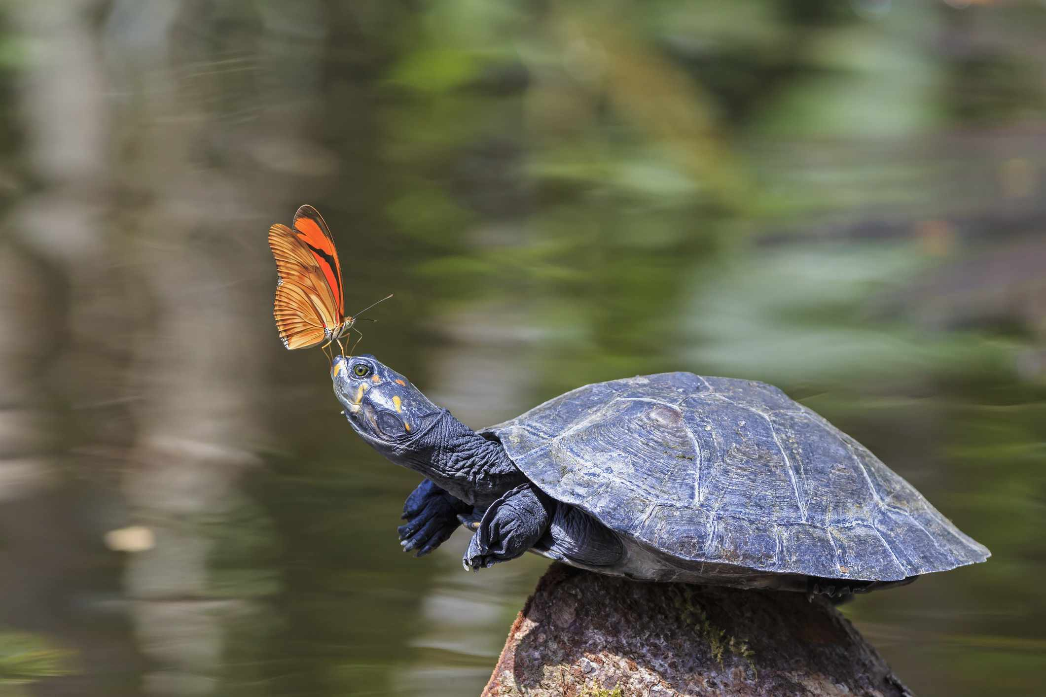
Order Testudine Name Institution

Slide 2
Basic characteristics and defining features
Taxonomy
Kingdom: Animalia
Phylum: Chordata
Class: Reptilia
Order: Testudines (Meylan & Gaffney, 1989)
2. Common Names: Tortunes, Tortoise, Turtle, Terrapins (Gibbons, 1990; Bickham, 1983)

Slide 3
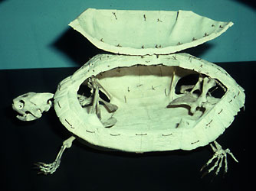
Basic characteristics and defining features
3. Anatomy
Bony Shell (Carapace) made up of fused ribs and costal bones
Cheeks having posteriorly concave and laterally exposed Quadrate
Absent Postparietals
No teeth
Solid Rod-like Stapes (Gaffney, 1996)

Slide 4
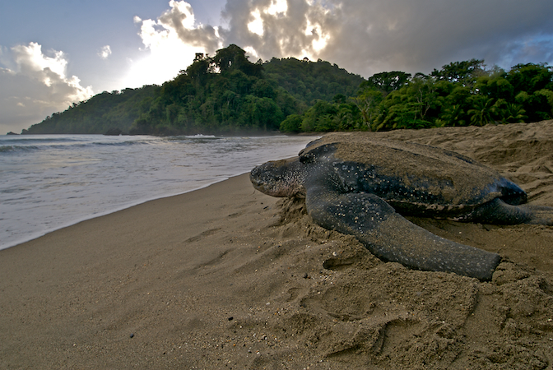
Basic characteristics and defining features
Physiology
Shell present for protection
Ectothermic with low metabolic rates hence entirely reliant on external heat sources—sun basking is common (Gaffney, 1975).
Aestivate in summer and hibernate in winter
Lungs are used for breathing present inside ribcage
Shell acting as “calcium bank” during hibernation, aids in the development of egg shell (Gaffney, 1975).

Slide 5
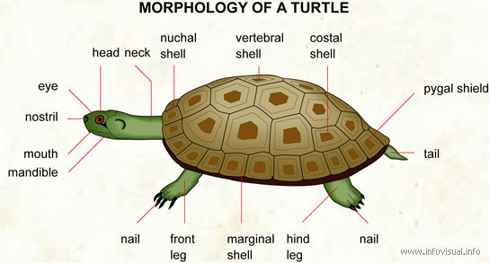

Slide 6
Basic characteristics and defining features
5. Evolutionary history
Eunotosaurus—the Permian reptile is considered close to their ancestor. Recent research suggests that they are far from this genus because of ectopterygoid bone and shell (Ernst & Barbour, 1987).
Fossils studies estimated their existence before 210 million years named Proganochelys (Chen et al., 1980).
Cotylosaur—another genus is thought to be close to testudines now (Cao et. al., 2000).

Slide 7
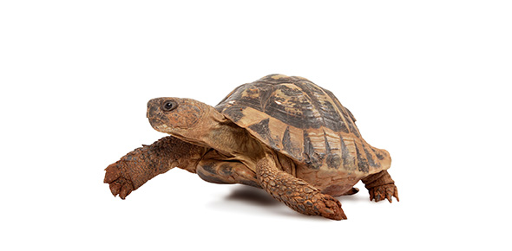
Basic characteristics and defining features
Life History
Turtles lay eggs on their original birth place
Eggs get hatched within 70 to 120 days
They race towards sea after being hatched feed on planktons
After reaching 60cm in length, they settle on shallow water
After 50-70 years they get matured enough to breed again
Again move to original birth place for breeding (Harless, & Morelock, 1979)

Slide 8
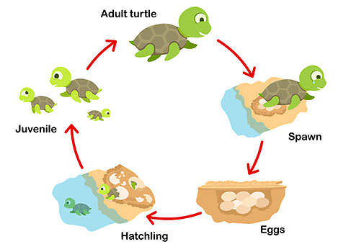

Slide 9
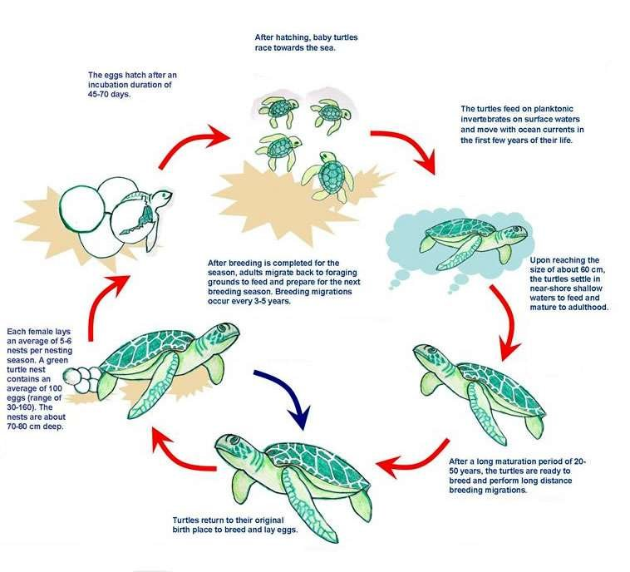

Slide 10
Interactions with physical environment
Habitat
They are found throughout the world in terrestrial
and marine environment
Mostly live on subtropical and tropical region
Cross even oceans for feeding purpose
Breathe in air through lungs (Pritchard, 1979)

Slide 11
Interaction with other Organisms
After being hatched, they feed on phytoplankton
Exhibit symbiotic relationship with Yellow tang fishes—they clean their shell by eating algae and parasites on it (Thomson, et. al., 2015)
Their eggs are preyed by dogs, fishes and sea birds as a prey-predator relationship (Shaffer, 1997)
Shrimp, algae, barnacles, crabs, oysters, bryozoans, polychaetes, bristle worms, other organisms stick on their shells—acting as parasites (Meylan, 1989)

Slide 12
Interaction with Humans
Humans use turtles for many reasons:
Food
Illegal trading of their eggs
To show their brilliant shells off as jewelry
Their blood, urine, bile, skin and shell is used as medicines in Chinese tradition (Shaffer et. al., 1997)
Maintenance of ecosystem

Slide 13
References
Meylan, P. A & Gaffney, E.S. (1989). The skeletal morphology of the Cretaceous Crytodiran turtle, Adocus, and the relationships of the trionychoidea. Amer. Mus. 2941, 1-60.
Gibbons, J. H. (1990). Life history and ecology of the slider turtle. Smithsonian Institution Press, Washington D.C.
Gaffney, E. S. (1996). The postcranial morphology of Meiolania platyceps and a review of the Meiolaniidae. Bull. Am. Mus. Nat. Hist. 229,1-166.
Gaffney, E. S. (1975). A phylogeny and classification of the higher categories of turtles. Bull. Amer. Mus. Nat. Hist. 155, 387-436.
Ernst, C. H. & Barbour R.W. (1989). Turtles of the world. Smithsonian Institution Press, Washington D.C.

Slide 14
References
Chen et al. (1980). Evolutionary relationships of turtles suggested by immunological cross-reactivity of albumins. Comp. Biochem. Physiol. 66, 421-425.
Cao, Y., Sorenson, M. D., Kumazawa,Y., Mindell, D. P., & Hasegawa, M. (2000). Phylogenetic position of turtles among amniotes: evidence from mitochondrial and nuclear genes. Gene, 259, 139-148.
Harless, M. & Morelock, K. (1979). Turtles: Perspective and Research. Wiley, New York.
Pritchard, P. C. H. (1979). Taxonomy, evolution, and zoogeography. In: M. Hareless and H. Morelock (eds) Turtles, perspectives and research. Wiley, New York,1-42.

Slide 15
References
Thomson, J. A., Gulick, A. & Heithaus, M. R.. (2015). Intraspecific behavioral dynamics in a green turtle Chelonia mydas foraging aggregation. Marine Ecology Progress Series 532, 243-256. doi: 10.3354/meps11346.
Shaffer, H. B., Meylan, P. & McKnight, M. L. (1997). Tests of turtle phylogeny: Molecular, morphological, and paleontological approaches. Systematic Biology, 46, 235-268.
Meylan, P. A & Gaffney, E.S. (1989). The skeletal morphology of the Cretaceous Crytodiran turtle, Adocus, and the relationships of the trionychoidea. Amer. Mus. 2941, 1-60.
Bickham, J. W. & Carr, J. L. (1983). Taxonomy and phylogeny of the higher categories of cryptodiran turtles based on a cladistic analysis of chromosomal data. Copeia 4, 918-932.

