Slide 1
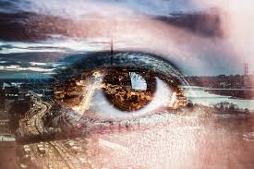
Why Do We Dream When We Sleep?

Slide 2
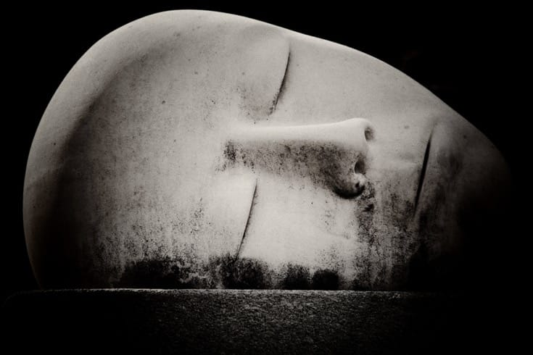
Dreams
Dreams have ben a subject to arguments and discussions by many philosophers and psychologists.
Much of efforts have been made in Neuroscience to understand the reason of dreaming.
Psychology and philosophy is treated as a tool to indicate the importance and cause of dreaming , taking into account that dreams can be associated with mental health and dream interpretation.
Notes:
Dreams are images and imagery, thoughts, sounds and voices, and subjective sensations experienced when we sleep. This can include people you know, people you've never met, places you've been, and places you've never even heard of. Sometimes they're as mundane as recalling events that happened earlier in the day. They can also be your deepest and darkest fears and secrets, and most private fantasies. There's no limit to what the mind can experience during a dream and really no rhyme or reason to what you end up dreaming about. The diversity invites work from different aspects of theoretical and practical knowledge such as history, philosophy and medical sciences.

Slide 3
Why do we dream?
According to Plato food and digestion affect sleep and dreaming.
“The Republic” infers that an individual dreams because of psychological understandings and underpinnings of a dreamer. (Shaw, et, al. 2016)
People dream, for filling their wishes unconsciously and they are source of fascination for them.
Notes:
In particular, the Phaedo, Meno, and Republic stand out as discussions of knowledge that anticipate in many ways the more explicit treatment for addressing the context of dreams. Despite what some recent criticism suggests, due consideration of the matter will show that what is common to philosophers is not merely the question of knowledge in general, but the problem of separation or “chorismos”: the classic problem of how to arrive at a knowledge of unchanging truth on the basis of ever changing experience. Side by side, dreams are a tool to address fascination.

Slide 4
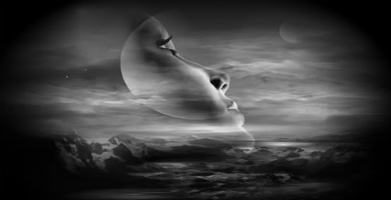
Aristotle on dreaming
According to Aristotle, if dreaming is common in both humans and animals, then it must be something necessary, when we perceive nothing externally, we are sleeping and perceive internally. (Shaw, et, al. 2016)
He believes that it is quite interesting that people may have experience of seeing things while their eyes are close through their psychological powers that moves like a rolling movie while they sleep.
Notes:
Aristotle explains that during sleep there is an absence of external sensory stimulation. While sleeping with our eyes closed, the eyes are unable to see, and so in this respect we perceive nothing while asleep. He compares hallucinations to dreams, saying "...the faculty by which, in waking hours, we are subject to illusion when affected by disease, is identical with that which produces illusory effects in sleep. When awake and perceiving, to see or hear something incorrectly only occurs when one actually sees or hears something, thinking it to be something else. But in sleep, if it is still true that one does not see, hear, or experience sense perception in the normal way, then the faculty of sense, he reasons, must be affected in some different way

Slide 5
Descartes on dreaming
According to Descartes dreams can be defined as an experience that is difficult to tease out from life.
Descartes believe that humans dream because they don't have a specific phenomenon of dreaming as they could see dream even while awake.
In contrast to Descartes, Plato believes that there is a strong connection between dreaming and psychological underpinnings of the dreams that means patterns, situations and circumstances of life. A situation would define what type of dream one would have. (Shaw, et, al. 2016)
Notes:
Descartes holds the common-sense view that dreams, which regularly occur in all people, are a sequence of experiences often similar to those we have in waking life (this has come to be labelled as the “received view” of dreaming). A dream makes it feel as though the dreamer is carrying out actions in waking life, for during a dream we do not realize that it is a dream we are experiencing. Descartes claims that the experience of a dream could in principle be indistinguishable from waking life – whatever apparent subjective differences there are between waking life and dreaming, they are insufficient differences to gain certainty that a person is not now dreaming.

Slide 6
Why do we dream while sleeping
Psychological Views
Sigmund Freud considered dreams as “manifestation of wishes”, inferring dreams as a function of unconsciousness”. (Porte, et, al. 2016).
There could be two types of dreams, one indicates towards unconscious wish and other indicates discharge of energy from any event of the day. (Porte, et, al. 2016).
Ideation and dreaming gives a feel to fulfillment of the wishes to the dreamers.
Notes:
Sigmund Freud was one of the first psychologists to really study dreams. His psychodynamic approach to dreaming led to his theory of unconscious wish fulfillment. The idea behind this theory is that dreams represent wishes that the dreamer subconsciously wants to be fulfilled. According to Freud, a person's dreams contain a latent and manifest meaning. The manifest meaning is the obvious meaning behind a dream and the latent meaning is the hidden meaning. Freud believed that in order to truly understand a dream, the manifest meaning has to be analyzed and picked apart. It is believed that a person's thoughts, feelings, and memories are represented by concrete objects and symbols in a person's dreams.

Slide 7
Dreams and their connection with life
Jung Carl proposed, “Jung dream analysis”, affirming events depicted by dreams are not just coincidence, they are real life unresolved conflicts.
According to Jung, dream base on daily life, so it could be said that dreams move forward as the life of a person pursues. (Porte, et, al. 2016).
Notes:
Dream is a state of your subconscious mind in which your desires, your wishes and your fear are experienced by your mind in which mostly you are a part of it. sometimes others are also a part of it but main center is you or your concept-not you. Dream is a feeling of a subconscious mind which is showing you or experienced you the things happening around you in which you are directly related with them by physically, mentally or emotionally (may be person may be situation, may be something else). Dream is mostly related with your observation and moments (actively or subconsciously)of day to day life.

Slide 8
Neuroscience and dreams
According to Llewellyn, “the stuff of dreaming is the stuff of memory, dreaming promotes the consolidation of memory”. (Young-Bruehl, et, al. 2005)
According to him, “dream state are justified, waking states are justified”, however a mad man lives more in sleep state.
Sleeping stage has more negative impacts on brain structure and mood of people than dreaming stage. Different dreaming stages are because of the different sleeping postures.
Notes:
The emerging view in neuroscience is that dreams are related to memory consolidation happening in the brain during sleep. This may include reorganizing and recoding memories in relation to emotional drives as well as transferring memories between brain regions. Dreaming can be thought of as a proto-conscious state which occurs mostly during Rapid Eye Movement (REM) sleep. Studies have shown that the nature of dreams varies according to the sleep stage in which they occur, with most dreams reported during REM sleep.

Slide 9
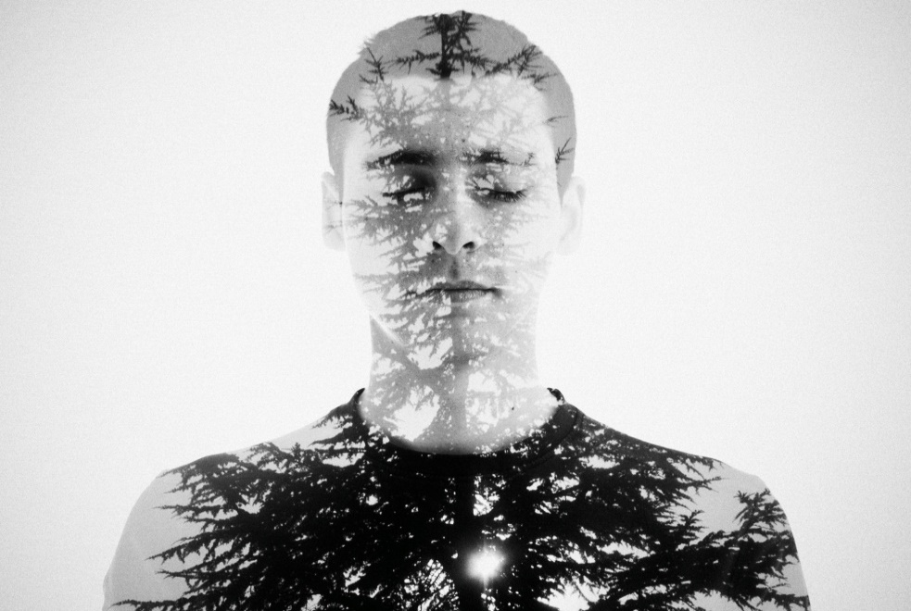
REM (Rapid Eye Movement) and Dream
Rapid eye movement promote consciousness of dream state
According to Varela, “REM sleep is a fundamental cognitive activity.” It is the place where people can engage in imaginary play, trying out different scenario, and learning new possibilities”. (Young-Bruehl, et, al. 2005)
It is affirmed that there comes an intense level in the sleep while dreaming where there runs high emotions as well. (Young-Bruehl, et, al. 2005)
Notes:
Dreams happen most often during REM (rapid eye moment) sleep, which is the deepest stage of sleep. This stage makes up about 20 to 25 percent of adult sleep and occurs in intervals that can last anywhere from a few minutes to 30 minutes. You cycle through REM sleep a number of times during the night, and if you happen to wake up in the morning during that stage of sleep, a dream may seem fresher in your mind.

Slide 10
Dreams and Academic aspects
Studies suggests that there is a strong connection between the episodes of memory and mood of the dreamer.
There is a strong participation of the neuronal activity when it comes to consciousness as brain would be effected by neural activity. Impanation has a direct link with dream.
When one constantly wants to have a thing or person in his life, one would see that things or person on his dreams as well.
Notes:
Studies have revealed that dreams enhance creativity, and hormones are at the heart of this. During REM sleep, cortisol, a stress hormone that regulates many things including blood glucose levels, fat breakdown and the immune system, is released. Although cortisol distorts memories and reduces memory recall, the brain instead tries to make sense of things and find patterns, and piece together these distorted memories and thoughts, paving the way for a unique form of innovative and creative thinking. It also affirms a heed to memory and life situations.

Slide 11
Conclusion
As a whole it could be concluded that there are different conceptions about connections of dreams with daily life. It can be said that people have various believes about sleeping and dreams. Some believe that we sleep and dream about things that remains in our unconscious as wishes and ideas.
Though today scientists are getting much help from neuroscience for understanding the conception of dreaming and what impacts it has on brain and life of people, still there is a long way that they have to cover for knowing the whole phenomenon.
Generally it is considered that dreams would be in accordance with routine life, if one had a depressing day, it is more likely he would be having negative dreams.
Notes:
Dreams are much more than just a chaotic scene of abstract and bizarre images. Dreams can be useful, and they can help us retain information, ideas and memories. Ultimately though, dreams are a gateway to a place where the most unbelievable things can happen!

Slide 12
References
Shaw, B. (2016). DEVELOPMENTS IN NEUROSCIENCE OF DREAMS
Porte, H.S. (2016). Homing in on consciousness: Why is a dream conscious?
Young-Bruehl, E., Levy, J., & Willock, B. (2005). Developmental Dreaming/ A discussion of young-bruehl’s “developmental dreaming “/ “developmental dreaming”? Canadian Journal of Psychoanalysis.

