Slide 1
Public Health Policy: second hand smoking
Presented By: …………….
Instructor: …………………..

Slide 2
Outline
introduction
objective of public policy
Harms of smoking for non-smokers
Policy recommendations
conclusion

Slide 3
Objective
highlight the effects of smoking on non-smokers
figure out a public policy to prevent the hazards of smoking
Notes:
This presentation will highlight the harms of cigarette smoke for non-smokers. We will also provide some suggestions for the public health policy that will be helpful to control the harms of smoking for non-smokers.

Slide 4
introduction
complete mental, physical and emotional wellbeing is called health.
the US spent 18% of its GDP on public health in 2018 (“American Health Care,” 2018).
Heart diseases, HIV, Teen pregnancy, alcohol and tobacco use are major problems in Public health.
Notes:
The absence of any disease cannot be defined as health. The World Health Organization defined health as the “Complete mental, physical, social and emotional wellbeing of an individual”. The government and private sector of the US annually spends more than 18% of its GDP on health related issues. The US government has spent 1.5 Trillion USD on public health in 2018. Besides this huge spending on healthcare, we are not the healthiest nation in the world. The major health related problems in the US are: Food safety, Healthcare-associated infections, Heart related diseases, teen pregnancy, alcohol and tobacco use.

Slide 5
Facts & Figures
13.7% of adult Americans are smokers.
34.2 million adults are smokers (CDC, 2019).
16 million Americans have smoking related diseases.
Notes:
Smoking has become an addiction in American society. The statistics of Centers for Disease Control and Prevention shows that almost 14% of adults in American population are smokers. The addiction rate of smoking is very high in females as 12% of adult females are smokers. Smoking is most common among the adults between the age of 25-44 years. It is estimated that more than 16 million people in the US are suffering form diseases caused by smoking.

Slide 6
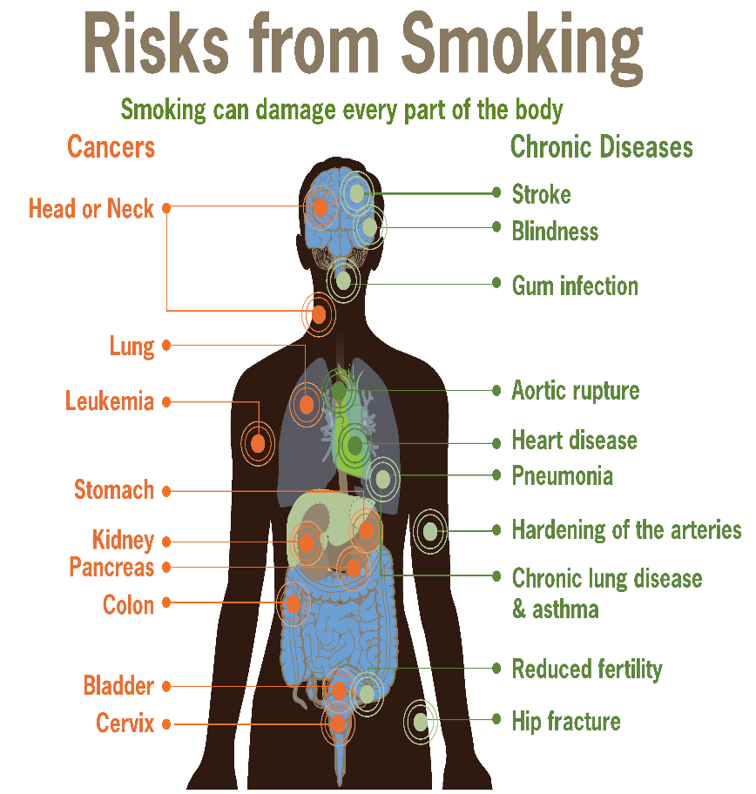
Facts and Figures
Tobacco smoke is a mixture of more than 7000 chemicals.
it causes nasal and middle ear irritation
tobacco smoke effects the reproductive ability
tobacco smoke can effect the growth of infants
Notes:
Tobacco smoke is very poisonous as it contains many toxic chemicals. It can create nasal irritation among the people who inhale smoke for a long period of time. Smoking can badly effect the reproductive ability of men and women. It can also cause a miscarriage in pregnant women. An infant’s physical and mental growth rate decreases in the womb of a smoker mother.

Slide 7
Harms of smoking for Non-smokers
tobacco smoke is dangerous for the people around a smoker as well.
people who indirectly inhale tobacco smoke are called secondhand smokers.
smoke from the burning cigarette or when breathed out by a smoker is harmful for others
2.5 million non-smokers died due to toxic smoke of cigarettes since 1964 (CDC Tobacco Free, 2017).
Notes:
Smoking is dangerous not only for the health of smokers but it affects the health of non-smokers as well. People around a smoker who indirectly inhale the smoke of cigarettes are called passive smokers or second hand smokers. Passive smokers feel it difficult to breath in a toxic environment. It has severe effects on blood and blood vessels. Smoke of the burning cigarette is toxic and can become a cause of lung cancer for the people around a smoker. People who continuously spend time around smokers are more likely to have heart disease.

Slide 8
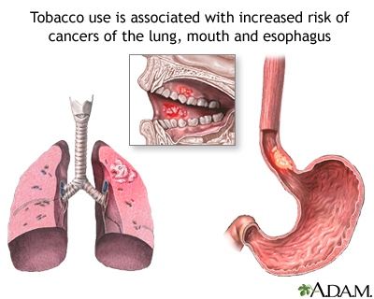
Harms of smoking for Non-smokers
infants are more likely be to affected by smoke.
34,000 secondhand smokers died every year in the us.
the risk of heart disease increased by 27% in non-smokers.
the risk of stroke increased by 22% in non-smokers.
Notes:
The data from Centers of Disease Control and Prevention shows that more than 34,000 non-smokers in America died every year due to the diseases related to smoking. Infants are more likely to be affected from the smoke of tobacco. Different studies show that the risk of heart related disease increased by 27% in those people who continuously stay around a smoker and inhale the poisonous air.

Slide 9
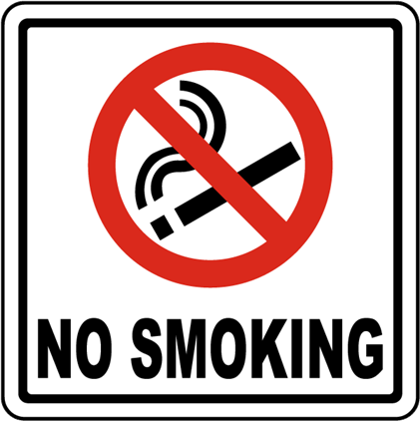
Policy recommendation
sell and purchase of tobacco products should be discouraged.
higher taxes should be imposed.
smoking in public and work places should be banned completely.
high penalties should be imposed on violators.
Citizens should also play their role.
https://stemcells.nih.gov/info/Regenerative_Medicine/2006Chapter1.htm
Notes:
The government should play its role to prevent the hazards of smoking for smokers as well as non-smokers. The government should impose high taxes on the sale and purchase of tobacco related items. Smoking should be completely banned on public places and high penalties should be imposed on the violators. Citizens should also take care the rights of non-smokers.

Slide 10
Conclusion
smoking is dangerous for the smoker and for people around a smoker.
non-smokers have to pay for the crimes of smokers.
strict policy should be imposed to protect the rights of passive smokers.
Notes:
Smoking is harmful for not only smokers but it also badly affects the health of people around a smoker. The poisonous smoke of tobacco become a source of many diseases for second hand smokers as well. The government should protect the rights of non-smokers as they are being affected by the sins of others. Smoking should be strictly banned in public places. Successful implementation of this policy would be very beneficial for the health of passive smokers.

Slide 11
References
American Health Care: Health Spending and the Federal Budget. (2018, May 16). Retrieved December 20, 2019, from Committee for a Responsible Federal Budget website: https://www.crfb.org/papers/american-health-care-health-spending-and-federal-budget
CDC. (2019, November 18). Current Cigarette Smoking Among Adults in the United States. Retrieved December 20, 2019, from Centers for Disease Control and Prevention website: https://www.cdc.gov/tobacco/data_statistics/fact_sheets/adult_data/cig_smoking/index.htm
CDCTobaccoFree. (2017, January 11). Health Effects of Secondhand Smoke. Retrieved December 20, 2019, from Centers for Disease Control and Prevention website: https://www.cdc.gov/tobacco/data_statistics/fact_sheets/secondhand_smoke/health_effects/index.htm

