Slide 1
Presentation Alternatives

Slide 2
Visme
Visme is a visualization and data presentation tool.
It is a web-based tool, but it can work offline as well.
Visme is effective as it provides a collaborative platform in order to develop new projects.
It helps in providing automation capabilities.
Notes:
Visme is a data presentation and visualization tool that helps the users in making their content compelling and presentable by transforming it into visually appealing presentations and infographics. The web-based tool, which can also run offline, is used extensively by users from the fields of education, marketing, business, and many other professional areas.
Visme provides a collaborative platform for the individuals and teams to start and develop new projects. It provides the team leads and managers with many useful organizational and management tools, enabling them to sort and classify files and information as well as setting access controls for individuals and groups. Likewise, the platform offers automation capabilities to streamline presentation of materials online as well as publishing of content.

Slide 3
Visme Features
Social Media Marketing
Data Visualization
Graphics and charts
Content database
Offline usability
Templates for projects and documents
Customer activity reports
Safety and privacy
Access management
Interface for collaborative work
Animations
User Interface

Slide 4
Prezi
Prezi is a web-based tool for creating presentations.
Prezi platform supports the use of video along with text and images.
For businesses, it provides ease to navigate the system.
Prezi uses a large canvas to emphasize visual content, text, and ideas, rather than using slides.
Notes:
For businesses that are new to Prezi, the program provides a collection of templates for users to choose from, so they can navigate the system with ease and get familiarized with the interface.
Rather than using slides, Prezi utilizes a large canvas on which users can zoom in and out to specific parts to emphasize text, visual content and ideas. As well as supporting text and images, the Prezi platform supports the use of video.

Slide 5
Prezi Features
Leaderboard tracking
Group editing
Zoom and pan on one slide
Centralized billing
Presentation library
Custom logo
Voice-over
Video upload storage
Real time data
Collaboration tools

Slide 6
PowerPoint vs Prezi (Pros)
PowerPoint features include pre-designed layouts that are helpful to assemble a presentation in no time.
On the other hand, Prezi is a used in-browser that does not need to be downloaded.
PowerPoint slides can be printed out, but one can not print slides from Prezi.
Presenter can jump to discussion point with Prezi's zoom function.
Notes:
Prezi is not the easiest piece of software to get your head around at first, which will alienate users who aren’t particularly tech literate. Its slides also aren’t optimized for printing in an easily digestible manner, unlike PowerPoint, and Prezi’s pre-designed templates aren’t easily customized.

Slide 7
Cont.
PowerPoint contains audiovisual capabilities to help people with differing tastes of taking information.
However, PowerPoint does not facilitate with infinite canvas and non-linear presentation style.
Unlike PowerPoint, Prezi aids in collaborating with other peers to edit slides online.
Notes:
The advantages offered by PowerPoint through its audiovisual capabilities can be useful to people who have different ways of taking in information. The variety of presentation techniques offered including the structured style of the slides enhance learning for people with certain personality types or learning styles (White, 2011).
The major features of Prezi are an infinite canvas and nonlinear presentation style. The infinite canvas is a large blank workspace in which various concept blocks form presentation slides. The nonlinear presentation style is a function of user-defined paths for illustrating the relationship among slides by zooming and panning screen animations (Chou, Chang & Lu, 2015).

Slide 8
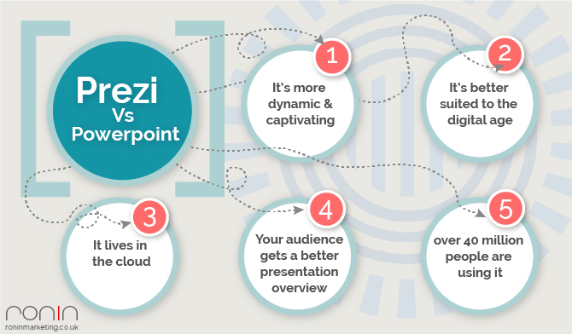

Slide 9
PowerPoint vs Visme
Unlike PowerPoint, Visme allows users to view user’s role, their access permissions, and number of projects they created.
It also provide critical information to view granular data on each project.
Visme provides ease for user to control the appearance of each object with a single animation timeline, however, this feature is bit more intuitive in PowerPoint.
Notes:
In PowerPoint, the user must first click on the object and then go to the Animation menu to select the desired effect. Finally, the user has the option to either set each effect to start right after the previous effect--so that they appear perfectly synchronized--or manually set their appearance by clicking on the Animation Pane.

Slide 10
Conclusion
In a nutshell, Prezi is more advanced than PowerPoint and Visme due to its Real time data, Collaboration tools, Zoom and pan on one slide, Presentation library, Custom logo, Video upload storage, and Group editing.
Moreover, Prezi provides a platform for many people to edit slides online in real time to avoid any misunderstanding. It is safe to say that Prezi is more effective than PowerPoint in various matters.

Slide 11
References
Chibana, N. (2018). PowerPoint Versus Visme: Which One Is Right For You? Retrieved from https://visme.co/blog/powerpoint-alternative-visme/
Chou, P. N., Chang, C. C., & Lu, P. F. (2015). Prezi versus PowerPoint: The effects of varied digital presentation tools on students’ learning performance. Computers & Education, 91, 73-82.
Noar, A. (2018). PowerPoint vs. Prezi | what’s The Difference?
White, N. L. (2011). Prezi v. PowerPoint: Finding the right tool for the job (Doctoral dissertation).

