Slide 1
Organizations and Career Development of Executives

Slide 2
Introduction
This presentation discusses:
  Importance of career development for organization
  Career development using internal and external resources
  Methods to provide equal opportunities for trainings
  Methods to improve executives’ KSA
  Ideas for training and development
  Methods to motivate executives

Slide 3
Importance of Career Developments for the Organization
To understand the positive business outcomes of career development
To encourage employees to have career discussions
To use their core employment processes to develop employees over time
To connect several stands of career support
To skill managers to support careers
Notes:
1. Understanding the positive business outcomes of career development, especially in growing scarce skills, deploying existing skills more flexibly, and motivating employees. Employers should develop clearer career strategies and policies for all employees, not just those seen as having ‘high potential’.
2. Encouraging employees to have informal as well as formal career discussions with a range of people who can help them.
3. Using their core employment processes, especially job design, job filling and training, to develop employees over time and not just in their current jobs.
4. Connecting several stands of career support – what we might call a ‘web’ of career support. This web should include at least one way of accessing career support, which is additional to the support provided by the individual’s line manager. The organization should also appoint someone to co‐ordinate career development policy and practical support.
5. Skilling managers to support careers and skilling employees to manage their careers.

Slide 4
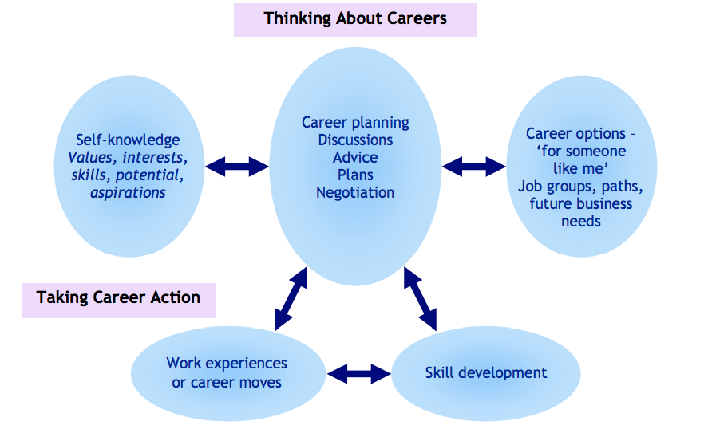
Notes:
The bottom of this figure links career planning to taking action, both in terms of accessing work experiences, including making job moves, and accessing formal and more personalized forms of learning. Such action involves navigating a range of formal and informal processes, and gaining support from a range of people. Individuals need career skills to achieve such action, just as much as they do to frame their own career plans or decisions.

Slide 5
Career Development Using Internal Resources
Support given by line managers
Career workshops or one-to-one career discussions by the HR department
Career planning tools, learning opportunities, and self-help information made available on company intranet
Use of volunteer career-help couches
Notes:
1. Strengthening the support given by line managers by, for example, more collective processes for reviewing and supporting the skill and career development needs of employees
2. One‐to‐one career discussions or career workshops for groups delivered by HR or training advisers within the business
3. Self‐help information on career options, learning opportunities and sometimes career planning tools made available in electronic form, often on the company intranet
4. The use of volunteer ‘career coaches’, usually a sub‐set of HR people and/or line managers, who are given special training and provide career support, often to people they don’t know, in addition to their normal work roles

Slide 6
Career Development Using External Resources
Outplacement companies
Career support through professional bodies
Trade unions
Notes:
1. So it is a further paradox that the group most likely to be given career support by employers are those being forced to leave.
2. For professional employees, their professional bodies may offer career support, usually through informal networking and events, and often provide structured continuing professional development (CPD).
3. Other employees may be able to access support through their Trade Union

Slide 7
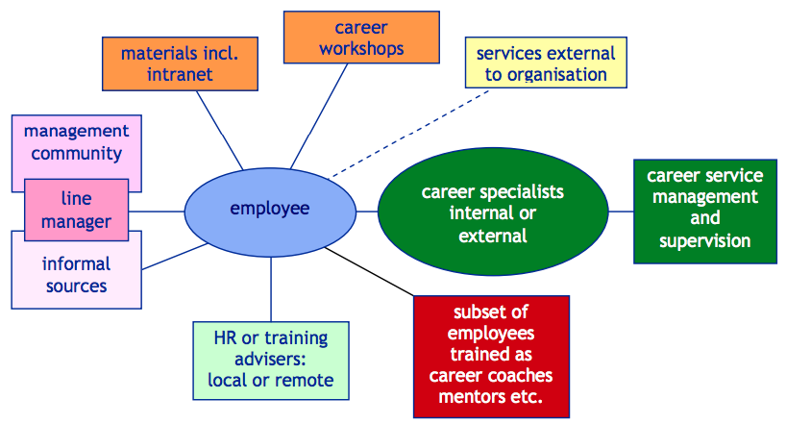
Notes:
So there are a range of models for delivering improved career support to employees, some of which are shown on figure here. It might be helpful if employers think about using several complementary source of career support to give employees more than one place they can go for help, especially if they find talking to their own manager difficult or if their manager lacks the information or skill to help them. We can think about providing a ‘web’ of career support – nothing to do with the internet but in the sense of a spider’s web – a linked set of interventions within a unified strategy.

Slide 8
Methods to Provide Equal Opportunities and Trainings
Conducting training at least every two years
Keeping a record of attendance at training sessions
Giving examples of acceptable and non-acceptable behaviors at work
Explaining the rights and responsibilities
Detailing the procedures
Notes:
Remember that all employers are under a duty to ensure that discrimination does not occur in the workplace. Having a clear Equal Opportunities Policy and conducting training on the policy for employees can help to set expectations around behavior and minimize the risk of legal claims.
Training can also help employers to establish a “reasonable steps” defense to discrimination claims if an employee goes against the Equal Opportunities Policy and commits an act of discrimination against a colleague. Here a few methods to provide equal opportunities and trainings:
1. Conduct training for all new starters and refresh training for all employees at least every two years.
2. Keep a record of attendance at training sessions, whether these are conducted in person or online. Get employees to sign a register or keep a computer record of who has completed training. Follow up non-attendance at training and repeat this for absent employees.
3. Give examples of what is and what is not acceptable behaviour at work. If possible, make this interactive to get employees thinking about real-life scenarios. Use case-studies or quick-fire yes/no questions. Online training can include quizzes or multiple choice questions.
4. Explain the rights and responsibilities of everyone in the workplace to ensure the policy is followed consistently.
5. Detail the procedures for dealing with complaints about discrimination or harassment in the workplace.

Slide 9
Continued
6. Explaining the link between harassment and recipient’s view of the conduct
7. Reminding the rule of non-discrimination
8. Telling the policies concerning breaches of the policy and the consequences
9. Displaying posters around the workplace
10. Sending regular emails
Notes:
6. Explain that harassment often depends on the recipient’s view of the conduct and it is not acceptable to say that there is a “culture” of banter in the workplace.
7. Remind employees that they should not be instructing anyone else to discriminate.
8. Tell employees how breaches of the policy will be dealt with and what the consequences could be, including the risk of claims against the business.
9. Display posters around the workplace reminding employees that there is a zero-tolerance approach to discrimination and who to contact if they or a colleague is being harassed.
10. Send regular emails reminding employees about their obligations.

Slide 10
Methods to Increase Executives’ KSAs
Each KSA element is of critical importance in learning and development.
According to Blanchard and Thacker (2010), a training program must focus on the following points:
  Knowledge base of the trainers must be increased
  Skills cannot be developed without practice
  Attitudes and behaviors must be improved
Notes:
Knowledge, Skills and Abilities (KSA) is a list of qualifications that an individual needs to perform a specific job. Usually an employer will create the KSA as a guideline to seek out the best applicants that qualify.
1. The training program should always aim to increase the knowledge base of the training audience. Training that fails in this objective is often considered by the training audience to be a waste of time, for obvious reasons
2. I have participated in many training programs that have told me what to do but have left me wondering how to do it. Students must not only be provided with what to do, but should also be trained and practiced in how to do it. Skills cannot be developed without practice.
3. Most people who have led a training class or seminar experienced the effects of a participant’s negative attitude toward the training. This is often the result of a bad experience related to a prior training or the subject matter. It should be the goal of every training program to improve attitudes and behaviors toward both the training process and the subject matter. This must be considered and addressed in the development phase. Failure to do this will result it low retention levels and a failed training program.

Slide 11
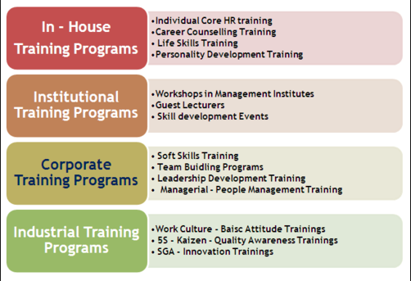
Ideas for Training and Development
Notes:
Job training or workplace training is learning to improve performance and advancement in profession, career and individual as well as Organizational goals. Present scenario in Industrial and Organizational segments mainly focusing on employee training and advancement include their employees’ career counseling, Career development, Career Management, skill assessment and competencies improvements.

Slide 12
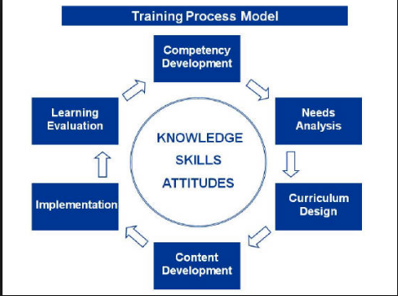
Notes:
Competency Development: A competency is a broad grouping of knowledge, skills, and attitudes along with inherent talents that enable a person to be successful in a particular role or responsibility. Competency development is the starting point in creating an effective training program. It defines the objectives of a learning initiative. It specifically describes what the desired performance behavior should look like and sound like. It projects what the desired learning results should be.
Needs Analysis: is an examination of the existing need for training within an organization. It compares the desired performance level to the current performance level to identify the performance gaps. It determines what a proposed training initiative content should be and sets the stage for the design and development of the program curriculum.
Curriculum Design: focuses on creating the blueprint for the proposed performance improvement initiative. The fundamental function of curriculum design is the determination of the format of the individual elements that will comprise the proposed training as wells as their interrelationship. Basic format options for training include instructor-led formal classroom training, learner-directed manual-based or computer -mediated training, synchronous or asynchronous distance training, facilitated group discussions as well blended learning initiatives which involve various combinations of the above.
Content Development: consists of acquisition and creation of each of the training program components identified in the curriculum design phase. It often involves working with subject matter experts from within and outside the organization to capture specialized knowledge for inclusion of the training content.
Implementation: All the aspects of a training program come together during the implementation phase. The implementation phase is the point of impact for all of the time and effort devoted to the development of a training program. While the implementation phase must be well-planned, appropriately structured and practiced, it must also allow for adaptation to special situations that arise during content delivery.
Learning Evaluation: helps measure the value and effectiveness of a training program. Learning evaluations use assessment tools to provide data for the evaluation. For instance, the work Watkins et al., (1998) explains evaluation model developed by Donald Kirkpatrick, Professor Emeritus of the University of Wisconsin in North America and a past president of the American Society for Training and Development (ASTD). It consists of 4 phases, i.e., evaluation of participant’s reaction, evaluation of learning, evaluation of learning transfer, and evaluation of results. Due to time limitation, I will leave the detailed discussion for some other session.

Slide 13
Methods to Motivate Employees
Eliminating job hygiene stressors:
  Rectifying bureaucratic policies
  Ensuring each team member feels supported
  Ensuring the day-to-day working culture is supportive
  Ensuring that salaries are competitive
  Increasing job satisfaction and status
Notes:
The first step to enhancing the motivation of a team is to ensure that the hygiene factors are not causing dissatisfaction. I will ensure that each person examines hygiene factors through their own unique frame of reference. Because of this, it’s important to work with each member of the team to understand his or her specific perspective. Some common steps to remove hygiene stressors are:
1. Rectify petty and bureaucratic company policies.
2. Ensure each team member feels supported without feeling micromanaged. You can do this by using servant leadership or a democratic leadership style.
3. Ensure the day-to-day working culture is supportive. No bullying. No cliques. Everyone treated with equal respect.
4. Ensure that salaries are competitive within the industry. Ensure there are no major salary disparities between employees doing similar jobs.
5. To increase job satisfaction and status, aim to construct jobs in such a way that each team member finds their job meaningful.

Slide 14
Continued
Boosting job satisfaction
  Job Enrichment
  Job Enlargement
  Employee Empowerment
Notes:
Once the hygiene stressors have been removed, the next step is to boost the job satisfaction of each team member. We can do this by improving the actual content of the job itself. Again, a unique approach for each employee will be required. Three techniques, which can be used to achieve the goal, are:
Job Enrichment: means enriching a team member’s job by giving them more challenging or complex tasks to perform. These more complex tasks should make the job more interesting.
Job Enlargement: means giving a team member a greater variety of tasks to perform. This variety can also make a job more interesting. Note that with job enlargement the variety of tasks is increased, but not the difficulty of those tasks. If difficulty increased then that would be job enrichment.
Employee Empowerment: means delegating increasing responsibility to each team member. This can be done by slowly increasing the amount of responsibility you delegate to an employee.

Slide 15
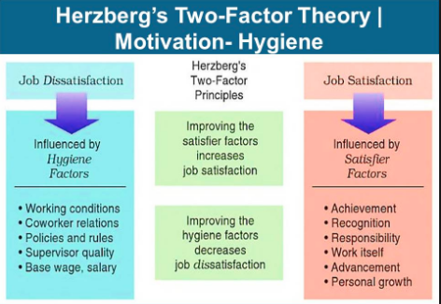
Notes:
The methods to motivate executives have been based on Herzberg’s Motivation Theory model, or Two Factor Theory, which argues that there are two factors that an organization can adjust to influence motivation in the workplace.
These factors are:
Motivators: Which can encourage employees to work harder.
Hygiene factors: These won’t encourage employees to work harder but they will cause them to become unmotivated if they are not present.
In a general sense, there are four states an organization or team can find themselves in when it comes to Two Factor Theory.
1. High Hygiene and High Motivation
This is the ideal situation and the one which every manager should strive for. Here, all employees are motivated and have very few grievances.
2. High Hygiene and Low Motivation
In this situation, employees have few grievances but they are not highly motivated. An example of this situation is where pay and working conditions are competitive but the work isn’t very interesting. Employees are simply there to collect their salary.
3. Low Hygiene and High Motivation
In this situation, employees are highly motivated but they have a lot of grievances. A typical example of this situation is where the work is exciting and really interesting but the pay and conditions are behind competitors in the same industry.
4. Low Hygiene and Low Motivation
This is obviously a bad situation for an organization or team to find itself in. Here, employees aren’t motivated and the hygiene factors are not up to scratch.

Slide 16
References
Blanchard, N.P., & Thacker, J. (2010). Effective training, systems, strategies and practices. (Custom 4th ed.). Upper Saddle River, NJ: Prentice Hall.
Watkins, R., Leigh, D., Foshay, R., & Kaufman, R. (1998). Kirkpatrick plus: Evaluation and continuous improvement with a community focus. Educational Technology Research and Development, 46(4), 90-96.
Herzberg's Motivation-Hygiene Theory. (2010). NetMBA: Business Knowledge Center. Retrieved from http://www.netmba.com/mgmt/ob/motivation/herzberg/

