Slide 1
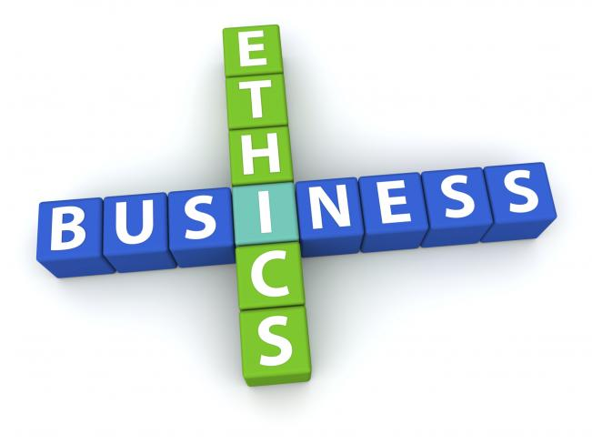
Ethical Culture in Business

Slide 2
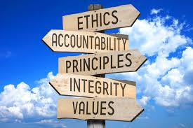
What is Ethics in Business?
System of moral principles
guide the right and wrong behavior
Ethics are the principles of conduct that govern an individual or group
define acceptable conduct in businesses
Business Ethics comprises written codes and values which guides actions and decisions in a company
Guides Business Principles
Notes:
According to Merriam Webster, Ethics are the principles of conduct governing an individual or a group
Ethics is based on well-founded standards of right and wrong that prescribe what humans ought to do, usually in terms of rights, obligations, benefits to society, fairness, or specific virtues.
Business ethics are moral principles that guide the way a business behaves. The same principles that determine an individual's actions also apply to business.
Acting in an ethical way involves distinguishing between “right” and “wrong” and then making the “right” choice. It is relatively easy to identify unethical business practices. For example, companies should not use child labour. They should not unlawfully use copyrighted materials and processes. They should not engage in bribery.

Slide 3
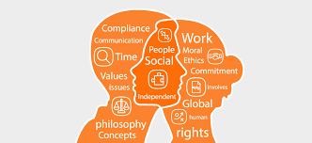
Business and Ethics, What is the need?
Ethical practices contribute to business success.
Benefits of ethical standards and code of Ethics are as follows:
Guides moral course in tough times
Strong teamwork and productivity
Support employee growth
Avoid criminal acts
Public image and Reputation
Notes:
Ethical standards, codes of ethics, and ethical practices in business are essential for the business success. Ethical Standards such as A code of ethics is a guide of principles designed to help professionals conduct business honestly and with integrity. A code of ethics document may outline the mission and values of the business or organization, how professionals are supposed to approach problems, the ethical principles based on the organization's core values and the standards to which the professional is held. A code of ethics, also referred to as an "ethical code," may encompass areas such as business ethics, a code of professional practice and an employee code of conduct.
Ethical practices and corporate social responsibility can bring significant benefits to a business. For example, they may:
Ethics programs help maintain a moral course in turbulent times:
Attention to business ethics is critical during times of fundamental change — times much like those faced now by businesses, both nonprofit or for-profit. During times of change, there is often no clear moral compass to guide leaders through complex conflicts about what is right or wrong. Continuing attention to ethics in the workplace sensitizes leaders and staff to how they want to act — consistently.
Ethics programs cultivate strong teamwork and productivity.
Ethics programs align employee behaviors with those top priority ethical values preferred by leaders of the organization. Employees feel strong alignment between their values and those of the organization. They react with strong motivation and performance.
Ethics programs support employee growth and meaning.
Attention to ethics in the workplace helps employees face reality, both good and bad — in the organization and themselves. Employees feel full confidence they can admit and deal with whatever comes their way.
Ethics programs help avoid criminal acts “of omission” and can lower fines.
Ethics programs tend to detect ethical issues and violations early on so they can be reported or addressed.
Ethics programs promote a strong public image.
Attention to ethics is also strong public relations — admittedly, managing ethics should not be done primarily for reasons of public relations. But, frankly, the fact that an organization regularly gives attention to its ethics can portray a strong positive to the public. People see those organizations as valuing people more than profit, as striving to operate with the utmost of integrity and honor.

Slide 4
Impact of lack of Ethical Standards and Practices
Legal issues and fines
Poor employee Performance
Poor Employee Relations
Damage to Company Credibility
Notes:
Legal Issues and Ethics
In the United States, federal and state governments establish rules and procedures for how a business should be run. Businesses that fail to follow federal and state guidelines often face large fines and other penalties. Larger companies sometimes decide that breaking laws and paying the fines involves lower costs than the financial gain made from breaking those laws. However, consistently breaking laws can lead to costly legal battles that outweigh the initial gain.
Additionally, executives at companies who break laws and engage in unethical behavior that leads to harmful practices for employees and customers could find themselves facing criminal charges.
Impact on Employee Performance
A lack of ethics has a negative effect on employee performance. In some cases, employees are so concerned with getting ahead and making money that they ignore procedures and protocol. This can lead to additional paperwork and careless errors that result in the task having to be completed again. Additionally, employees who feel acting ethically and following the rules will not get them ahead in the business sometimes feel a lack of motivation, which often leads to a decrease in performance.
Employee Relations Are Affected
When a manager or head of a business exhibits a lack of ethical behavior, he faces losing the respect of his employees. It is difficult to have a successful business without well-respected leaders. A lack of ethical behavior can also cause tension among employees, with some employees resenting those who do not play by the rules and still manage to get ahead. Unethical behavior in the workplace also has the potential to lead to a lack of trust among employees, which is detrimental to a business that relies on collaboration and a sense of community.
Damage to Company Credibility
If a lack of ethics in a business becomes public knowledge, that business loses credibility. While some businesses survive public knowledge of a lack of ethics through reimaging and advertising campaigns, many lose a key customer base. Even if a business recovers from news about its lack of ethics, it takes a lot of time and money to restore its image and consumer confidence. Customers that abandon a company because they are dismayed by poor ethical practices will find other products and services to meet their needs.

Slide 5
What is Ethical Culture in Business?
Shared perceptions of right behavior
The extent to which people of an organization regards and considers its values
Strong Ethical cultures promote right doings
Culture can be unwritten
Notes:
An ethical organizational culture can be considered to be the shared perceptions of what ethically correct behavior is and how ethical issues should be handled within an organization. Does one report ethical issues? Ignore them? Does one follow the rules or does one bend, or even break them? Ethical culture, then, is “the extent to which an organization regards its values. Strong ethical cultures make doing what is right a priority. In this context, ethical culture is often the unwritten code by which employees learn what they should think and do”.

Slide 6
Cont..
Ethical Culture is very beneficial for the organization
It promotes a strong public image
Ethical culture means better decision making
Ethical organizational culture cultivates strong teamwork
It is desirable on multiple levels
Notes:
Researchers have demonstrated that an ethical organizational culture has many positive benefits. An organization having ethical culture is marked with following characteristics. It promotes a strong public image and better relations with stakeholders, partners, and others. It leads to better decision making, results in a stronger organizational culture, helps employees act in a consistent manner in difficult situations, keeps morale high during periods of change, cultivates strong teamwork and productivity, ensures the continuity and sustainability of efforts in values and ethics, increases the awareness and understanding of ethical problems (because employees are willing to speak up), and ensures that policies and procedures adhere to high moral standards . In short, an ethical organizational culture is desirable on multiple levels. In opposition to the benefits of promoting an ethical organizational culture, the consequences of not focusing on the organization’s values or making “doing what is right” a priority can be catastrophic (Fraser, 2016)
.

Slide 7
Auditing Process for Adherence to Ethical Practices
Develop metrics
Cross-functional team
Audit efficiently
Look for other issues
Communicate
Detailed foundation
Notes:
Six Steps to Highly Effective Ethics Audits
These tips can help companies conduct effective ethics audits:
Start with a detailed foundation. An ethics audit is a comparison between actual employee behavior and the guidance for employee behavior provided in policies and procedures. The more descriptive and specific ethics-related policies and procedures are, the easier it is to make these comparisons.
Develop metrics. Ethics audits may not be as black-and-white as financial or operational audits, but they run more smoothly when tangible ethics measures are in place. Consider adding ethics goals to annual performance reviews and, where possible, tying compensation to ethical behavior.
Create a cross-functional team. Include an HR professional familiar with people in the business unit being audited. Most ethics audit teams include an ethics and compliance manager where possible as well as an internal auditor and legal managers.
Audit efficiently. Audits frequently disrupt normal operations in business areas subjected to review. Before scheduling an audit, find out if internal auditors or the finance team may be conducting reviews of the same area. If so, combine these efforts to limit disruptions. Once the audit has been scheduled, create a plan that spells out employees to be interviewed, information that requires review and any processes that require observation.
Look for other issues. Keep an eye out for other improvement opportunities, and share those with relevant colleagues. For example, ethics issues in a sales area may have revenue-recognition implications from a financial reporting perspective.
Respond consistently and communicate. Discipline ethics violations in complete accord with policies and procedures and the code of conduct every time. Also, use ethics issues, when possible, as grist for "lessons learned" in ethics-related communications and training.

Slide 8
Methods to Ensure Adherence to Ethical Practices
Ethics Programs
Codes of Ethics
Codes of Conduct
Notes:
Managing Ethics Programs in the Workplace
Organizations can manage ethics in their workplaces by establishing an ethics management program. Brian Schrag, Executive Secretary of the Association for Practical and Professional Ethics, clarifies. "Typically, ethics programs convey corporate values, often using codes and policies to guide decisions and behavior, and can include extensive training and evaluating, depending on the organization. They provide guidance in ethical dilemmas." Rarely are two programs alike.
Developing Codes of Ethics
A code of ethics specifies the ethical rules of operation. In the latter 1980s, The Conference Board, a leading business membership organization, found that 76% of corporations surveyed had codes of ethics. A code of ethics document may outline the mission and values of the business or organization, how professionals are supposed to approach problems, the ethical principles based on the organization's core values and the standards to which the professional is held. A code of ethics, also referred to as an "ethical code," may encompass areas such as business ethics, a code of professional practice and an employee code of conduct.
Developing Codes of Conduct
If your organization is quite large, e.g., includes several large programs or departments, you may want to develop an overall corporate code of ethics and then a separate code to guide each of your programs or departments. Codes should not be developed out of the Human Resource or Legal departments alone, as is too often done. Codes are insufficient if intended only to ensure that policies are legal. All staff must see the ethics program being driven by top management. Note that codes of ethics and codes of conduct may be the same in some organizations, depending on the organization's culture and operations and on the ultimate level of specificity in the code(s).

Slide 9
Cont..
Resolving Ethical Dilemmas
Cultivating Ethical Culture
Training
Ethical Leadership
Notes:
Resolving Ethical Dilemmas and Making Ethical Decisions
Perhaps too often, business ethics is portrayed as a matter of resolving conflicts in which one option appears to be the clear choice. For example, case studies are often presented in which an employee is faced with whether or not to lie, steal, cheat, abuse another, break terms of a contract, etc. However, ethical dilemmas faced by managers are often more real-to-life and highly complex with no clear guidelines, whether in law or often in religion.
Assessing and Cultivating Ethical Culture
Culture is comprised of the values, norms, folkways and behaviors of an organization. Ethics is about moral values, or values regarding right and wrong. Therefore, cultural assessments can be extremely valuable when assessing the moral values in an organization.
Ethics Training
The ethics program is essentially useless unless all staff members are trained about what it is, how it works and their roles in it. The nature of the system may invite suspicion if not handled openly and honestly. In addition, no matter how fair and up-to-date is a set of policies, the legal system will often interpret employee behavior (rather than written policies) as de facto policy. Therefore, all staff must be aware of and act in full accordance with policies and procedures (this is true, whether policies and procedures are for ethics programs or personnel management). This full accordance requires training about policies and procedures.
Ethical Leadership
Unethical employee behavior is a organisations, but it has been discovered that effective leadership can minimize the prevalence of these unwanted behavior. Organizational leaders should hence take full responsibility for cultivating an ethical climate through ethical leader behavior. By reinforcing these aspects, perceived leader effectiveness can be advanced among employees, which will ultimately effect overall organizational performance (Engelbrecht, Wolmarans, & Mahembe, 2017).

Slide 10
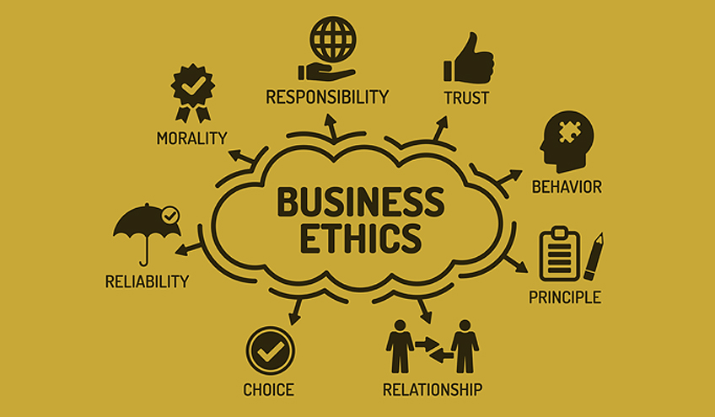
Role of Culture in Global Business Ethics
Culture impacts the way local values impact global business ethics
Culture impacts perceptions about issues
Culture can influence global business ethics in these ways:
Management Practices
Corruption
Corporate social responsibility
Notes:
Culture impacts how local values influence global business ethics. There are differences in how much importance cultures place on specific ethical behaviors. For example, bribery remains widespread in many countries, and while people may not approve of it, they accept it as a necessity of daily life. Each professional is influenced by the values, social programming, and experiences encountered from childhood on. These collective factors impact how a person perceives an issue and the related correct or incorrect behaviors. Even within a specific culture, individuals have different ideas of what constitutes ethical or unethical behavior. Judgments may differ greatly depending on an individual’s social or economic standing, education, and experiences with other cultures and beliefs. Just as in the example of bribery, it should be noted that there is a difference between ethical behavior and normal practice. It may be acceptable to discriminate in certain cultures, even if the people in that society know that it is not right or fair. In global business ethics, people try to understand what the ethical action is and what the normal practice might be. If these are not consistent, the focus is placed on how to encourage ethical actions.
There are three ways in which culture can influence global business ethics:
Ethics and management
Ethics and corruption
Corporate social responsibility

Slide 11
Cont..
Ethics and Management Practices
Differ from culture to culture
Antidiscrimination policies
Role of each other
Local practices impact decision making
Ethics and Corruption
Culturally accepted norms
Conflicts with global business practices
Bribery and embezzlement acceptable in various countries
Notes:
Ethics and Management Practices
Ethics impacts various aspects of management and operations, including human resources, marketing, research and development, and even the corporate mission.
The role of ethics in management practices, particularly those practices involving human resources and employment, differs from culture to culture. Local culture impacts the way people view the employee-employer relationship. In many cultures, there are no clear social rules preventing discrimination against people based on age, race, gender, sexual preference, handicap, and so on. Even when there are formal rules or laws against discrimination, they may not be enforced, as normal practice may allow people and companies to act in accordance with local cultural and social practices.
Culture can impact how people see the role of one another in the workplace. For example, gender issues are at times impacted by local perceptions of women in the workplace. So how do companies handle local customs and values for the treatment of women in the workplace? If you’re a senior officer of an American company, do you send a woman to Saudi Arabia or Afghanistan to negotiate with government officials or manage the local office? Does it matter what your industry is or if your firm is the seller or buyer? In theory, most global firms have clear guidelines articulating antidiscrimination policies. In reality, global businesses routinely self-censor. Companies often determine whether a person—based on their gender, ethnicity, or race—can be effective in a specific culture based on the prevailing values in that culture. The largest and most respected global companies, typically the Fortune Global 500, can often make management and employment decisions regardless of local practices. Most people in each country will want to deal with these large and well-respected companies. The person representing the larger company brings the clout of their company to any business interaction. In contrast, lesser-known, midsize, and smaller companies may find that who their representative is will be more important. Often lacking business recognition in the marketplace, these smaller and midsize companies have to rely on their corporate representatives to create the professional image and bond with their in-country counterparts.
Ethics and Corruption
Our modern understanding of business ethics notes that following culturally accepted norms is not always the ethical choice. What may be acceptable at certain points in history, such as racism or sexism, became unacceptable with the further development of society’s mind-set. What happens when cultures change but business practices don’t? Does that behavior become unethical, and is the person engaged in the behavior unethical? In some cultures, there may be conflicts with global business practices, such as in the area of gift giving, which has evolved into bribery—a form of corruption.
Paying bribes is relatively common in many countries, and bribes often take the form of grease payments, which are small inducements intended to expedite decisions and transactions. In India and Mexico, for example, a grease payment may help get your phones installed faster—at home or at work. Transparency International tracks illicit behavior, such as bribery and embezzlement, in the public sector in 180 countries by surveying international business executives. It assigns a CPI (Corruption Perceptions Index) rating to each country. New Zealand, Denmark, Singapore, and Sweden have the lowest levels of corruption, while the highest levels of corruption are seen in most African nations, Russia, Myanmar, and Afghanistan.

Slide 12
Cont..
Corporate Social Responsibility
It determines how companies make profits
Goodwill of the country in which business in operating
Contributing to sustainability
Example of Coca-Cola
Notes:
Corporate Social Responsibility
CSR emerged more than three decades ago, and it has gained increasing strength over time as companies seek to generate goodwill with their employees, customers, and stakeholders. “Corporate social responsibility encompasses not only what companies do with their profits, but also how they make them. It goes beyond philanthropy and compliance and addresses how companies manage their economic, social, and environmental impacts, as well as their relationships in all key spheres of influence: the workplace, the marketplace, the supply chain, the community, and the public policy realm. Companies may support nonprofit causes and organizations, global initiatives, and prevailing themes. Promoting environmentally friendly and green initiatives is an example of a current prevailing theme.
Coca-Cola is an example of global corporation with a long-term commitment to CSR. In many developing countries, Coca-Cola promotes local economic development through a combination of philanthropy and social and economic development. Whether by using environmentally friendly containers or supporting local education initiatives through its foundation, Coca-Cola is only one of many global companies that seek to increase their commitment to local markets while enhancing their brand, corporate image, and reputation by engaging in socially responsible business practices.

Slide 13
Conclusion
Ethics are moral principles and it helps in distinguishing between right and wrong
Ethics bring nothing but all good to the business
Various methods can contribute to ethical practices in business such as code of ethics and conduct and leadership
Ethics also influences global business practices
Notes:
Business ethics are moral principles that guide the way a business behaves. Ethical standards, codes of ethics, and ethical practices in business are essential for the business success. Ethics bring various benefits to a business and unethical behavior results in adverse consequences. An ethical organizational culture can be considered to be the shared perceptions of what ethically correct behavior is and how ethical issues should be handled within an organization. Various methods can contribute to the ethical practices in an organization.
Culture impacts how local values influence the concept of global business ethics. Each professional is influenced by the values, social programming, and experiences he or she has absorbed since childhood.
Ethics impacts global business in the areas of management, corruption, and corporate social responsibility.

Slide 14
References
Engelbrecht, A. S., Wolmarans, J., & Mahembe, B. (2017). Effect of ethical leadership and climate on effectiveness. SA Journal of Human Resource Management, 15(1), 1-8.
Fraser, A. D. (2016). A Case Study in Utilizing an Ethical Climate Survey for Creating and Maintaining an Ethical Organizational Culture. Journal of Behavioral and Social Sciences, 183-189 .

