Slide 1
Workplace Diversity by Abdullah Swaray
April 18, 2019

Slide 2
Agenda
Thesis Statement
Introduction
History
Benefits
The Problem
The Solution
Summary slide

Slide 3
Thesis Statement
Workplace diversity can help develop a multi-talented workforce with diversified skills that can perform organizational tasks with high level efficiency, optimization and creativity.

Slide 4
Introduction
Diversity is defined as the understanding of unique characteristics and experiences that differentiate individuals.
It refers to the heterogeneity on the basis of gender, age, ethnicity, and religion.
Diversity explains the acceptance and respect for the broad workforce.
It creates innovative culture as individuals share their respective talents.
.
4
Notes:
Diversity can include Race, Ethnicity, Gender, Age, Religion, Disability, and Sexual orientation. A diverse workplace aims to create an inclusive culture that values and uses the talents of all its employees.

Slide 5
History Of Workplace Diversity
The Civil Rights Act (1964) emphasises on equal opportunities for all and it was considers illegal to discriminate against employees.
Executive Order was passed in 1965 to reduce the patterns of discrimination.
Many organizations diversified, while some constantly show resistant.
Trainings programs were provided aimed to value diversity (Fassinger, 2008).
Notes:
The 1964 Civil Rights Act made it illegal for organizations to engage in employment practices that discriminated against employees on the basis of race, color, religion, gender, national origin, age, and disability.
In 1965, Executive Order 11246 was passed requiring all government contractors to take affirmative actions to overcome past patterns of exclusion and discrimination.
These mandates eliminated formal policies that discriminated against certain classes of workers and raised costs to organizations that failed to implement fair employment practices. These laws remain a part of the legal responsibilities under which organizations abide by today.
Although many organizations became more diverse, there were still organizations inhospitable to certain classes of workers, and were slow to change.
In order to foster the development of more diverse organizational cultures, companies began to offer training programs aimed at valuing diversity.

Slide 6
Benefits of Workplace Diversity
Increase the productivity. Enhance employees creativity. Maximize employees loyalty. It provide competitive advantage. It reinforce cultural values. Provide diverse perspective on issues. Enhance the credibility of Organization and their corporate reputation Improve motivation Improve efficiency of employees Increase customer satisfaction (Patrick & Kumar, 2012).
Notes:
Groups with greater diversity were shown to have greater innovation and creativity.
Diverse groups have a greater range of perspectives, and are able to generate more high quality solutions than less diverse groups.
Diversity increases constructive group processes and is positively associated with performance in business units.
Diversity is associated with increased sales revenue, greater market share, more customers, and greater profits.

Slide 7
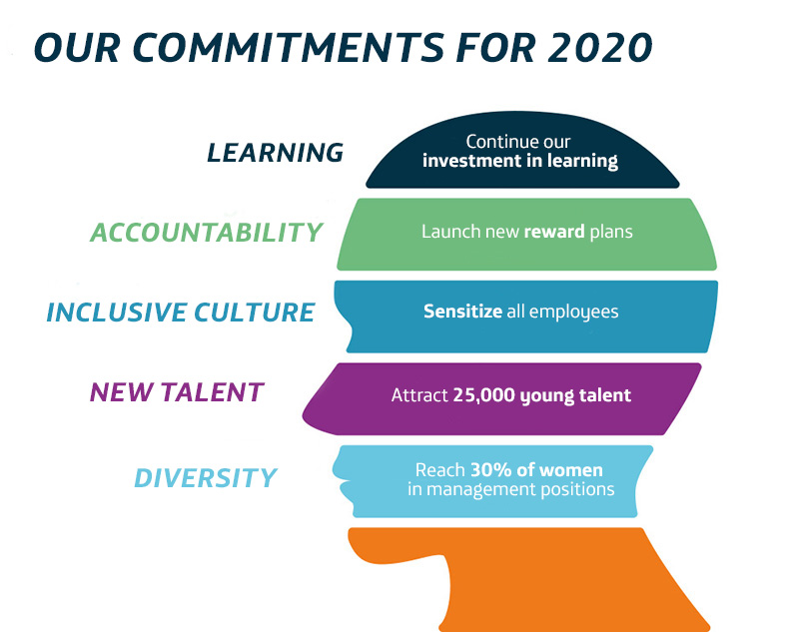
Telefonica has placed diversity at the centre of their core values
Notes:
Groups with greater diversity were shown to have greater innovation and creativity.
Diverse groups have a greater range of perspectives, and are able to generate more high quality solutions than less diverse groups.
Diversity increases constructive group processes and is positively associated with performance in business units.
Diversity is associated with increased sales revenue, greater market share, more customers, and greater profits.

Slide 8
Workplace Challenges
Research suggests that diversity has a negative impact as well. Thus, organizational performance should be regularly evaluated.
It impact organization’s policies, values, and practices.
Certain characteristics plays an important role in diverse workforce such as size, age, and type of organization.
This indicates that diversity is beneficial under specific circumstances (Pugh, Dietz, Brief, & Wiley, 2008).
Notes:
Diversity can also be linked with conflict, lower group adhesiveness, increased employee turnover and absenteeism, and lower quality of performance.
Diverse groups are shown to be less integrated and have a higher level of dissatisfaction. Increases the level of dissatisfaction in group members, as well as miscommunication.

Slide 9
Workplace Challenges
Conflicts
Time Consumption
Communication
Resistance To Change
Harassment
High Turnover Rate
Absenteeism
Exclusion
Notes:
Conflict arise because of distrust and lack of confidence among group members.
TIME CONSUMPTION There are differences in the way people carry- out instructions.
RESISTANCE TO CHANGE “We have always done it this way”.
DISCRIMINATIONS When diversity is not accepted in an organizations, much of the time this is due to varying levels and kind of discrimination. Some types of discrimination which exist are gender, religion, disability, economic class or cultural background.
HARASSMENT Negative attitudes can arise which may lead to harassment of others who are different from the person provoking this behavior.
HIGH TURNOVER RATE This is costly because each time someone leaves the company.
EXCLUSION – “Exclude people for reasons which have nothing to do with the job.”

Slide 10
The Problem
Many organizations still show racial preferences such as Abercrombie & Fitch by hiring “Classic American” employees.
Now these companies claim diversity due to pressure and response to lawsuits.
The most prominent companies of Fortune 500 provide training on adaptation of diversity.
40% of organization still do not prefer formal trainings for diversity acceptance.
10
Notes:
Abercrombie and Fitch show extreme racial preference, with a reputation for hiring people to fit their image of a “Classic American,” which they believe are attractive white employees. Due to this, they have faced many lawsuits.
Even the organizations that claim to be strong advocates for diversity do not have the statistics to back their claims.

Slide 11
The Problem
Gender discrimination is another major issue in organizations.
Females are not provided with managerial positions.
They are taught to be physically vulnerable due to sexual harassments.
In Wal-Mart, 70% of employees are female, however the managerial positions are given to only 30% of female employees.
11
Notes:
Gender discrimination is still a huge problem within many organizations. Many male managers are slow to promote female employees to managerial positions. A Senior Vice President interviewed by Turner (2007), was quoted saying, “ Well, yes we need to have more women in senior positions. Our senior leadership team includes only men. But, personally, I’m just less comfortable with women on the senior team. We spend a lot of time together. You know you always have to be worried about the sexual harassment thing, what you say, how you say it…But, that doesn’t mean we shouldn’t pursue it .”

Slide 12
Solution
Diversity Training
Increase awareness
Reduce stereotypes
Effective management
Change behaviors
Effectiveness of Diversity Training
Mentoring
Changing policies and practices
12
Notes:
As diversity in the workforce grows at an amazing rate, more and more organizations are now focusing on diversity in the workplace by emphasizing recruitment, selection, retention, and training.
li>With diversity training, employees have a greater understanding of the value diversity, better diversity management skills, and more effective diversity related behaviors . </li></ul><ul><li>After undergoing training, managers saw diversity related practices as more important than they did prior to the training, and were more likely to positively engage in diversity related practices.

Slide 14
Conclusion
Workplace diversity is highly emphasized in recent years to increase organizational performance.
A study conducted revealed that organization shows 18% greater productivity due to diverse employees.
Diversity is a source of innovation and new structures.
It increase earnings for the organization.
14

Slide 15
References Fassinger, R. E. (2008). Workplace diversity and public policy: Challenges and opportunities for psychology. American Psychologist, 63(4), 252. Patrick, H. A., & Kumar, V. R. (2012). Managing workplace diversity: Issues and challenges. Sage Open, 2(2), 2158244012444615. Pugh, S. D., Dietz, J., Brief, A. P., & Wiley, J. W. (2008). Looking inside and out: The impact of employee and community demographic composition on organizational diversity climate. Journal of applied psychology, 93(6), 1422.
15

