Slide 1
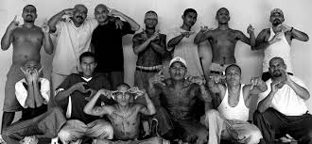
GANG MEMBERSHIP
Juvenile Justice Administration & Delinquency

Slide 2
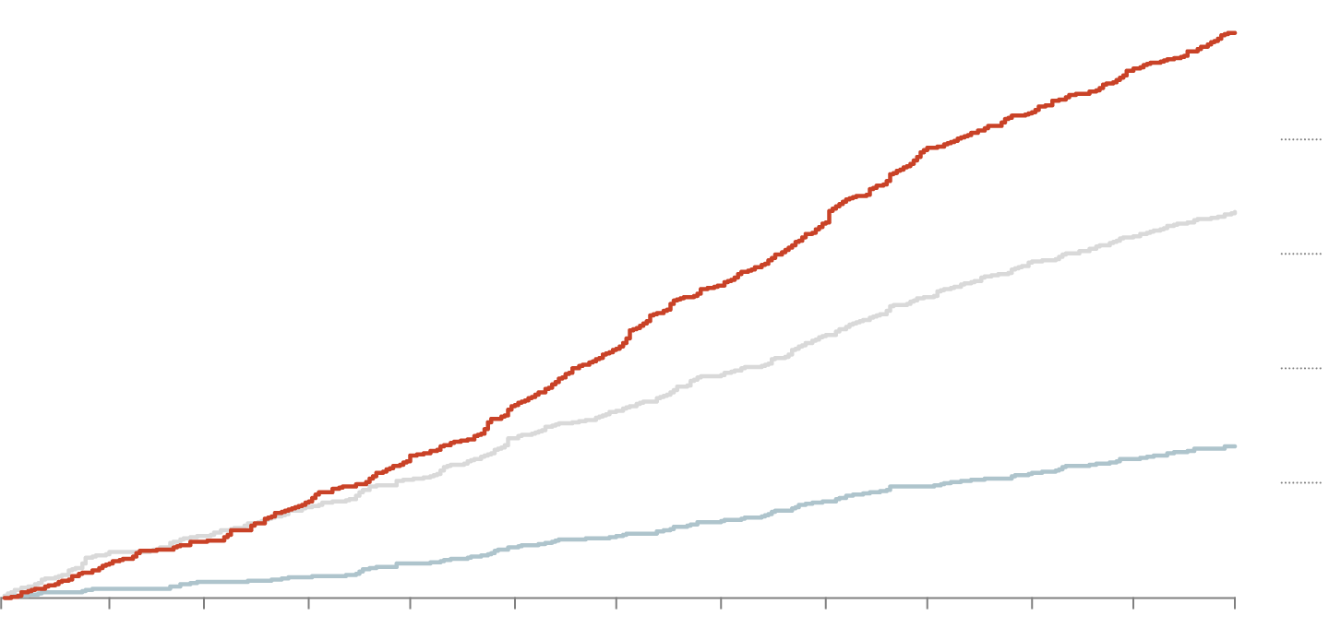
Gang problem in the United States
Juvenile gangs is the most prevalent problem in the US
Gangs make the adolescents feel like they are very special to them
Defy laws and moral values
30,000 gangs and 800,000 members in US
80% crime is due to gang members
Notes:
Gangs are offering under-served youth the option to feel like they are a part of something important. It is problematic that such an essential part of growing up is being fulfilled by joining a group that is affiliated with drugs and violence. Gangs and gang violence go against the morals that we as a society have set for one another. Gangs defy these morals and laws that are set for them, and everyone else, to obey. Gangs can actually control the government as is the case with the Mexican Cartels of today.
Number of gang members in U.S. = 30,000 gangs with 800,000 members
Number of gang members incarcerated = 147,000. 80% of crimes in communities are from gang members.

Slide 3
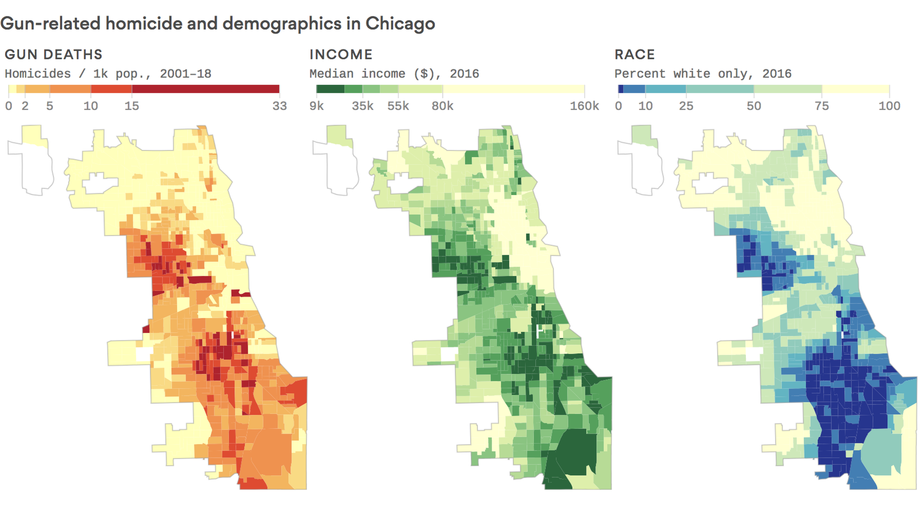
States with Highest Gang Membership
Chicago and los Angeles have highest gang crime rate
Chicago has 150,000 gang members
LA has 120,000 gang members
There was a decrease in Chicago after 2012
Notes:
The Chicago Crime Commission publication "The Gang Book 2012" gave the statistic that Chicago has more gang members than any other city in the United States: 150,000. the city had 532 murders in 2012, however, it saw a decrease to 413 murders in 2013, but up to 762 in 2016. Not all murders are gang-related, but the Chicago Police Department states that 80% of all shootings and murders in the city are gang-related, which means that most violence in the city is gang upon gang violence.
Los Angeles has held the nickname "gang capital America" since 1930 because approximately 120,000 gang members reside in the city, and tens of thousands more in surrounding Los Angeles County.

Slide 4
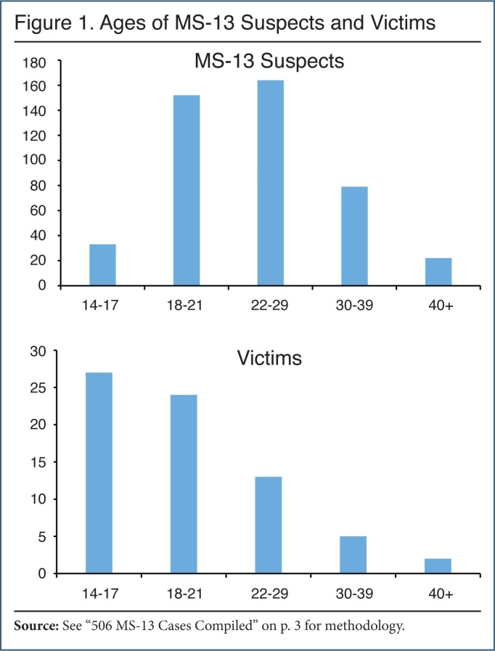
Prevalence
in the U.S, every state with 250,000 or more people has gang activity.
States with at least 100,000 people reportedly have 86% of gang problem
Approximately 25, 000 gangs
Adolescent boys= 360,000
Adolescent girls= 32,000
Increasing in rural areas too
Prevalence of youth gangs in schools; drug gangs
Pyrooz, & Sweeten, 2015.
Notes:
All the states in the U.S. with at least 250,000 people has gang activity. Howver, 86% of those with at least 100,000 people report gang activity. There are 24,500 gangs in the U.S. There are approximately 360,000 teenage boys and 32,000 teenage girls in gangs. Although the prevalence of youth gangs is decreasing nationwide, it is increasing in rural communities. Even with a national decrease in youth gang activity, many communities face major challenges as they address their gang problem. Youth gangs are prevalent in schools, where drug and gang activities appear linked.

Slide 5
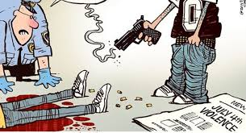
Characteristics of the Gang
stabbings, drug trafficking, sometimes murders and shootings
Specific dress code, hand signals, symbols and pseudo names
Gang graffiti on public places, telephone booths and buildings
Acts of gangs occur wherever young people assemble
Notes:
Drug trafficking, stabbings, shootings and sometimes murder. Members may wear certain kinds of colors of clothing in very specific ways and/or use special hand signals, nicknames or symbols. Graffiti is not just art. Gang graffiti on buildings, telephone booths and other public places is often used by gangs to mark their territory and bring intimidation to rival gangs and the community. Usually a cryptic combination of letters or symbols, gang graffiti also is responsible for millions of dollars of damage to public and private buildings in most North American cities. Gangs act wherever young people congregate: on public transit or at transit stops, in malls, parks, schools, and on the streets of our community.

Slide 6
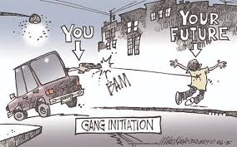
Rationale
Reasons for formation of gang membership would help in eliminating the issue
Most influential or basic is household instability
Need for safety
Economic benefit
Peer influence
Enhances status
Notes:
Familiarizing ourselves with the various reasons for gang membership could ease the development of programs meant to bring down the number of individuals joining gangs. Apart from raising crime rates, gangs are in most cases also blamed for encouraging drug use given the role they play in drug trade. It is however important to note that though quite a number of reasons have been advanced in an attempt to explain why individuals join gangs, the role household instability plays in influencing gang membership is more often than not underplayed. This effectively means that in seeking to explain the various reasons for gang membership, issues like the need for protection, economic benefit, influence from friends etc have been given more prominence than household instability.

Slide 7
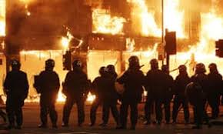
Gang Violence
Criminal acts, i.e. fights, homicides, killings etc.
Physical hostility between two groups
Illegal and non-political
It is done against other gangs, firefighters, civilians, law enforcement officers, or military personnel
Notes:
Gang violence means criminal acts of violence committed by a group of people who regularly engage in criminal activity against innocent people. The term may also refer to physical hostile interactions between two or more gangs. It also refers mostly to the illegal and non-political acts of violence perpetrated by gangs against civilians, other gangs, law enforcement officers, firefighters, or military personnel. Throughout history, such acts have been committed by gangs at all levels of organization.

Slide 8
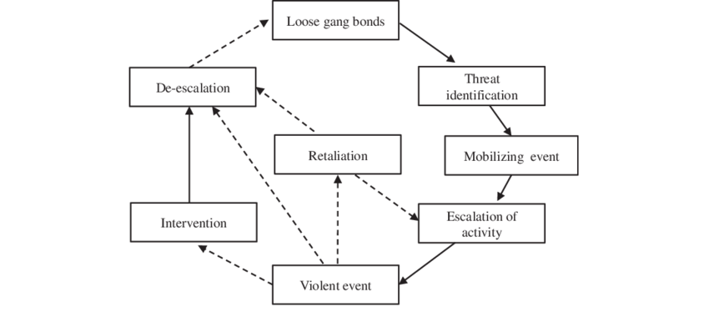
Preventive Resources
Addressing to elevated risk
Family’s strengthening
Community level supervision
Training for teachers and parents
Softening of zero-tolerance policy regarding expulsion form school
Awareness
Rehabilitation centers
Notes:
communities must employ multiple strategies and services, including:
Addressing elevated risk factors for joining a gang.
Strengthening families.
Reducing youth’s conflicts.
Improving community-level supervision of youth.
Providing training for teachers on how to manage disruptive students.
Providing training for parents of disruptive and delinquent youth.
Reviewing and softening school “zero tolerance” policies to reduce suspensions and expulsions.
Ensuring that punitive sanctions target delinquent gang behaviors, not gang apparel, signs, and symbols.
Providing tutoring for students who are performing poorly in school.
Increasing adult supervision of students after school.
Providing interpersonal skills training to students to help resolve conflicts.
Providing a center for youth recreation and referrals for services.
Providing gang awareness training for school personnel, parents, and students.
Teaching students that gangs can be dangerous.
Providing training for school resource officers in mediating conflicts.
A balance of prevention, intervention, and suppression strategies is important for success in any community.

Slide 9
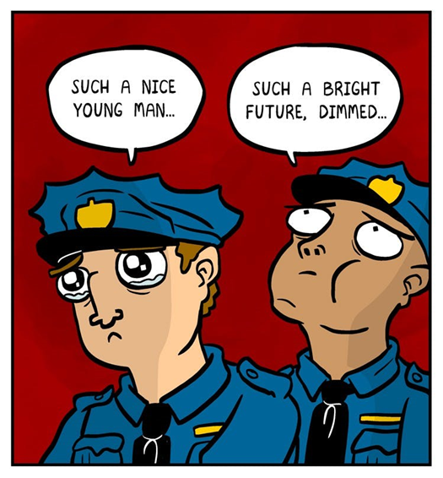
Preventive Policies
Law-enforcement suppression strategies
Intervention programs
Intensive services target
Rehabilitation, either inhibiting the people from joining gangs or creating awareness
Prevention programs
Psychological counseling related to substance abuse
tutoring, and employment training
Melde, Esbensen, & Carson, 2016.
Notes:
Intervention programs and strategies provide sanctions and services for younger youth who are actively involved in gangs to push them away from gangs. Law enforcement suppression strategies and intensive services target and rehabilitate the most violent gangs and older, criminally active gang members. aw enforcement can reduce gang violence by implementing gang prevention strategies that either increase awareness or directly attempt to prevent individuals from joining gangs. Awareness programs are wide in focus and attempt to teach youths the skills to resist peer pressure to join a gang. Gang membership prevention programs are narrower in focus and look to identify youths with risk factors for joining gangs. Police help refer at-risk youths to programs where they are offered psychological and substance abuse counseling, tutoring, and employment training, among other services. Law enforcement can also reduce gang violence by implementing activity regulation strategies that provide alternatives to gang membership and that either prevent or suppress gang activity. Gang alternative programs look to get individuals to leave their gangs, and they provide opportunities to prevent the individual from rejoining the gang. Gang activity prevention strategies focus on specific activities, places, or behaviors associated with gang activity. These strategies typically include special laws, mediation, and situational crime prevention strategies. Gang activity suppression strategies are deterrence-based strategies.

Slide 10
References
Melde, C., Esbensen, F. A., & Carson, D. C. (2016). Gang membership and involvement in violence among US adolescents: A test of construct validity. In Gang transitions and transformations in an international context (pp. 33-50). Springer, Cham.
Pyrooz, D. C., & Sweeten, G. (2015). Gang membership between ages 5 and 17 years in the United States. Journal of Adolescent Health, 56(4), 414-419.

