Slide 1
Common Software Used for Graphic Designing: Current and Future Trends
Presented By: Edward Lopez
Instructor: …………………….

Slide 2
Outline
What is Graphic Designing?
History of Graphic Designing
Graphic Designing Trends
Graphic Designing software
Conclusion
Works Cited

Slide 3
What is Graphic Designing?
Graphic designing is considered as a craft to create visual content for communicating messages.
It can be done by applying the techniques of page layout and visual hierarchy.
The graphic designer utilizes pictures and typography while displaying elements of logic in the interactive designs for optimizing the experience of the user.
Notes:
It is considered as the craft to create visual content for communicating messages. Applying the techniques of page layout and visual hierarchy, the graphic designer utilizes pictures and typography to fulfill the specific requirements of users and also focuses on displaying elements logic in the interactive designs for optimizing the experience of the user. However, this digital age is based on designing through interactive software but graphic designing is still based on the principles of old age. The most important points to consider while designing are that it must strike with the psychology of users which include balance and symmetry, repetition, pattern, flow, typography, thirds rule and the golden ratio

Slide 4
History of Graphic Designing (1/3)
The history of graphic designing started before the printing press, but was properly initiated after printing press invention in 1440.
In 200 BC, Chinese utilized the wood reliefs for the stamp and print design on paper and silk clothes.
In the year 1040 AD, Bi Sheng developed the world's first printing press from porcelain.
In 700 BC, typography initiated and took off when humans began to expand their aesthetic horizons in the form of words and letters themselves.
Notes:
The history of graphic designing covers the entire part of human existence as well as the old graphics designing techniques still inspirational and informational for the present graphic designers. Back in 200 BC, Chinese utilized the wood reliefs for the stamp and print design on paper and silk clothes. In the year 1040, Bi Sheng developed the world's first printing press from porcelain which is a moveable type i.e. almost four-hundred years before Gutenburg brings the same technology in Europe. In the 700s, typography initiated and take off when humans begin to expand their aesthetic horizons in the form of words and letters themselves. As at that time text can be replicated and produced through the hand, the little amount of artistry more valued these books as well as set particular scholars in comparison to other books

Slide 5
History of Graphic Designing (2/3)
In the Islamic culture, typography has double significance as they see figurative art as being sacrilegious, which means typography is the permissible artistic way of expression.
The first logo of the world is utilized in the form of a symbol that presents territories or family houses practices became popular in the time of Crusades.
Latterly, these logos are used for practical purposes as well.
In 1439 Gutenberg completely transformed the culture of graphic designing by bringing the moveable type of mass communication in Europe
Notes:
In the Islamic culture, typography has double significance as they see figurative art in the form of sacrilegious which means typography is the permissible artistic expression way. Technically the first logo of the world arms coat which are utilized in the form of a symbol that presents territories or family houses. In 1439 Gutenberg completely transform the culture of graphic designing through bringing the moveable type of mass communication in Europe. Through this people do not require to base on reproduction of lengthy scholarly books, Gutenberg made the way easier for people this era ushered the techniques of graphic designing.

Slide 6
History of Graphic Designing (3/3)
The graphic designing which is known today, was initiated in the modern era, almost late in the 1800s till the end of World War II.
In 1903, the first graphic design agency came into being which contributed to the business expansion as well.
The ‘Wiener Werkstätte’ is the first visual artists’ organization which consists of architects, graphic designers, and painters.
In 1992, the term Graphic Designing first emerged in the book and designer Addison Dwiggins was the first man who used the term “Graphic Designing” in the visuals book design.
Notes:
The graphic designing which is known today was initiated in the modern era, almost late in the 1800s to World War II end. Although the 19th century is more related to innovations and technological advancement, though the modern era is all about learning and utilizing the techniques which trickle quickly the branding and advertising. In 1903, the first graphic design agency came into being which contributed to the business and design style similar. The ‘Wiener Werkstätte’ is the first visual artists’ organization which consists of architects, graphic designers, and painters. In 1992 the term graphic designing first emerges the book designer Addison Dwiggins was the first man who used the term ‘graphic designing’ which exactly describes his managing and structuring role in the visuals book design.

Slide 7
Graphic Designing: Current And Future Trends (1/3)
3D design and typography
Typography is a technique that is concerned with design elements applied to the letters and text on a printed page.
Spacing and kerning, x-height and vertical proportions along with character variation, width, weight, and contrast are techniques necessary when thinking about the appropriateness of specific typefaces or creating them
Notes:
Three dimensional works seem to be everywhere right now: entire compositions that have so much depth, you can’t help but reach out and touch them. 3D typography especially, feels just about ready to pop. The best part about it is, there’s no particular type that works best for this trend: bold, skinny, sans-serif, script, any font can be rendered in 3D.
Some designs, like Pinch Studio’s vibrant pop art or Issey Miyake’s marriage of textiles and food, merge these two design trends into futuristic landscapes of color, type and form

Slide 8
Graphic Designing: Current And Future Trends (2/3)
Asymmetrical layouts
Asymmetrical layouts are typically dynamic as the designers intentionally ignore balance.
The designer is able to create tension while also convey multiple moods such as anger, joy, etc.
Notes:
The approach of ‘Eclectic’ shifts the designer from rigid layouts towards asymmetrical approaches. The most important trend in 2019 is an open composition that doesn't give framed fines to design. This makes a spark in the design and also brings the audience in imagination

Slide 9
Graphic Designing: Current And Future Trends (3/3)
Modern Mid-Century Modern
This technique comprises of architecture, furniture and graphic designs used in the middle of the 20th century.
Modern Mid-Century Modern graphic design has almost similar aesthetics to flat design.
This can be done by utilizing geometric shapes, bright hues and earthly palettes to create designs.
Notes:
This technique is comprised of architecture, furniture and graphic designs belonging from the middle of the 20th century. Modern Mid-Century Modern graphic design have almost similar aesthetics to flat design. This can be done by utilizing geometric shapes, bright hues and earthly palettes to create designs.

Slide 10
Graphic Designing Software (1/4)
Adobe Photoshop
The Adobe Photoshop Software was released in 1990.
The creation of photo manipulation in graphic designing blends the features of CGI,
illustration, and photography.
MTV was the first organization that brings the new technique of logo usage.
The design professionals’ standard industry is Adobe Creative Cloud.
Its depth and range in its tool Suit cannot be rivaled through any other organization.
It gives access to Illustrator, Photoshop, After Effects, InDesign and various more.
Notes:
In 1990, the software Adobe Photoshop is released for the first time and it completely changed the graphic design face. The creation of photo manipulation formed an entirely new category in graphic designing which blends the features of CGI, illustration, and photography. At the same time, it also changed the branding nature to fulfill the needs of changing times. MTV was the first organization that brings the new technique of logo usage.
The design professionals’ standard industry is Adobe Creative Cloud, its depth and range in its tool Suit cannot be rivalled by any other organization.
Though it gives access to Illustrator, Photoshop, After Effects, InDesign and various more.

Slide 11
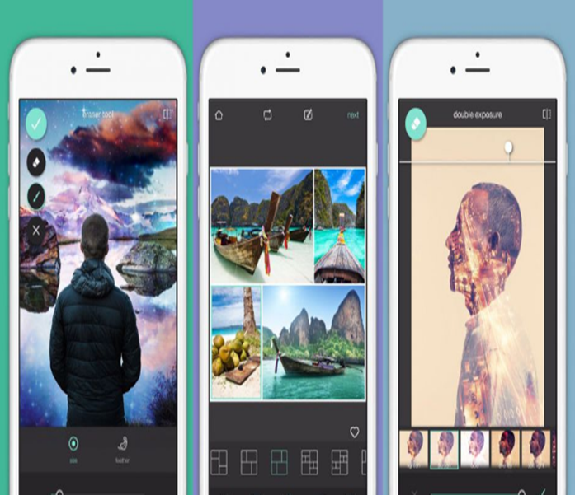
Graphic Designing Software (2/4)
Pixlr
The alternative of ‘Photoshop’ is ‘Pixlr’ designed for
non-professionals.
The photo editors’ set, is based on clouds and consist of few of the
advanced tools which include removal of red-eye, teeth whitening and
cropping.
This software application is suitable for both Android and iOS and can be utilized
as a desktop application on tablets and smartphones.
It can also be utilized in the form of a web app.
Its layout is also similar to Photoshop, the software Pixlr is very easy to use if the person is already familiar with Adobe Software.
Notes:
Pixlr is the alternative of ‘Photoshop’ and is designed for non-professionals. The photo editors’ set, is based on clouds and consist of few of the advanced tools which include removal of red-eye, teeth whitening and cropping. This software application is suitable for both Android and iOS and can be utilized as a desktop application on tablets and smartphones. It can also be utilized in the form of a web app. Its layout is also similar to Photoshop, the software Pixlr is very easy to use if the person is already familiar with Adobe Software.

Slide 12
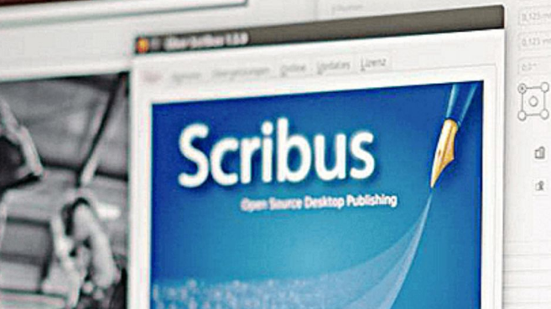
Graphic Designing Software (3/4)
Scribus
It is the alternative of ‘InDesign’ because of its zero price tag and reliability.
This professional program of page layout is appropriate for Linux, Mac
and Windows operating systems.
Its features consist of spot colors, CMYK colors as well as the creation of versatile PDF.
This software also supports the tools of vector drawing. ‘
Notes:
Scribus is alternative of ‘InDesign’ because of its zero price tag and reliability. . This professional program of page layout is appropriate for Linux, Mac and Windows operating systems. Its features consist of spot colors, CMYK colors as well as the creation of versatile PDF. This software also supports the tools of vector drawing. ‘DaVinci Resolve' is the alternative for 'Premiere Pro' which is an efficient tool for video editing. This tool is used in big-budget TV productions and films. Although, it is the free package that could run at any operating software Mac, Linux, and Windows.

Slide 13
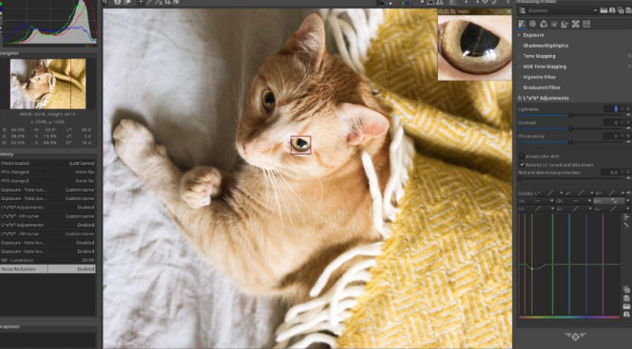
Graphic Designing Software (4/4)
RawTherapee
It is the alternative of ‘Light-room’
This software can be used for editing the photo files which are raw
and also of other formats.
With the extensive range of editing tools, the designer can get the ability
to boost colors, correct distortion as well as recover the details.
It allows its users to modify photos as desired.
Notes:
‘RawTherapee’ is the alternative of ‘Lightroom’ as the name suggests this software can be used for editing the photo files which are raw and also the other formats. With the extensive range of editing tools, the person can get the ability to boost colors, correct distortion as well as recover the details. Although they are not the basic abilities because of their advanced options, the RawTherapee allow their users that they can modify their photos until they look exactly as desired. ‘Inkscape’ is the alternative of ‘Illustrator’ which focused on the format of SVG, it is supported through advanced features which are unable to find anywhere which consist of markers, alpha blending and cloned objects.

Slide 14
Conclusion
Graphic designing is continuously enhancing but its core would always remain the same which is creativity.
The top trends of graphic designing includes 3D designs.
In current trends, flat design and realism are more concentrated as the mixture of both made the design appear in 3D.
The approach of ‘Eclectic’, this trend shifts the designer from rigid layouts towards asymmetrical approaches.

Slide 15
Works Cited
6 Amazing Free Adobe CC Alternatives | Creative Bloq. https://www.creativebloq.com/features/6-amazing-free-adobe-cc-alternatives. Accessed 13 Nov. 2019.
A Brief History of Graphic Design - 99designs. https://99designs.com/blog/design-history-movements/history-graphic-design/. Accessed 13 Nov. 2019.
Top 5 Graphic Design Trends of 2019 | Adobe Blog. https://theblog.adobe.com/top-5-graphic-design-trends-of-2019/. Accessed 13 Nov. 2019.
Trends in Graphic Design Technology You Need to Know about - 99designs. https://99designs.com/blog/trends/graphic-design-technology-trends/. Accessed 13 Nov. 2019.
Visual Representation | The Encyclopedia of Human-Computer Interaction, 2nd Ed. https://www.interaction-design.org/literature/book/the-encyclopedia-of-human-computer-interaction-2nd-ed/visual-representation. Accessed 13 Nov. 2019.
What Is Graphic Design? | Interaction Design Foundation. https://www.interaction-design.org/literature/topics/graphic-design. Accessed 13 Nov. 2019.

