Slide 1
Global Warming and its Impact on Climate Changes
Supervisor – Dr.
(Group Members)

Slide 2
Presentation Outline :
Background
Introduction
Scope of Study
Objectives of Study
Methodology
Results and Discussion
Effective Strategies
Conclusion

Slide 3
Background
In the last hundred years, global warming caused
Rise of 0.9 degree Celsius
rise of 60% of GHGs
Rise of Carbon Dioxide from 290ppm to 430ppm
Rise of sea levels about 2 meters which are approximately 6.6 feet.
Causes of climate change and global warming;
Burning of fossil fuels, such as gas, oil, and coal,
Clearing of forests,
Chemical activities,
Agricultural practices
Notes:
The rise of 0.9 degree Celsius has observed between 1880 and 2015. 2016 is considered as the third hottest year as it broke all records of rising temperature. When comparing the emission of GHGs since 1990, a rise of 60% can be observed, and thus the concentration of carbon dioxide has risen from 290ppm to 430ppm between 1990 and 2014.
The primary sources of emission of GHG to the atmosphere are burning of fossil fuels, such as gas, oil, and coal, and thus clearing of forests, chemical activities, and agricultural practices are considered as catalytic activities for changing the climate all across the world. Specifically, fuel consumption for heat as well as electricity production generated more than 25% of the total GHG emission.
To control the changing climate, it is essential to look into human activities which are causing emission of harmful gases to the atmosphere. Nearly 200 nations have acknowledged international agreements and joint statements that some human activities are contributing to the emission of GHGs as well as global climate change. When concerned about scientists, almost 97% of them agree that some human activities are causing climate change, and thus working as a catalyst to rising temperature and polluted atmosphere. However, remaining 3% are of the view that human beings have nothing to do with the climate instead it is solar cycles or volcanic activity which are a contribution to the rise in temperature and change in climate. Thus, there starts a little debate about the reality of climate change and global warming all across the world.

Slide 4
Introduction
Climate change is affecting the sea level through;
Melting the ice fields
Increasing the warmness of oceans
Climate change is affecting the rainfall patterns
Precipitation is becoming more intense but less frequent
California, 2015 was recorded as the driest year.
Climate change is causing reduction in crop yields
East African countries faced a 30% reduction due to below-average rainfall between 2010 and 2016.

Slide 5
Introduction (Cont..)
Climate change has brought political instability worldwide
Examples: the Somalian Civil war and Syrian civil war
Climate change is increasing health issues
In 2003, approx 70,000 people died due to European hot wave
Causing excel to lives lost due to heart and lung diseases
Climate change is affecting the wildlife and ecosystems
Example: coral bleaching event in Queensland
Notes:
impact of climate change in details then rising sea levels, changing weather patterns, pressure on water and food, political and security risks, human health and risks, and impact on wildlife and ecosystems become very prominent.
The increasing temperature is melting the ice fields and increasing the warmness of oceans, causing expansion and rise in the sea levels.
climate change is affecting the evaporation patterns due to which the precipitation is becoming more intense but less frequent. It is also causing a shift of rainfall patterns across the world. In California, 2015 was recorded as the driest year,
whereas Kenya, Somalia, and other East African countries faced a 30% reduction in crop yields due to below-average rainfall between 2010 and 2016. Food production is highly dependent on water availability.
climate change has brought political instability worldwide. Going back to the nineteenth and twentieth century, the Somalian Civil war and Syrian civil war can also be linked to the famine and drought exacerbated by climate change.
climate change is increasing health issues amongst human beings. The rise in temperature is increasing the death ratio due to heat-related injury. In 2003, approx 70,000 people died due to European hat wave and the similar case was recorded in Russia in 2010. Harvard T. H. Chan School of Public Health, the emission of carbon dioxide and increasing concentration of GHG in the atmosphere is causing excel to lives lost due to heart and lung diseases. Not only human beings but also the wildlife and ecosystems are highly affected by climate change. the climate change caused the coral bleaching event in Queensland, which left an adverse impact on the water species.

Slide 6
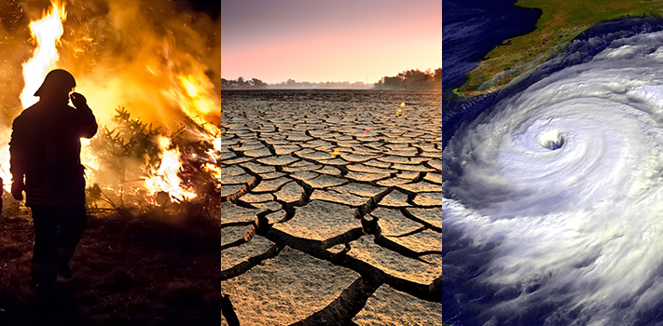

Slide 7
Scope of the Study
The knowledge regarding the impact of global warming on climate is crucial;
To understand its adverse effects on the agriculture, lifestyles, survival of animals, and health of human beings.
To develop new strategies in order to control activities causing global warming

Slide 8
Objectives
To analyze how global warming is affecting the climates worldwide, and how Australia is being affected by such changes.

Slide 9
METHODOLOGY
Meta-Analysis
Collected published data
Analyse
Quantitative Meta-analysis Methdology
Analyzed already published data and reports to evaluate how the climate change has affected the world in last hundred years

Slide 10
Results & Discussion
Climate change has affected;
Temperature
Sea levels
Hurricanes
Floods
Water availability
Healthcare and lifestyle
Wildlife
Notes:
climate has affected the sea levels, Hurricanes, floods, water availability, healthcare and lifestyle, and wildlife in an adverse way. Due to melting glaciers, the sea level has risen from 7 to 23 inches. Increasing temperature has affected the plants' growth and thus the hurricanes and storms are becoming stronger. Also, due to affected plants, the growth of trees, rainfall, and glaciers the floods and droughts have become more common. The figure below shows how the temperature has changed in between 1850 and 2012 and how it is expected to be changed till 2100, all across the world.

Slide 11
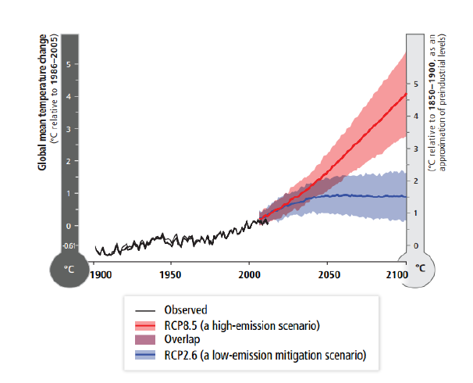
Results & Discussion (Cont..)
The figure shows how the temperature has changed in between 1850 and 2012 and how it is expected to be changed till 2100, all across the world.

Slide 12
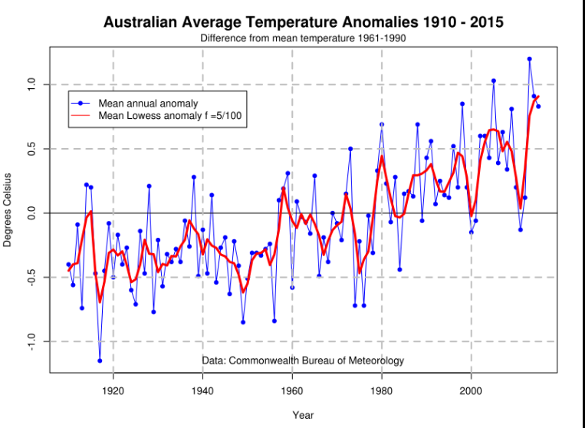
Results & Discussion (Cont..)
Specifically, when concerned to discuss how climate change has affected Australia, then figure shows how the temperature is rising in the last 100 years;

Slide 13
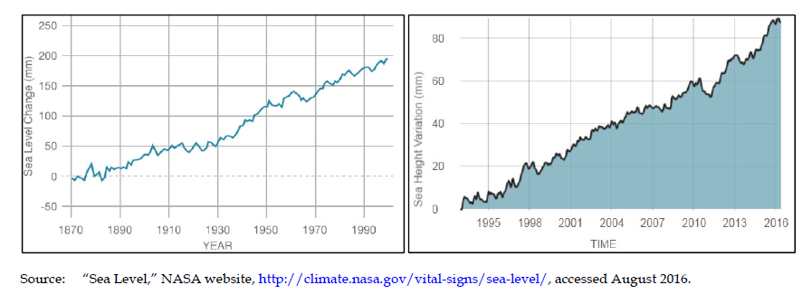
Results & Discussion (Cont..)
When comparing the sea level from 1870 to the sea level in 2000, it becomes clear that the rise in temperature as well as global warming is highly affecting the sea levels all across the world.

Slide 14
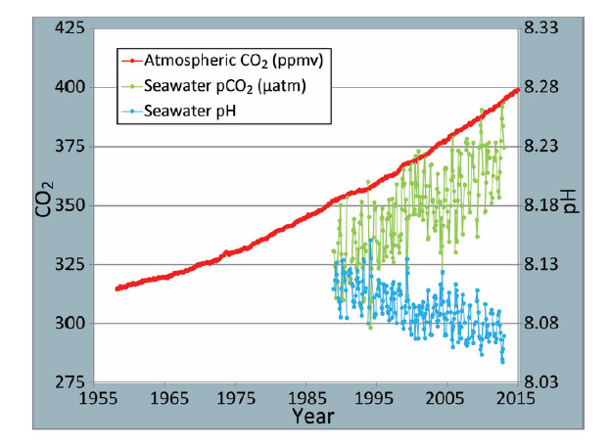
Results & Discussion (Cont..)
The human activities are the real contributor to climate change, as the production of heat and electricity, industrial reactions, agricultural practices, and fuel consumption by vehicles are causing great emission of carbon dioxide.

Slide 15
Strategies
Use Hybrid and Electric Cars
Reduce use of fossil fuels
Replacement of fuels with solar sources
Promote usage of renewable resources
Plastic must be banned
Avoid burning forests
Avoid use of agricultural chemicals

Slide 16
Conclusion
The analysis of the last hundred years revealed that
increasing carbon dioxide and other gases in the atmosphere is found due to unhealthy human activities such as use of fossil fuels, and other carbon emission objects. Thus, with the use of effective strategies, such as electric motors and solar energies, a considerable change can be observed in the climate change.

Slide 17
References
(AWEA), A. W. (2011). AWEA U.S. Wind Industry Annual Market Report. Washington, D.C: American Wind Energy Association.
Ahmed, M. N., & Schmitz, M. (2011). Economic assessment of the impact of climate change on the agriculture of Pakistan. Bus. Econ. Horiz, 4(1), 12.
Anderegg, W., Prall, J. W., Harold, J., & Schneider, S. (2010). Expert credibility in Climate Change. Froceedings of the National Academy of Sciences of the United States of America, 12107.
Bank, T. W. (2012). World Bank Health Nutrition and Population Statistics. . Retrieved 2018, from http://databank.worldbank.org/data/home.aspx
Epstein, P. R., Buonocore, J. J., Eckerle, K., Hendry, M., III, B. M., Heinberg, R., . . . Reinhart, N. L. (2017). Full cost accounting for the life cycle of coal. Annals of the new York Academy of Sciences, 1219(1), 73-98.
Gordon, K. (2014). Risky Business: The economic risks of climate change in the United States. The Risky Business Project, 4.
Greenfieldboyce, N. (January 18, 2017). 2016 was the hottest year yet, scientists declare. Retrieved from http://www.npr.org/sections/thetwo-way/2017/01/18/510405739/2016-was-the-hottest-year-yet-scientists-declare
Karl, T. R., Melillo, J. M., & Peterson, T. C. (2014). Climate Change Impacts in the United States. Retrieved from https://downloads.globalchange.gov/usimpacts/pdfs/climate-impacts-report.pdf

Slide 18
References
Kerry, J. F. (2015). Remarks by Secretary Kerry on climate change and National Security. Retrieved from http://www.state.gov/secretary/remarks/2015/11/249393.htm
Peterson, T. C., Hoerling, M. P., Stott, P. A., & Herring, S. C. (2013). Explaining Extreme events of 2012 from a climate perspective. Bulletin o fthe American Meterological Society, 94(9), 45.
Policymakers, S. o. (2014). In: Climate Change 2014, Mitigation of Climate Change. Retrieved from https://www.ipcc.ch/pdf/assessment-report/ar5/wg3/ipcc_wg3_ar5_summary-for-policymakers.pdf
Quere, C. L. (2013). The global carbon budget 1959-2011. Earth System Science Data 5.1, 165-185.
Trochim, W. M. (2016). Research Methodology. Research methods Knowledge Based.
Wheeler, T., & Braun, J. V. (2013). Climate change impacts on global food security. Science, 341, 508–513.

Slide 19
Any Question???

