Slide 1
PowerPoint

Slide 2
Betty Neumann's Theory
It explains the correlation between a person and stress along with the reconstitution factors and a person’s reaction to the stress
In the current practice, the theory is used for
Rehabilitation and public health
Family therapy
Reducing gap between nurses and patients (Parker, 1990)

Slide 3
Betty Neuman’s Theory
Three Positive patients outcomes
Patients become psychological strong
Patients get engaged to developmental needs
Patients can maintain their energy level
Three Benefits to nursing satisfaction
Nursing knowledge increases
Efficient assessment can be made
Productive plan can be developed (Parker, 1990)

Slide 4
Betty Neuman’s Theory
Two Barriers
Prevention only consider family and group; however, nurses can eliminate this barrier by including other people in the process
Specific factors are considered that increase stress but nurses can keep space for unknown factors for a better result (Parker, 1990)

Slide 5
Imogene King’s Theory
It explains the interpersonal relationship and dynamics use to get specific life goals by individuals
In the current practice, theory is used
In clinical practice
To develop evidence based practice
To use three dimensional nursing practice
Three Positive patients outcomes
They achieve goals through nurse-patient partnership
Number of hospitalization days decrease
Positive family interaction increases
(Nursing Theories, 2011)

Slide 6
Imogene King’s Theory
Three Benefits to nursing satisfaction
Nurses become able to use various other theories based on this theory
Partnership with patient increases to improve life quality
With patient satisfaction, nurses’ satisfaction is also achieved
Two Barriers
Lack of application development for a group but nurses can engage families to achieve the goal and to ignore this barrier
Nurses and patients are assumed strangers, but this barrier can be omitted by family doctor or nurse (Nursing Theories, 2011)

Slide 7
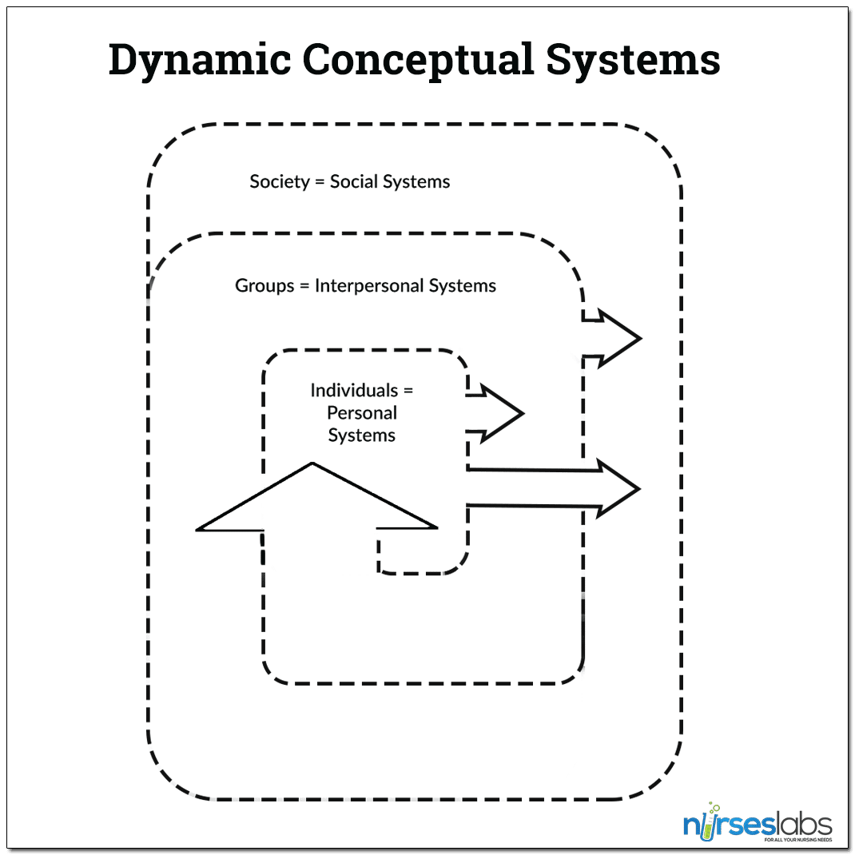
Betty Neuman's & Imogene King’s Theory

Slide 8
Roger’s Science of Unitary Theory
It explains nursing as a combination of both art and science because it provides insight for viewing the unitary human being
In the current practice, theory is used for
Identifying human field motion
Noticing human sleeping pattern
Indicating rhythmic development
Three Positive patients outcomes
They understand own energy field
They become more anxious towards self care
They build trust-power relationship
(Malinski, 2018)

Slide 9
Roger’s Science of Unitary Theory
Three Benefits to nursing satisfaction
They get job satisfaction
Scientific nursing knowledge increases
They can improve their own personal trust-power relationship
Two Barriers
Concept is difficult but more research can eliminate this barrier
No proper evaluation instruments but nurses can use various other theories along with this to cope with the issue (Malinski, 2018)

Slide 10
Johnson’s Theory
It explains the behavioral system of the individuals that are consist of 7 subsystems
In the current practice, the theory is used for
Understanding patient relationship with environment
Stimulation for patient growth
To increase professional nursing practice
Three Positive patients outcomes
They can get effective assistance
They can prevent illness
They achieve quality improvement in health
(Parker, 1990)

Slide 11
Johnson’s Theory
Three Benefits to nursing satisfaction
They can become efficient professionals
They become confident while making care plans
Nurses’ commitment to a job can be achieved
Two Barriers
It is individual oriented but nurses can use coworker’s experience to eliminate this barrier
Nurses cannot work with physical impaired patients but additional measures can omit this barrier (Parker, 1990)

Slide 12
Roger’s Science of Unitary & Johnson’s Theory

Slide 13
Peplau Phases
It defines the four phases that identify the interpersonal relation crucial to gain well-being and health of the patient
In the current practice, theory is used for
Facilitating patient by analyzing phases
Increasing bond between patient and nurse
Increasing competency in nursing training
Three Positive patients outcomes
Patients understand the need for health
They also adjust to the hospital environment
They show positive response to the caregivers (Nursing Theories, 2011)

Slide 14
Peplau Phases
Three Benefits to nursing satisfaction
They can guide patients easily
Communication gap reduces
Respect and courtesy increases
Two Barriers
Fewer personal space but it can be eliminated by bringing professionalism
Cannot use on unconscious patients but it can be used by analyzing their recovery pattern (Nursing Theories, 2011)

Slide 15
Henderson’s Theory
It explains the patient’s needs to gain progress during hospitalization through nurse assistance
In the current practice, theory is used for
Analyzing sleep-rest pattern of patients
For modifying patient’s environment
To protect patients
Three Positive patients outcomes
They remain well groomed in hospital
They can maintain desirable postures
They can follow the adjusted routine (Parker, 1990)

Slide 16
Henderson’s Theory
Three Benefits to nursing satisfaction
They can understand the requirement of the patients
They can improve their practices
They can be efficient while making plans for patients
Two Barriers
Patient background is crucial but it can be known through family members
Nurses should have enough knowledge that can be obtained through educational programs (Parker, 1990)

Slide 17
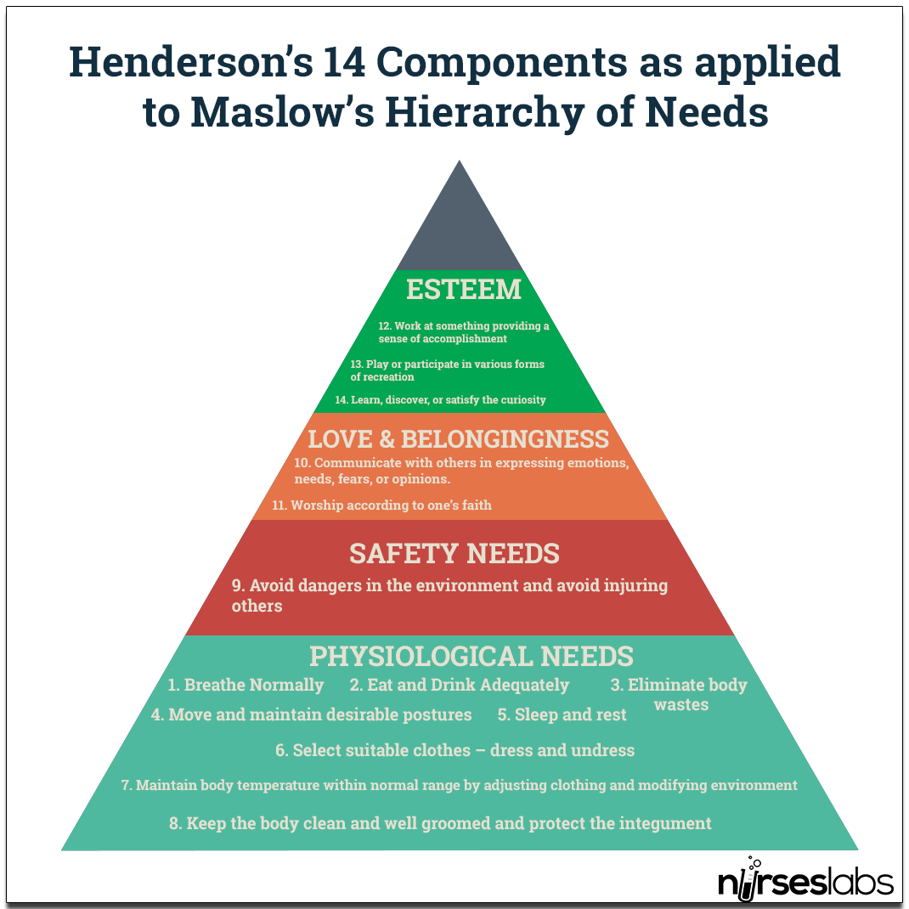
Peplau Phases & Henderson’s Theory

Slide 18
References
Malinski, V. (2018). The Importance of a Nursing Theoretical Framework for Nursing Practice: Rogers’ Science of Unitary Human Beings and Barrett’s Theory of Knowing Participation in Change as Exemplars. Cultura Del Cuidado, 15(2), 6–13. https://doi.org/10.18041/1794-5232/cultrua.2018v15n2.5108
Nursing Theories: The Base for Professional Nursing Practice, 6/e. (2011). Pearson Education India.
Parker, M. E. (1990). Nursing Theories in Practice. Jones & Bartlett Learning.

