Slide 1
The McDonaldization of Society
Resisting McDonaldization

Slide 2
Your Class
Your group members’ names

Slide 3
McDonaldization in Food Production
Modern food production is affecting the health of massive population in America.
Today, industrial agriculture is dominating majority of American farmland (Ritzer,2004).
Resulting in chemically intensive food production on a massive scale in large animal production and single-crop production facilities ("Mcdonaldization: A Primer | Soc 205“, 2019).
Notes:
This presentation examines modern food production and its consequences, and of how food production on a mass scale negatively affects health in the United States. The majority of American farmland today is dominated by industrial agriculture featuring chemically intensive food production in large single-crop farms and animal production facilities. Modern food processing has grown into a large industry with revenue of hundreds of billions of dollars. The effects of industrial agriculture and the food processing industry on the environment and public health have raised concerns over the decades.

Slide 4
Reasons of the popularity of McDonaldization
Easy to prepare
Long-lasting
Massive production
Less investment
Heavy profit
Notes:
What exists now is a food industrial complex, which focuses on efficiency, high volume production, and profitability.
Modern food processing has grown into a large industry with revenue of hundreds of billions of dollars.

Slide 5
How is it unhealthy and harmful?
Extreme amount of fats
Massive Use of Preservatives
Use of too much sugar
Offsetting good foods
Digestive issues
Empty calories.
Notes:
Many citizens, students, and policymakers are simply unaware of the inner workings of the food-industrial complex, along with the dangers inherent in factory farms and other sites of production within this economic sector. 35% of adults’ daily energy intake (kilojoules) comes from junk food.
41% of children’s daily energy intake (kilojoules) comes from junk food.
This means junk food is taking the place of other more nutritious foods in our diets.

Slide 6
Why people are falling for McDonaldization?
Easily available
Fun to eat
Visually appealing
Taste and preference
Status
Trend
Peer pressure
Notes:
Fast food is popular because the food is inexpensive, convenient, and tastes good. However, fast food is often made with cheaper ingredients such as high fat meat, refined grains, and added sugar and fats, instead of nutritious ingredients such as lean meats, whole grains, fresh fruits, and vegetables. Fast food is also high in sodium (aka salt) which is used as a preservative and makes food more flavorful and satisfying. Junk food is lurking in vending machines and convenience stores. Even establishments that don't typically sell food items might have snacks and sodas near the cash register. They're easy to prepare, and you can stockpile them in your kitchen cabinet for a long time. Because junk foods are easy to find, easy to make, and a lot of them just flat out taste good, consuming them becomes a habit. That's the real problem.

Slide 7
Effect on human body
Diabetes
Blood pressure
Obesity
Heart diseases
Harmonic imbalance
Notes:
A study published in 2012 in “The American Journal of Clinical Nutrition” found that regularly consuming high-energy-dense junk food decreases sensory-specific satiety, causing you to eat more of that food. If you overeat consistently, especially junk food, this can lead to weight gain and obesity.
Junk food tends to be high in saturated fat and cholesterol. According to the American Heart Association, saturated fat and cholesterol raise your cholesterol levels, putting you at risk for heart disease and stroke. The excess sodium that's found in most processed food can raise your blood pressure as well as increase the chance that you will develop heart disease.
Your body uses insulin to move blood sugar from digested food into cells, where it is stored until your body needs it. The refined carbohydrates, or added sugars, in junk food cause spikes and then dips in your blood sugar levels. This leads to insulin resistance and hyperglycemia, where sugar doesn’t get stored, but rather stays in your bloodstream. Over time, you can develop Type 2 diabetes, a condition that puts you at risk for a number of other health complications.

Slide 8
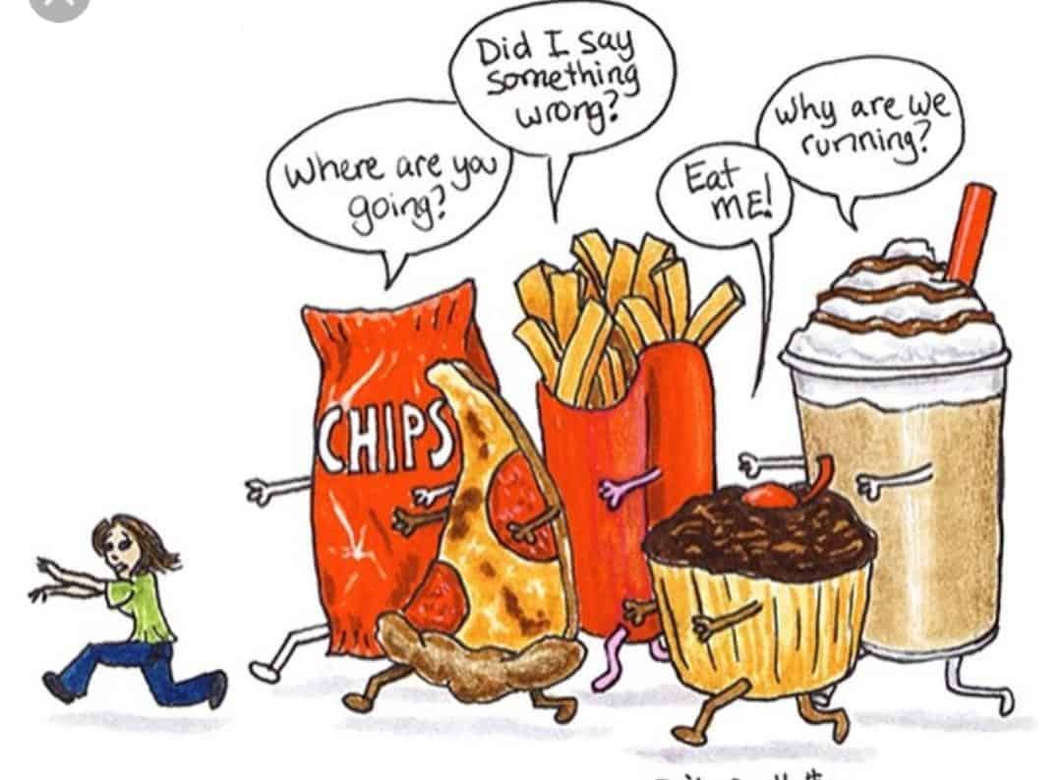
Steps Against McDonaldization
Many organizations are producing food products that are organic.
Concept of being a vegetarian has been increasing lately.
There are different apps, websites, blogs and social media influencers that help and motivate to eat healthy (Us et al., 2019).

Slide 9
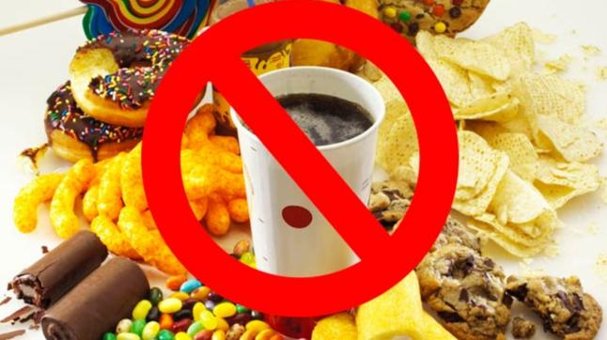
Cont.
Educational institutes have been raising awareness about the harmful affects of McDonaldization.
Doctors’ and therapists’ first recommendation is to take healthy and fresh meal.

Slide 10
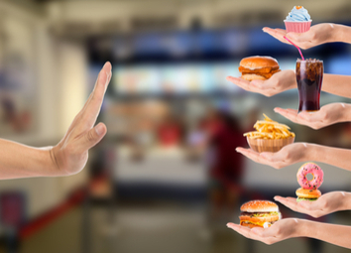
How can we minimize it?
Avoiding as much junk food as we can
Avoiding can-food
Eating fresh and healthy meals
Eating on time
Notes:
Eliminate packaged and processed snack foods from your kitchen and home. Do not purchase junk foods such as chips, crackers, soda, candy, and frozen pizza and pastry snacks. Removing unhealthy but convenient junk food options will help you make better food choices.

Slide 11
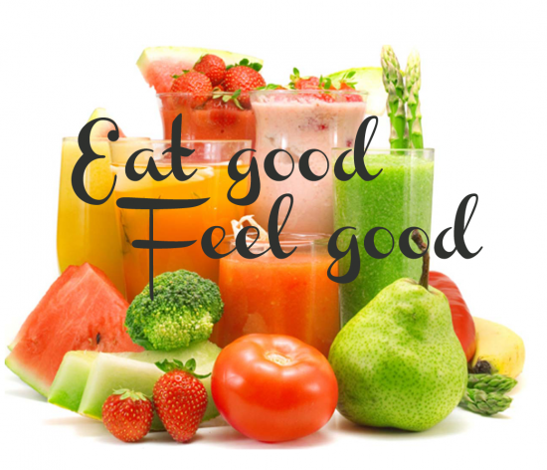
Cont.
Eradicating the use of soft drinks from our lives.
By adding more green vegetables in meals.
Avoid taking too much fats and sweets.
Regularly exercising.
Notes:
Make fresh fruit more appealing to children by serving washed and cut apples, pears, peaches, apricots and other fruits with spreads such as peanut butter and jam. Prepare vegetables such as celery, cucumbers, carrots and bell peppers by slicing them into easy-to-eat fingers; serve with low-fat cream cheese, yogurt, hummus or other dips. Cook healthy alternatives to junk food.

Slide 12
What’s the future of McDonaldization
Sadly, we live in a world today where profit is focused more than anything else. With the growth of industries it seems like McDonaldization will grow too. But will it?

Slide 13
Cont.
Industries are dependent of customers. If the rate of the buyers of specific product drops, it means it is death of that particular industry.
People are now more aware of the dreadful consequences of McDonaldization
If Anti-McDonaldization organizations successfully achieve their goals, McDonaldization’s fall will be not a surprise.

Slide 14
References
"Mcdonaldization: A Primer | Soc 205." People.eou.edu. N.p., 2019. Web. 9 Feb. 2019.
Us, About et al. "How The Food Movement Is Gaining Strength - Food Revolution Network." Food Revolution Network. N.p., 2019. Web. 9 Feb. 2019.
Ritzer, G. (2004). The McDonaldization of society. Newbury Park.

Slide 16
References

