Slide 1
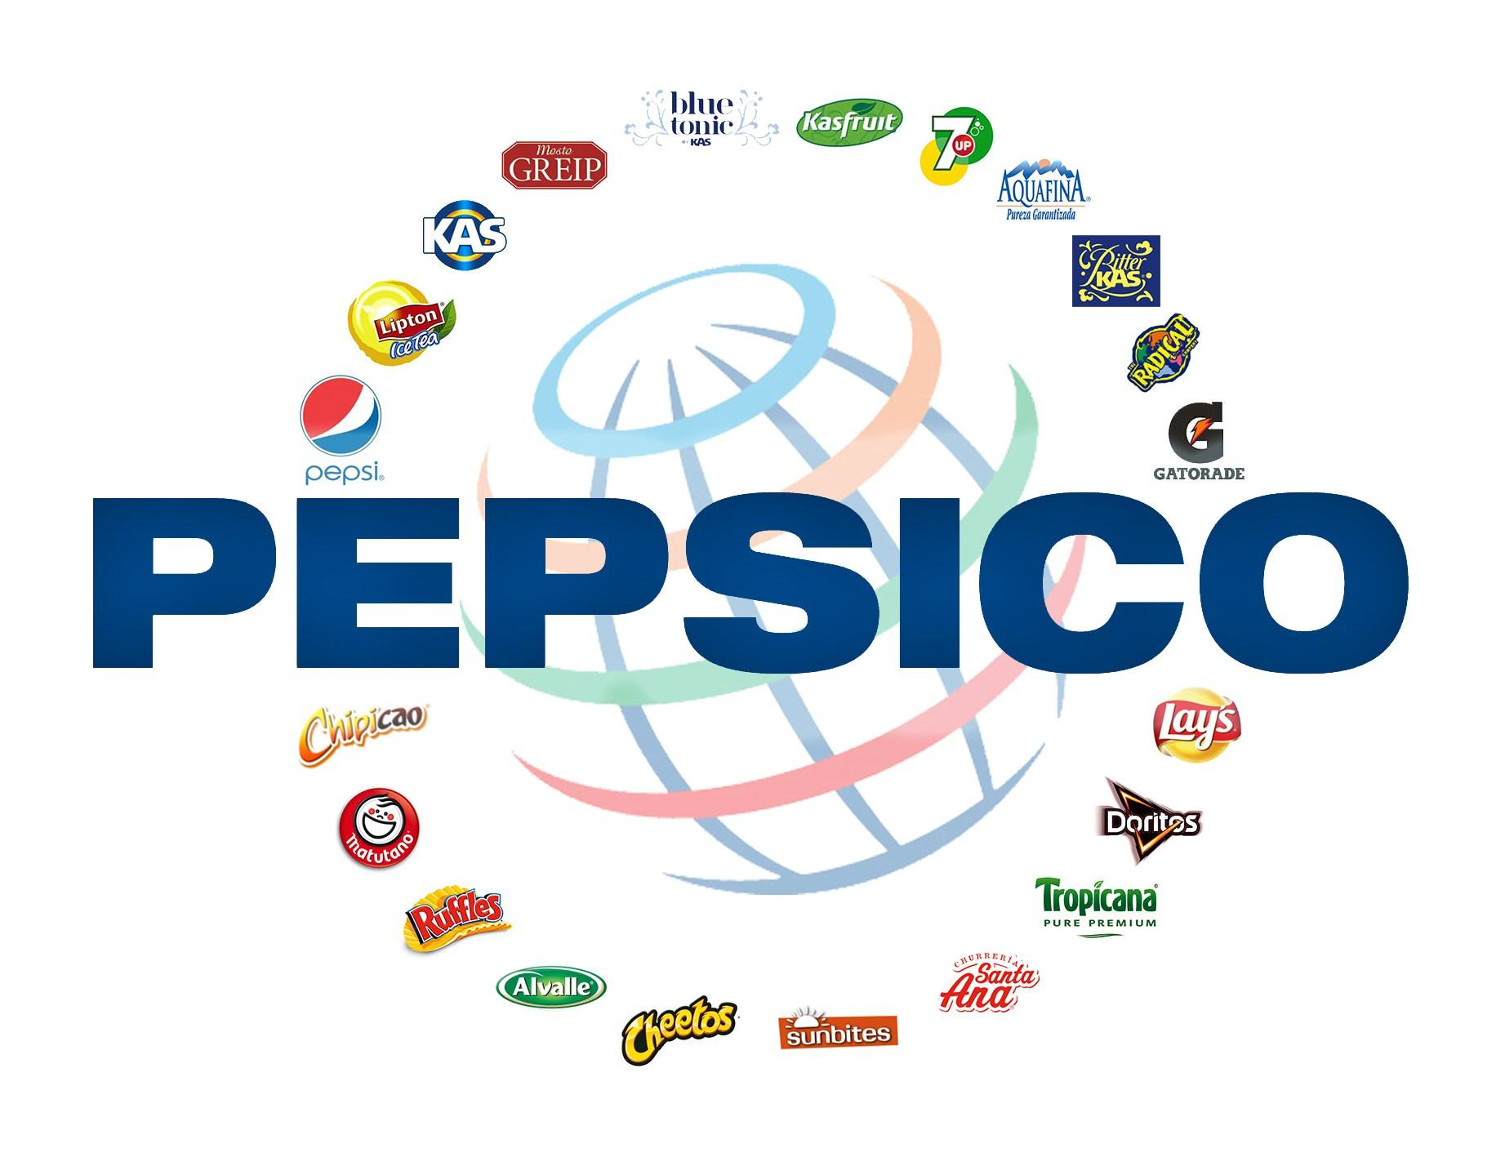
PepsiCo Invention and Innovation
[Name of the writer]

Slide 2
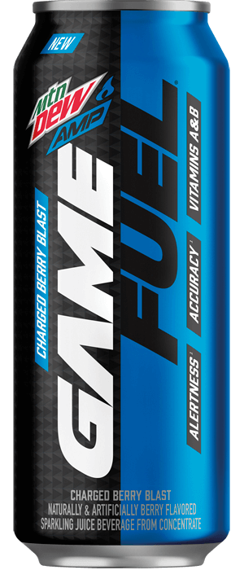
Description of new product
Amp Game Fuel Charged (Berry Blast)
Launched in stores on January, 2019
It is a berry flavored soft drink which is blue in color
It was first introduced on Amazon.com
Especially designed for gamers
Made with real fruit juice
It includes caffeine-boosted formula to provide extra energy
It also includes vitamins A and B
Notes:
Mtn Dew Amp Game Fuel is a new beverage line made just for gamers. The brand is available in 16-ounce cans in four vitamin-charged and caffeine-boosted varieties. It was launched in stores on January, 2019. Mtn Dew Amp Game Fuel cans have a resealable lid that helps keep the beverage cold and fresh longer, and a no-slip grip texture similar to gaming hardware to help prevent spills. It was introduced first on Amazon.com then at Walmart.com for sale. Amp Game Fuel Charged (Berry Blast) is a berry flavored soda, and is blue in color, similar to that of Game Fuel.

Slide 3
Importance of R&D
R&D plays a vital role in the success of a business
It helps to bring innovation into the business
It provides help in dealing with the competition in the market
It also provide a business a competitive edge over its competitors
The aim of R&D is to discover new products
Create new knowledge about scientific and technological topics
Increases the productivity
It is a process that also make improvements in existing products
Notes:
R&D embodies a long-term vision of a company and its strategy when innovation operates more in a short-term economic model of the company. Implementing and managing R&D activities within your business offers tremendous advantages for your company. Innovation is a key today to beat the competition and R&D helps to bring innovation into the business. Many times a market is already embracing a trend, and the research and development department can be used to make the business active in that trend and increase sales. The research and development department works to make new product designs or add features, and the marketing department interprets these changes in the most exciting light possible in order to attract customers, creating synergies between the two branches.

Slide 4
Discussion of structure and culture
Culture and structure are very important to support innovation
Culture helps to establish rules of doing business
A proper structure is very important for innovation and productivity
Risk taking
Fast decision making
Avoiding conflicts
Motivate intrapreneurs
Think like a Venture Capitalist
Notes:
Culture and structure plays a very important to support innovation. Many companies want to establish a culture of innovation, one that will encourage employees to take risks that lead to breakthrough products. It is very important to take risks to brought innovation in business. Team coordination is also very important factor which helps organization to achieve its goals (Timkastelle.org, 2015). Intrapreneurs are the persons in big organizations who are having entrepreneurial mindset and can brought productivity and innovation in the business. Venture capitalists tend to focus on big ideas that make the risk worth taking. You should do the same. When you hear a new idea, ask if it can make a significant difference. If not, hand it to someone in operations; it’s still a good idea, but you’re looking for the next big thing.

Slide 5
Future Inventions
Amp Game Fuel Charged (Berry Blast) is a very innovative product
It has allowed to introduced PepsiCo in the world of gameplay
It include ingredients which are different from other beverages of PepsiCo
It also include a resealable lid which makes it more innovative
It is also different from other soft drinks because it contains zero fats
It is the first drink which is specially created for gamers
It has become very successful in the united states
Notes:
Amp Game Fuel Charged (Berry Blast) is a very innovative product. MTN DEW AMP GAME FUEL is giving gamers access to some of the biggest events, leagues and esports teams, starting with its new Call of Duty World League sponsorship (Prnewswire.com, 2019). New to the lineup is Amp Game Fuel, specifically designed to serve the vast world of high-stakes endurance gaming. The 16 oz cans feature a no-slip grip that “mirrors the sensory design of accessories and hardware in gaming,”​ according to PepsiCo. The cans also have a re-sealable lid designed by Xolution. It’s easier to open and allows for more uninterrupted game play. Amp Game Fuel will be stocked with energy drinks at the grocery store and will come in four flavors: Charged Cherry Burst, Charged Berry Blast, Charged Tropical Strike and Charged Original DEW.

Slide 6
Future Predictions
In future Amp game fuel charged will become more successful
It is innovative because there is no drink currently in the market which is designed for gamers
It is also considered as energy drink because it includes several vitamins and caffeine
It is different from other beverages so product demand will increase in future
It is planning to partnership with big entities
Notes:
Mountain Dew is partnering with Call of Duty World League, OpTic Gaming and others to promote the new drink at upcoming gaming and esports events. Brandon Snow, chief revenue officer of Activision Blizzard Esports Leagues, said "Mtn Dew Amp Game Fuel shares our vision for growing the audience for esports, and will help us deliver unique experiences for fans at each Call of Duty World League event this season, as well as help create exceptional content for viewers online”. Brandon Snow, chief revenue officer of Activision Blizzard Esports Leagues, said. “Call of Duty World League looks forward to working closely with the Mtn Dew Amp Game Fuel team to develop the most exciting season in Call of Duty World League history”. It is designed with ingredients that show an improvement in accuracy and alertness, the drink is vitamin-charged, provides a boost of caffeine and was designed for gamers by gamers (Forbes.com, 2019).

Slide 7
References
Mountain Dew's New 'Game Fuel' Drink Has A Seriously Interesting Can. (2019). Forbes.com. Retrieved from https://www.forbes.com/sites/mitchwallace/2018/12/05/mountain-dews-new-game-fuel-drink-has-a-seriously-interesting-can/#339946152377
Innovation and Organizational Culture. (2015). Tim Kastelle. Retrieved from http://timkastelle.org/blog/2015/02/innovation-and-organizational-culture/
MTN DEW® AMP® GAME FUEL® Unlocks A New Level Of Gaming With First Drink Made By Gamers, For Gamers. (2019). Prnewswire.com. Retrieved from https://www.prnewswire.com/news-releases/mtn-dew-amp-game-fuel-unlocks-a-new-level-of-gaming-with-first-drink-made-by-gamers-for-gamers-300761295.html

