Slide 1
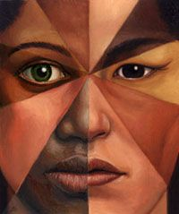
Ethnicity issues in diversity

Slide 2
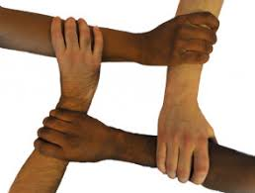
Introduction
At places where people live, study or work together, diversity is found commonly.
Diversity comes with many ethnicity issues that separate people from each other on the basis of their race, skin color, culture or nationality.
Ethnic diversity refers to a collective presence of people belonging to different identities and backgrounds (Shangani et al, 2019).
Issues of ethnic diversity point towards issue in community members that highlight their conflicts due to their specific characteristics linked with their origin and race.
Notes:
People are discriminated on the basis of race, religion, color, nationality and culture etc. and becomes the root cause of many issues.

Slide 3
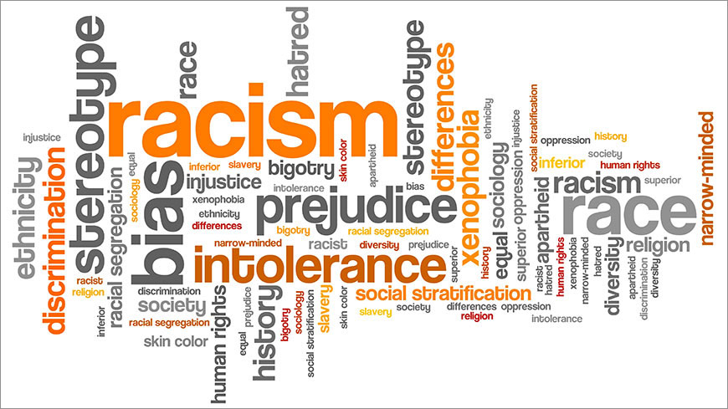
Key issues
Following are the ethnicity issues of diversity:
Discrimination
Prejudice
Stereotyping
Racism
Bias
Notes:
There arise many issues when people from diverse groups live, study or work together. These issues include discrimination and racism etc.

Slide 4
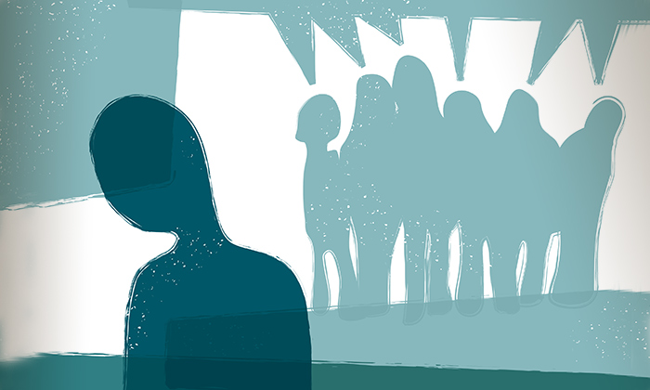
Discrimination
People are discriminated on the basis of characteristics that make them different from the rest. People are unjustly treated on the grounds of race, skin color, nationality or culture. For example, in the USA, Caucasians are preferred over African-Americans at the workplace.
Prejudice
It is an affective feeling for people of one’s own ethnic group based on a person’s perceived group membership. It is the holding of negative beliefs, attitudes or opinions simply because they belong to a specific ethnic group (Major et al, 2019).
Notes:
People belonging to majority or same ethnic group support or favor each other violating the rights of minorities.

Slide 5
Stereotyping
Mistreating people on the basis of over-generalized belief about a particular category of people. Category could be of race, color, religion, nationality or culture etc. For example, believing all colored people living outside America are financially weak.
Racism
People believe that their race is superior discriminate and discourage others. For example, ‘black people’ on the basis of their race, face many issues in diverse environments and are considered inferior, predetermined by their inborn characteristics.
Notes:
Race and skin color has become the most common base due to which people are treated badly.

Slide 6
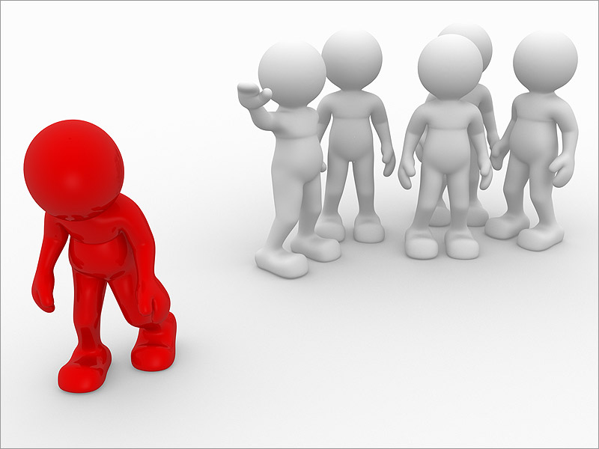
Bias
People of a different ethnic group are favored or discouraged on the basis of their ethnic identity. For example, a ‘white’ employer would always show bias attitude for supporting ‘white people’.
Lack of opportunities
Ethnic diversity forces prejudiced employers for not offering opportunities and jobs to people of another particular racial backgrounds. For example, if the employers is ‘black’, he would offer more growth opportunities to ‘black’ people.
Notes:
People of the same ethnic group support their own people without considering whether they are right or wrong and this bias attitude leads towards frustration and violence.

Slide 7
Solution for resolving this issue of ethnicity in diversity
Following are the solutions that could be used for mitigating the issues of ethnicity in a diverse group:
Promote equality
Encouraging people to have a healthy and positive relationship with each other
Train them morally and ethically (Hegde et al, 2019).
Promote human rights
Feedback from people.
Notes:
Different ways are present, to resolve issues of ethnicity at places where people belong to diverse backgrounds

Slide 8
References
Hegde, N. (2019). ACM Sigmetrics Performance Evaluation Review: A New Series on Diversity. ACM SIGMETRICS Performance Evaluation Review, 46(1), 139-139.
Shangani, S., Gamarel, K. E., Ogunbajo, A., Cai, J., & Operario, D. (2019). Intersectional minority stress disparities among sexual minority adults in the USA: the role of race/ethnicity and socioeconomic status. Culture, health & sexuality, 1-15.
Major, A. (2019). Inclusive Learning for Liberal Arts Education: The Case of Landmark College, USA. In Doing Liberal Arts Education (pp. 121-134). Springer, Singapore.

