Slide 1
Literature in Africa and Caribbean

Slide 2
Summary
Literature of a country presents traditional, social, political and intellectual perspective of native people.
Both oral and written literature in Africa flourished with the advancement of time.
Writer of both types of literature depicted life of Africans. Main concepts discussed by these writers are orality, novel, poem, proverb, black consciousness and anthology etc.
In Africa, both African and non-African literature flourished.
In this chapter, it could be seen, African writers not only attracted native readers but also influenced the foreign readers.
Notes:
African literature is rich with both oral and written work of various African writers who are depicting traditions and process of change in African culture.

Slide 3
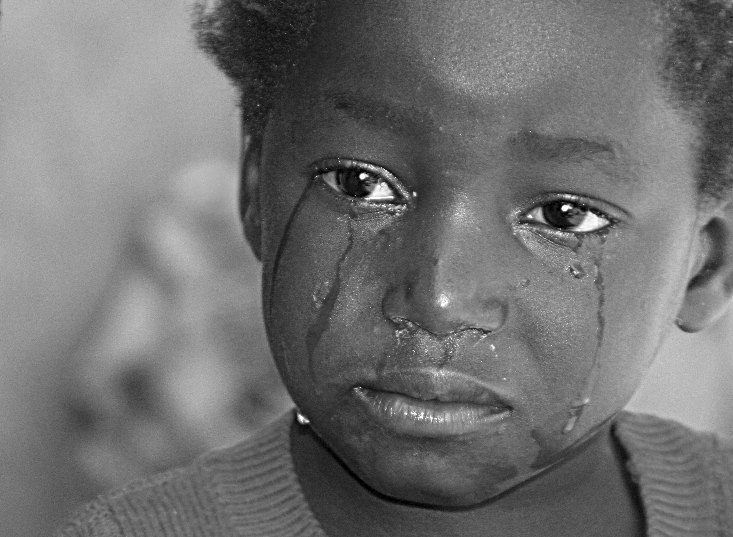
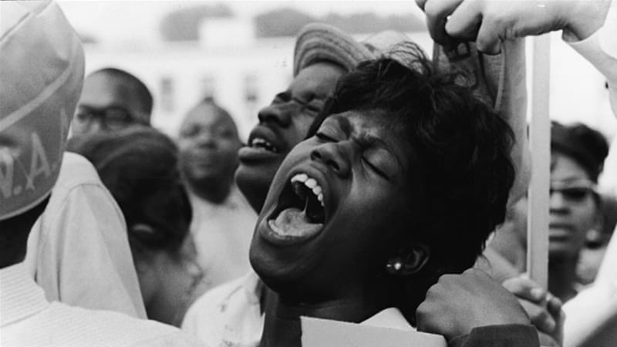
How has the African writer reflected the realities of the community over the centuries?
African writers have pointed towards many realities of the community that they noticed over centuries.
Intellectual change
More social and political awareness in 1970s was one of the basic reality reflected by the African writer.
A little later in 1973s, writers reflected common issues and realities of life (Desai,et,al,2005).
Notes:
Primarily, focus of writers was social and political change, but later they started considering common issues of Africans as their main subject.

Slide 4
Compare and contrast African oral literature and written literature on the continent.
There is a difference between written and oral African literature:
It was a traditional way of passing knowledge from one to another generation.
Mainly used by elderly people.
Depended on memory.
It was used as primary way of teaching that has been used for centuries.
Lack of proper institutions was compensated by orality.
In western Africa, oral literature was in the form of live art and performer has to performance side by side.
Oral literature was more about traditional stories and moral teachings.
Oral literature used to give identity to the poet or artist.
Notes:
African oral literature is quite different from written literature.

Slide 5
Written literature could be transferred sooner than the oral literature.
Changes are difficult in written literature.
There are less chances of error in written African literature when transferred to other.
Written literature was more about social and political issues.
Depended on printing press and other related sources.
Notes:
Written literature is one of the modern form of conveying knowledge.

Slide 6
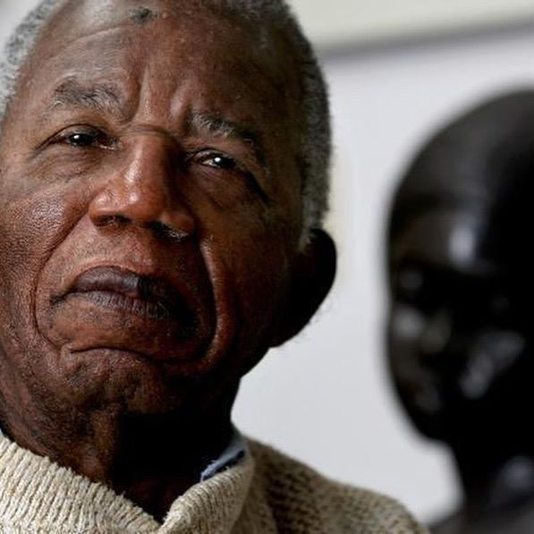
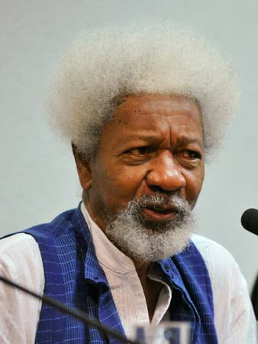
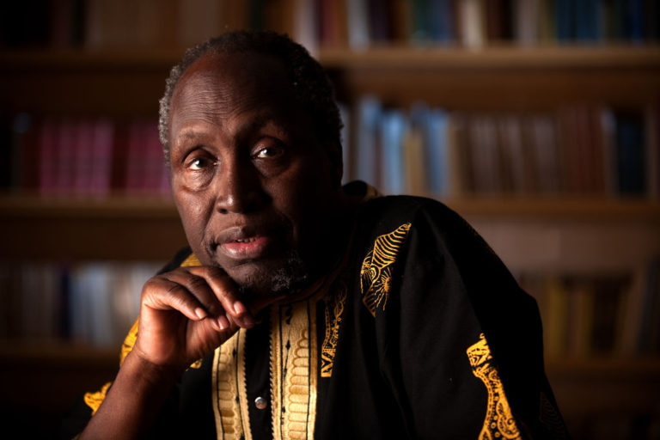
Do research on three Africa writers who write in English and French and outline their major themes from 1960s to the present
Following are the African writers who wrote in both English and French.
Avi kwei Armah,
Wole Soyinka
Ngugi wa Thiong’o
Notes:
There are various African writers who wrote in English and other languages as well.

Slide 7
Themes
All these three writers who wrote in both English and French depicted many themes from 1960s till present.
These writers discussed the themes of promise and also at present, they reflected theme of disappointment, period in which they were writing.
Notes:
Different African writers used different themes in their writings.

Slide 8
References:
Desai, Gaurav Gajanan. "The Cambridge History of African and Caribbean Literature." Research in African Literatures36.3 (2005): 158-159.

