Slide 1
Tourism
Hotel management

Slide 2
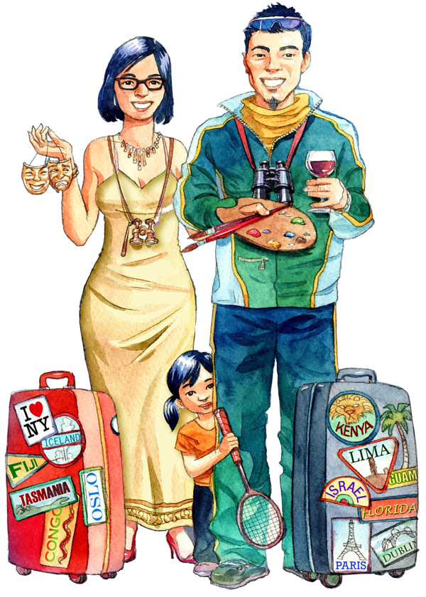
Introduction to Tourism
An ever-thriving industry
People want to experience something new
Communities
Cultures
Chinese tourism: The largest tourism market
Tourism reshaped according to their requirements

Slide 3
Introduction to Tourism
Travelers believe in luxury during travel
Want to unplug from all the stress
Staycations are a hot trend

Slide 4
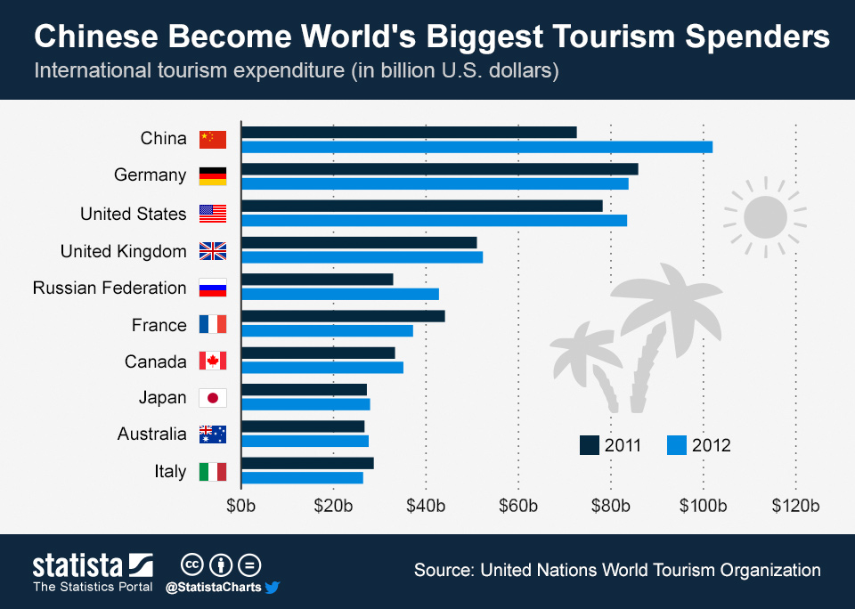
Increasing Strength of Chinese Tourism
Chinese tourism market: a big contributor to economy
The biggest tourism industry in the world
Increasing in both outbound and inbound dimensions
Chinese making their way to international sights
Millions of Chinese travel each year with family and friends
(McCarthy, 2013)

Slide 5
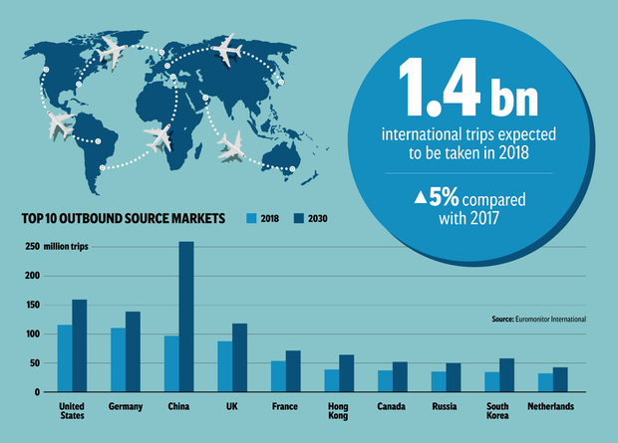
Increasing Strength of Chinese Tourism (Cont.)
Known to spend the most per trip
Growth of Chinese tourism is 5.4% annually
Europe and South-East Asia are the most popular destinations
Current trends suggest US and Australia will join the list as well
The Chinese travel even through language barrier
(Anon., n.d.)

Slide 6
Increasing Strength of Chinese Tourism (Cont.)
Food is the main source of attraction
Destination points for tourists are increasing (Fang, et al., 2016)
Ever increasing demand for more vacation spots
Culinary spots
Lodging
Entertainment

Slide 7
Traveler's Unplug
Traveler’s tendency to disconnect from the world
Ditching technology to escape busy life
Travel companies capitalizing on this concept
Making trips cell-phone free
Unplugged traveling is the new major trend

Slide 8
Traveler's Unplug
Travel agencies utilizing emergency phones without data
Resorts providing tech detox programs for guests
Involving guests into other activities
Boating
Rafting
Skiing

Slide 9
Traveler's Unplug
Destinations removing wi-fi
Slow travelers are encouraged at many places
Such guests tend to stay more and enjoy sight seeing (Tribe & Liburd, n.d.)
Process still in the experimental stages

Slide 10
Staycations
Staycations: Holiday close to home
Combination of words “stay” and “vacation”
People take a day visit to entertainment locations
No overnight trips
More relaxing than long vacations (Bloom, et al., 2016)

Slide 11
Staycations
Considered actual breaks from stressful life
Staycations allow families to get together
Having conversation
Preparing food
Spend fun time
Redesigning home for a more desirable environment

Slide 12
Staycations
Staycation changing the tourism sector
More focus being given to local spots
Things that promote staycations
Time
Financial situation
Travel facilities
Community trends
Many more

Slide 13
Conclusion
People reshaping tourism
Chinese travel the farthest and spend the most money
Unplugging during travel is the latest trend
Staycations are also an option

Slide 14
References
Anon., n.d. Visitor boom: Trends predict China will become the largest source of outbound tourism by 2030. [Online] Available at: https://travelwirenews.com/visitor-boom-trends-predict-china-will-become-the-largest- source-of-outbound-tourism-by-2030-1265181/
Bloom, J. d. et al., 2016. Holiday travel, staycations, and subjective well-being. Journal of Sustainable Tourism.
Fang, B., Ye, Q. & Law, R., 2016. Effect of sharing economy on tourism industry employment.
McCarthy, N., 2013. Chinese Become World's Biggest Tourism Spenders. [Online] Available at: https://www.statista.com/chart/1467/chinese-become-worlds-biggest-tourism-spenders/
Tribe, J. & Liburd, J. J., n.d. The tourism knowledge system. Annals of Tourism Research.

