Slide 1
Feminism and Women of Color
Intersectional feminism, despite its current relevance in the global discourse, remains an ideology in need of propagation. I believe that we can achieve remarkable goals on the road to gender equality. However, unless our struggle also uplifts women of color, we are ignoring the most basic tenet of what feminism is.

Slide 2
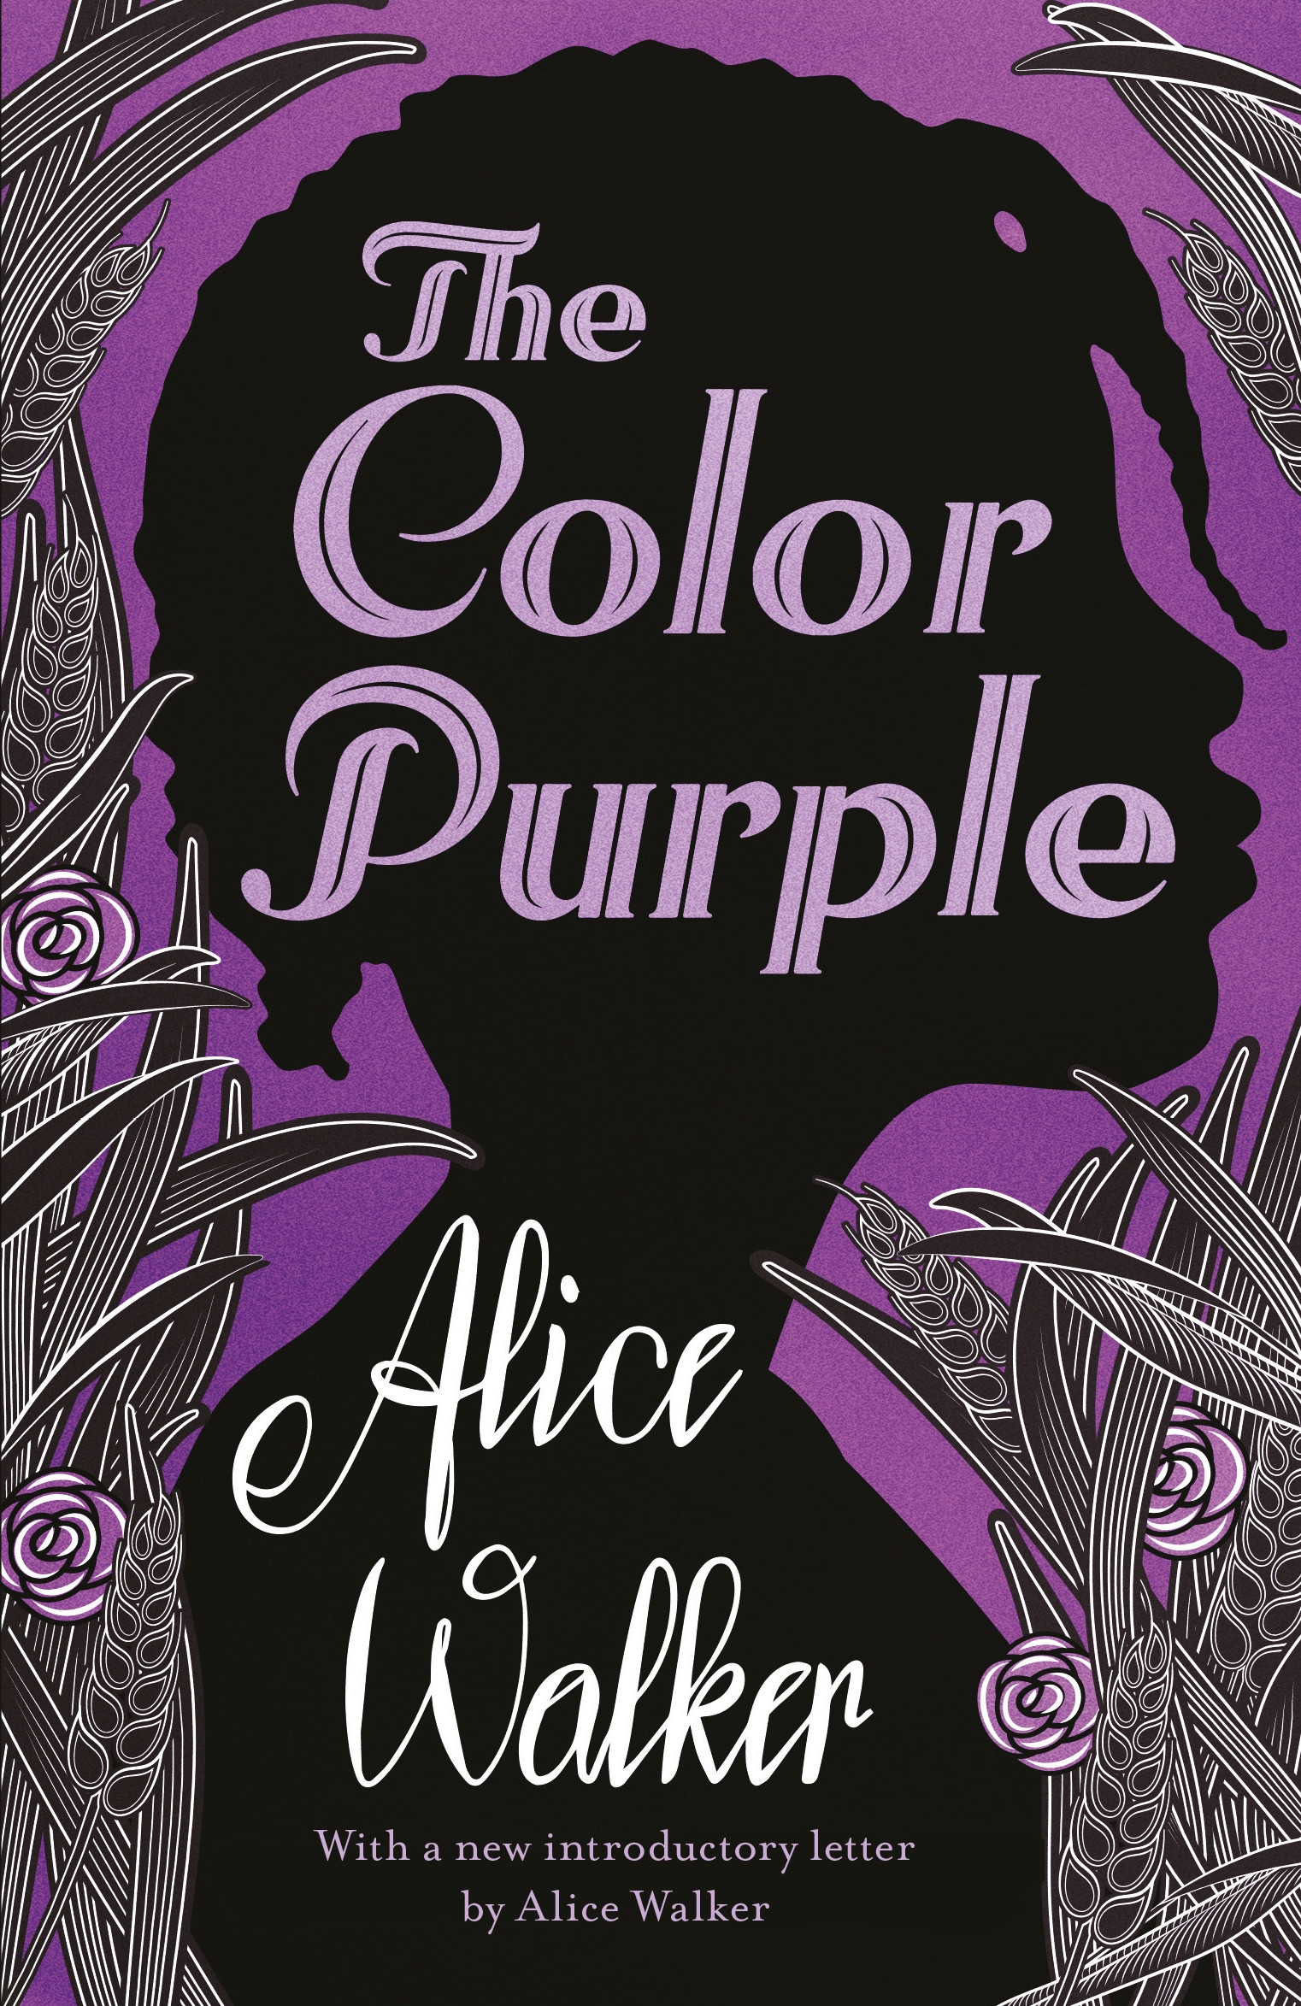
Literature: The Color Purple
The author has meticulously explored the added jeopardy of a black woman as she faces discrimination both for her gender and her race. A Civil Rights campaigner herself, Alice Walker coined the term ‘Womanism’ especially taking into context the struggles, plights and triumphs of women of color. This novel is an ode to the unique realization of what it means to be a black woman.

Slide 3
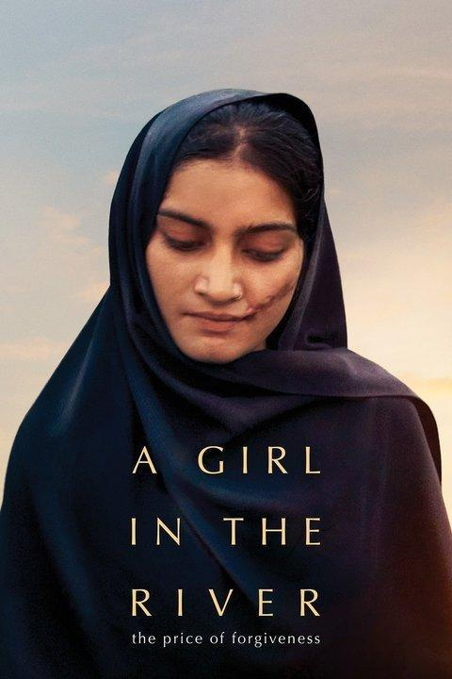
Film: A Girl in the River
This Oscar-winning documentary follows the life of a Pakistani girl who must be murdered by her own family over the accusation of soiling their ‘honor’. Her sole crime was falling in love. Honor killings claim over a thousand lives each year in Pakistan. This film gives the justice and legal system of the country a chance at redemption.

Slide 4
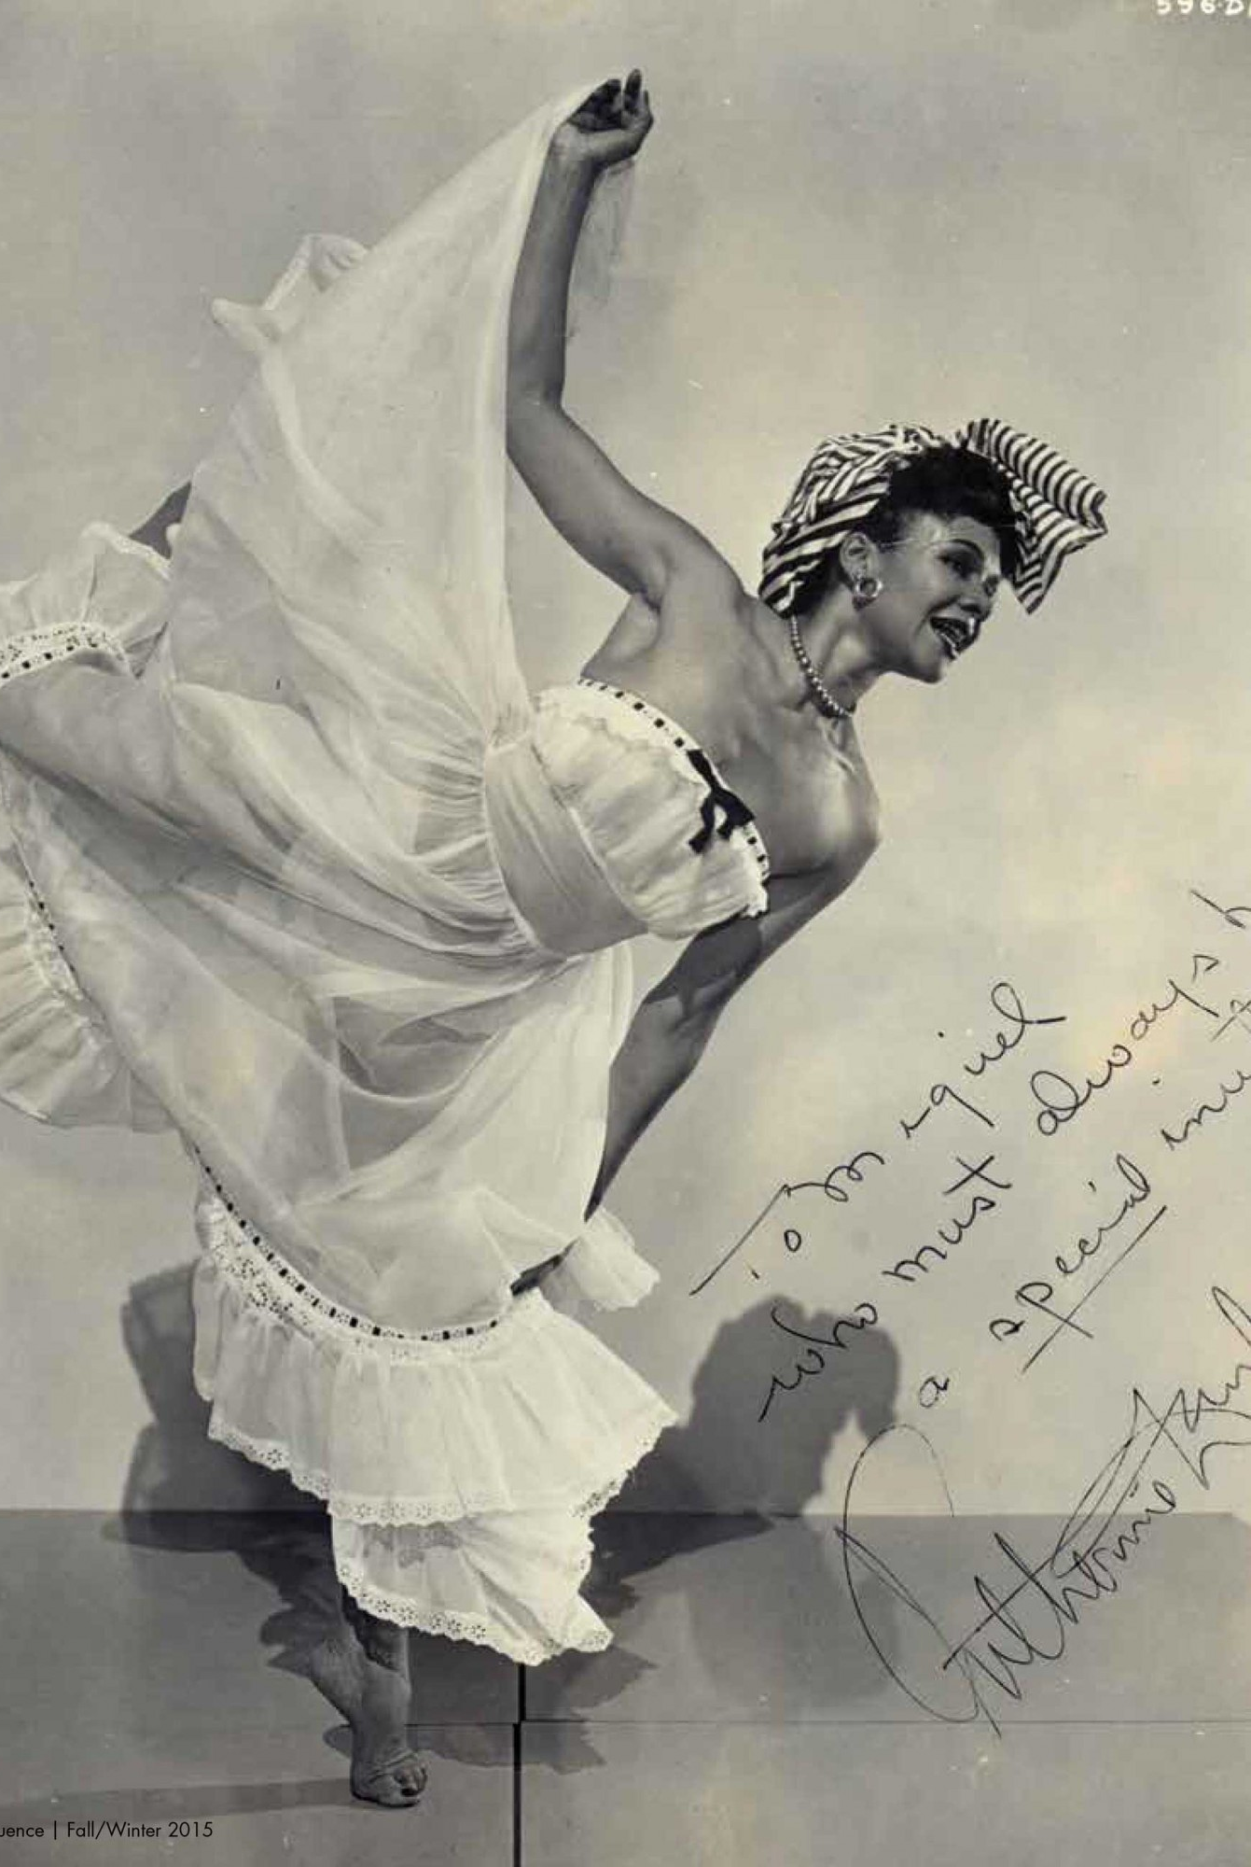
Dance: Katherine Dunham
She rose to fame with dance numbers and rhythms that symbolized the dances of slaves. These specifically memorialized slaves dancing in preparation of uprisings against their masters. Also incorporated in her dance were ballet and modern dance inspirations.

Slide 5
Conclusions
I learned that adding a second lens of race to feminism opens a world of injustices previously overlooked in the sacred fight for gender equality. Movements that fight to right the wrongs of race or gender, both overlook the people caught in the middle i.e. women of color.
The complex issues relating to women of color in various parts of the world are exclusive to their communities and work around those issues therefore needs to find root inside those very communities.
I also learned that relating the struggle of women of color to the struggle of their respective races and/or ethnicities is a legitimate feminist tool in increasing the credibility of the demands and the actions that surround those demands.
I will, therefore, equate feminism with intersectional feminism from now on and urge my fellow feminists and allies to made the inclusion of women of color on feminist platforms a mandatory act of social justice.

Slide 6
References
Harriet, Elizabeth. “The Color Purple by Alice Walker”. Feminist Library, Feminist Library, 30-03-2018, feministlibrary.co.uk/4783-2/. (Literature)
Hassan, Yasmeen. “A Girl in the River's Oscar win gives Pakistan chance to end honour killings”. The Guardian, Guardian News and Media Limited, 04-03-2016, theguardian.com/global-development/2016/mar/04/a-girl-in-the-river-oscar-win-pakistan-end-honour-killings. (Film)
Risner, Vicky J. “Katherine Dunham: A Life in Dance”. Library of Congress, Congress US. loc.gov/item/ihas.200152685/. (Dance)

