Slide 1
The Hagia Sophia in Istanbul, Turkey
Rusik Patel

Slide 2
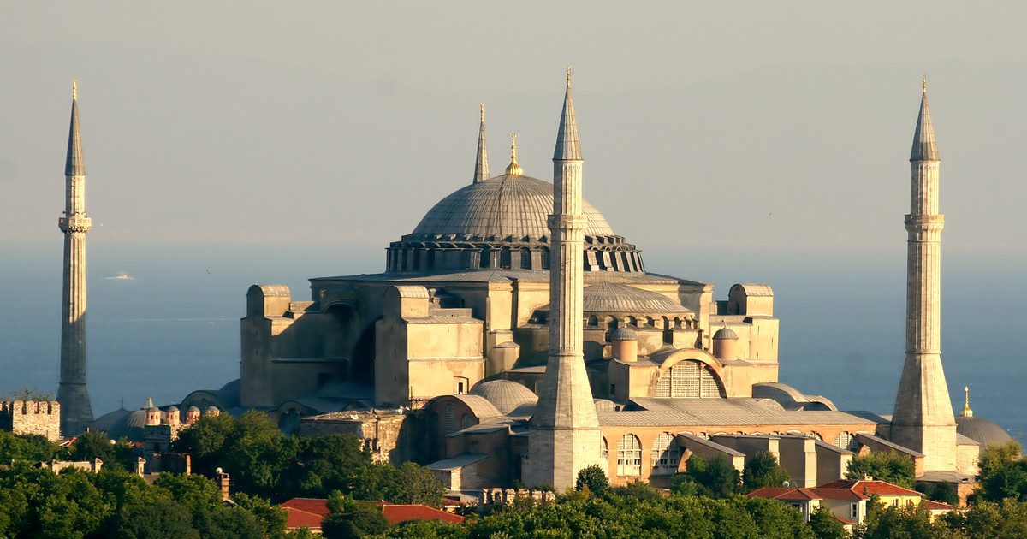
Overview
In Greek, Hagia Sophia means ‘divine wisdom’.
It is a religious building in Istanbul, Turkey.
It was built in 360 AD under the commission of Byzantine Emperor.
Notes:
Hagia Sophia, Turkish Ayasofya, Latin Sancta Sophia, also called Church of the Holy Wisdom or Church of the Divine Wisdom. Hagia Sophia means "Divine Wisdom" in Greek. It was an Orthodox church dedicated to holly wisdom. It was built in the 6th Century (532–537) under the direction of the Byzantine emperor Justinian I.

Slide 3
Cont.
It is called Aya Sofya by the Turkish people.
It is a great example of Byzantine architecture.
It transformed from Byzantine church into Ottoman Mosque.
Notes:
Turkish people call it Aya Sofya. It's a former Byzantine church and former Ottoman mosque, now located in Sultanahmet neighborhood, being one of the most important museums of Istanbul. It has gone through various transformations since its construction. It transformed from Byzantine church into Ottoman mosque and now, it is a museum.

Slide 4
Construction of Hagia Sophia
During ‘Nika riots’, Hagia Sophia was built.
Modern Hagia Sophia was built by emperor Justinian I.
10,000 people worked to complete its construction under two major architects.
Notes:
The first church of Hagia Sophia was built on the same site in the 4th century by Constantine the Great. After its destruction, a second and larger Hagia Sophia was built at the same location in 415 AD by the emperor Theodosius II. This second church was also burned down during the Nika riots of 532 AD (Schibille, 2016).
Finally, the third Hagia Sophia, the one that you can visit today, was built by emperor Justinian I between 532-537 AD over the remains of the previous basilica. The emperor spent almost all of his treasure. 10,000 people worked in its construction under the supervision of two architects; Anthemius of Tralles and Isidorus of Miletos.

Slide 5
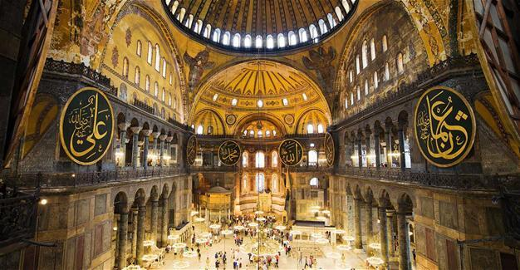
Symbolization of Hagia Sophia
It is a symbol of peace and harmony.
It represents a meeting point of different religions of the world.
It symbolizes a blend between symbols of Islamic art and Christianity.
Notes:
Hagia Sophia is a symbol of harmony, peace and tolerance in Turkey. It is an important symbol in Istanbul because it is a meeting point of the world's religions. The walls of Hagia Sophia represent a blend between Islamic art and symbols of Christianity. Hagia Sophia was a Church, a Mosque, and today it's a museum.

Slide 6
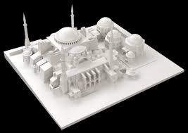
Modeling of Hagia Sophia
Robert Van Nice’s measured drawings were used as a reference for Hagia Sophia modeling.
It is comprised of 46 sheets, bricks, and floor tiles.
Composite materials as well as stone and marble are used for Hagia Sophia.
Notes:
Hagia Sophia was modelled with reference to the measured drawings of Robert Van Nice. It is important to consider that Hagia Sophia contains 46 sheets, floor tiles and bricks. The material composed of Hagia Sophia was stone and marble, as well as the composite material containing mortar and brick in even amount.

Slide 7
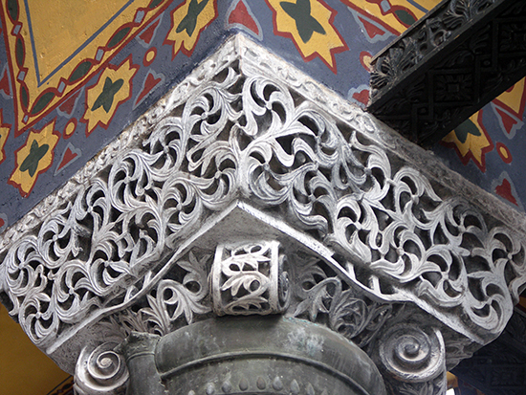
Basket Capital
“Basket Capital” derivate from the Classical ionic order.
The circuit of its lower regions is decorated by the shrunken volutes.
The column capital provides support to the underlying round column.
It demonstrates a filigree work by architectures.
Notes:
The capital is a derivative of the Classical Ionic order via the variations of the Roman composite capital and Byzantine invention. Shrunken volutes appear at the corners. Decorative detailing runs the circuit of lower regions of the capital. The column capital does important work, providing transition from what it supports to the round column beneath. What we see here is decoration that makes the capital appear light, even insubstantial (Schibille, 2016). The whole appears more as filigree work than as robust stone capable of supporting enormous weight to the column.

Slide 8
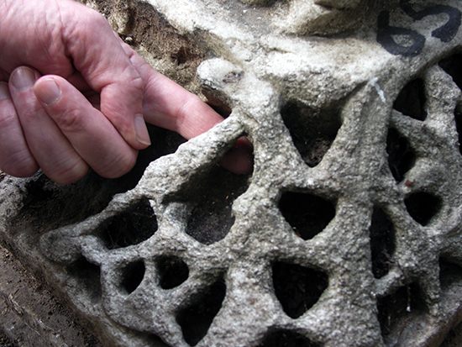
Cont.
The capital fragment demonstrates the carving technique.
Architects and workers carefully drilled its stones to create shadow.
The surface of the capital seems thin.
The technique of deep carving is used in various spandrels, entablatures, and capitals.
Notes:
A capital fragment on the grounds of Hagia Sophia illustrates the carving technique. The stone is deeply drilled, creating shadows behind the vegetative decoration. The capital surface appears thin. The capital contradicts its task rather than expressing it. This deep carving appears throughout Hagia Sophia's capitals, spandrels, and entablatures.

Slide 9
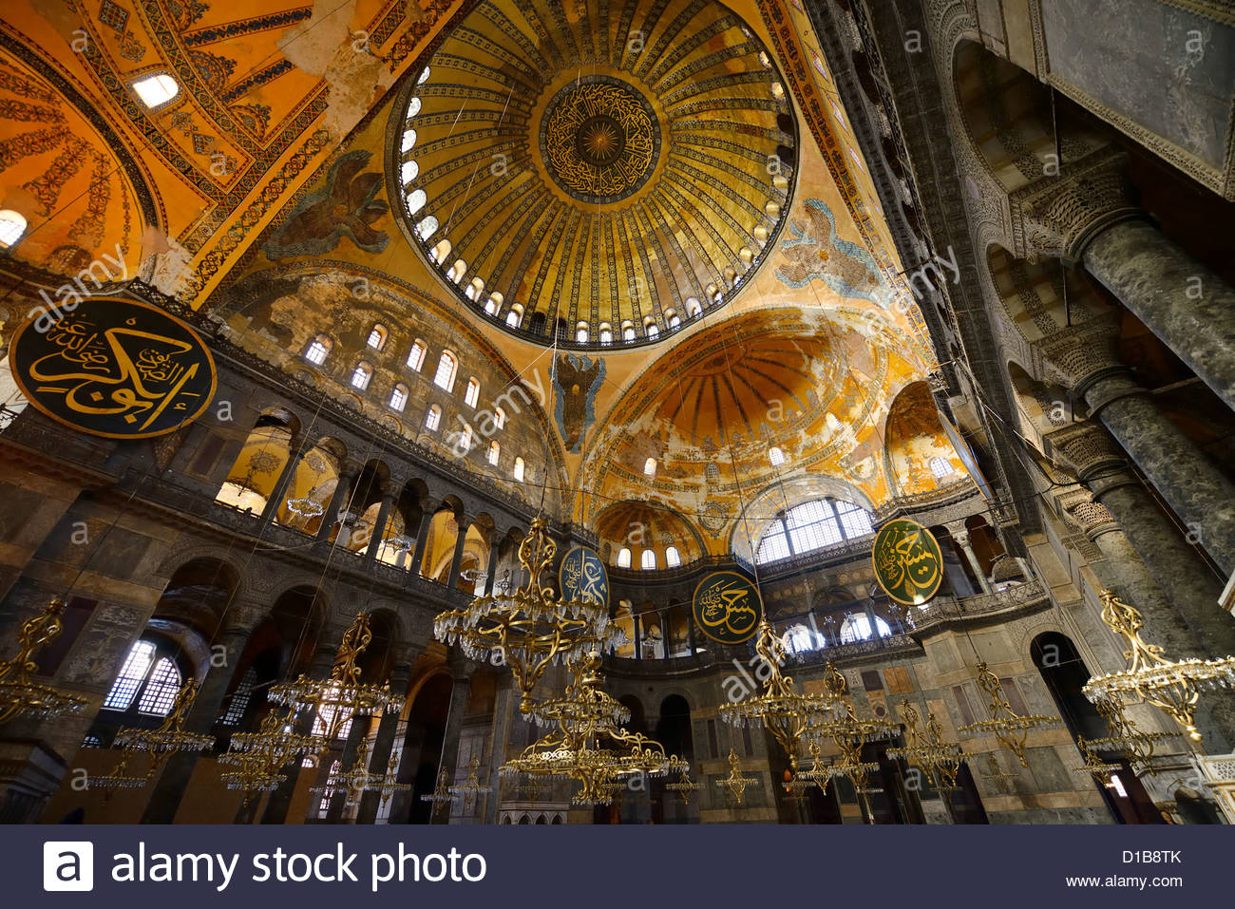
Golden Dome
Hagia Sophia has a huge spherical dome.
At the bottom of the dome, the windows are closely spaced.
Jambs of the window are lined with gold medley.
Notes:
The windows at the bottom of the dome are closely spaced, visually asserting that the base of the dome is insubstantial and hardly touching the building itself. The building planners did more than squeeze the windows together, they also lined the jambs or sides of the windows with gold mosaic. The dome is an amazing piece of art which creates an imagination of a floating dome due to its impressive gold mosaic.

Slide 10
Mortar and Brick
In the construction of dome, mortar and bricks were used.
In the building process, more mortar was used as compared to bricks.
Interior walls were rebuild due to improper construction by builders.
Notes:
The construction was made using brick and mortar as the main materials for the dome. More mortar than brick was used, however, and builders didn't let the mortar dry properly before starting a new layer. That weakened the walls, causing them to lean. When Isidore started the reconstruction, he had to rebuild all the interior walls first to make them vertical and strong enough to support the weight of the new dome.

Slide 11
Square Base
Hagia Sophia is based on Greek cross layout.
The dome is supported by the square base.
The base curves into the dome to provide less tension for the structure.
Notes:
The geometry of Hagia Sophia is based on a Greek cross layout, inscribed in a square box. The area in the center of this cross is the room of the square base that supports the dome. This base isn't actually perfectly straight; it curves into the dome, helping to support it while also allowing the weight to flow downwards and cause less tension on the structure.

Slide 12
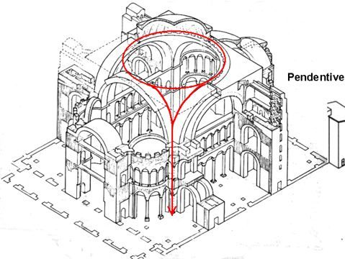
Pendentives for Dome
Architects used pendentives as a constructional improvement.
They served as a structural transition to support the dome.
Notes:
One of the constructive improvements introduced was the use of pendentives. These elements in the form of spherical triangles are a structural transition between the square shape of the base and the round shape of the dome (Schibille, 2016). They help to transfer the loads from the dome, down to the base walls, and finally onto the ground.

Slide 13
Concluding Remarks
Hagia Sophia is an amazing piece of Byzantine architecture.
It is richly and artistically decorated with mosaics and marble pillars.
Notes:
Hagia Sophia is one of the greatest surviving examples of Byzantine architecture. Its great artistic value is its decorated interior with mosaics and marble pillars and coverings. The temple itself is richly and artistically decorated.

Slide 14
References
Schibille, N. (2016). Hagia Sophia and the Byzantine aesthetic experience. Routledge.

