Slide 1
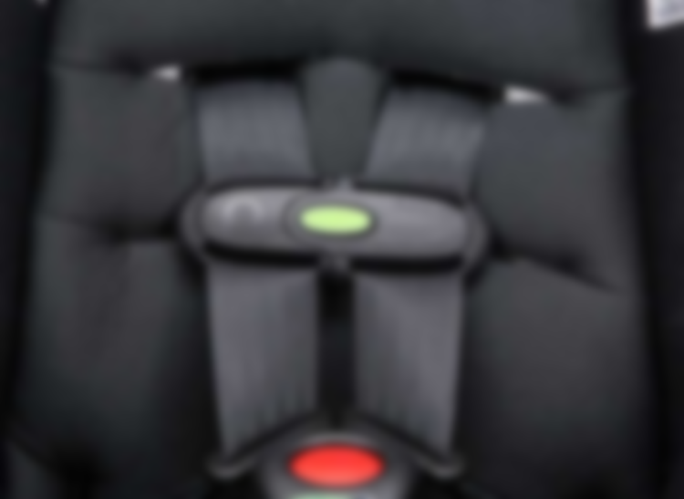
Baby alert
Baby Seat Occupancy Sensor

Slide 2
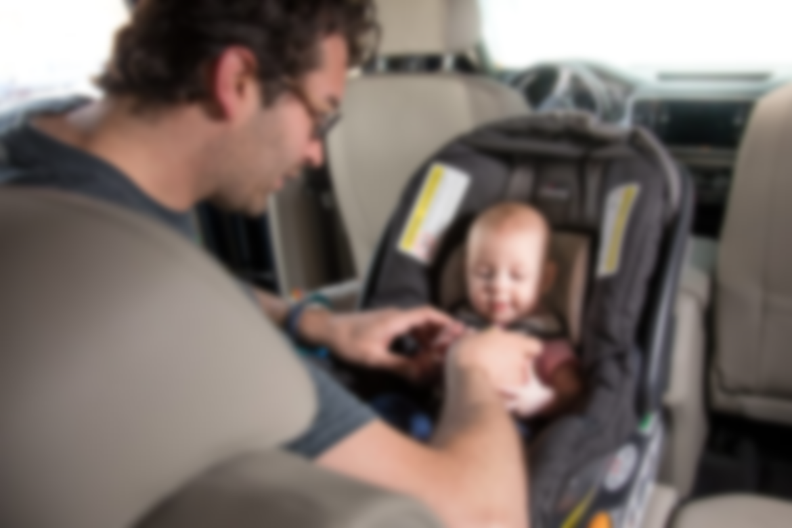
Introduction
Business Idea.
The idea is to provide children car seats with a sensor attached with them.
Car seats will be smarter with the addition of a sensor.
Reminds the parent regarding the position of the child if they have forgotten them.
Customer Needs, or Fears Addressed
We are trying to address fear of fatal distraction (Eria and Subramanian, 2018).
Parents forgetting their children in the backseat.
This can lead to the death of a child.

Slide 3

Continued
Business Differentiation
This is idea is completely new.
No current children car seat has the design and the specifications such as ours.
Furthermore, none of them have a sensor installed in them as well (Nasr and Cheraghi, 2017).
Cultural Context in Developing the Business Idea
Culturally, it becomes a stigma if a parent cannot care for his child (Sherr, 2019).
Due to technology, our attentions get diverted.
This technology is only to support parents in such a fast paced life.

Slide 4
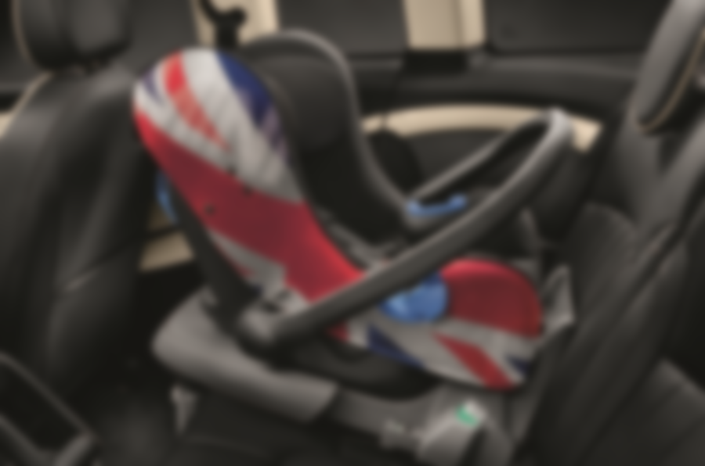
Reflection
Entrepreneurship Validation Tools
The first entrepreneurship validation tool used was:
Design Thinking
Through the use of user reviews certain tweaks were made into the product (Kolko, 2015).
These tweaks were based on the prototype reviews given by a selected group of customers.
This way the problems that surfaced helped in identifying areas in which the product was still lagging.

Slide 5

Continued
Entrepreneurship Validation Tools
The second entrepreneurship validation tool used was:
Lean Startup
The production of the product was kept as lean as possible.
Maximum utilization of the least amount of resources was done (Frederiksen and Brem, 2017).
This way cost of production was minimized
Which allowed for a low selling price compared to our competitors.

Slide 6
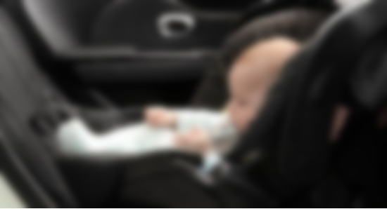
Key marketing and Resource considerations
Attractiveness of Industry
The industry is currently very favorable.
This is because the high requirement of safety for children from the parents side.
Competition in Industry
Well the idea is generally new but there are some competitors.
Such as Driver’s Little Helper, Baby Alert International and Nabi.
Targeted Customers
Targeted customers are mostly child bearing families
specifically those with infants to 7 year olds.
Major Product Benefits
The benefit of this product is if the parent does not reply in a certain time, a call is made to a friend or a family member
Alerting them if anything is wrong.

Slide 7
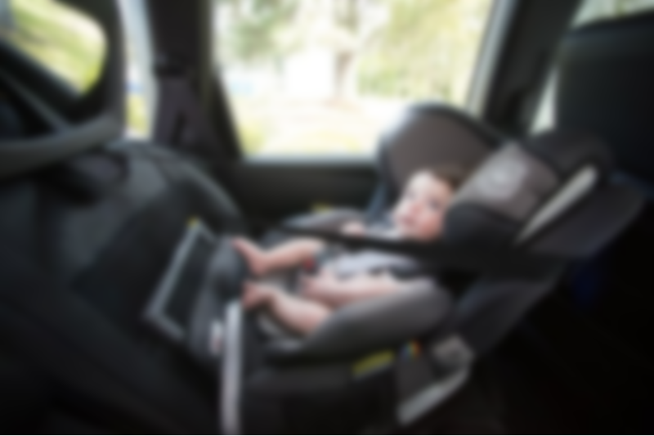
Continued
Unit Price of the Product/Service
Our intended unit price is $50 (Australian dollars)
This is much cheaper compared to the $70 to $149 range of our competitors
Distribution and Technology Incorporation in Product to reach Customers
The fastest way would be to order it on Amazon.
This way ecommerce technology is being used to deliver products at a much faster pace
Promotion at the Initial Stage
Social media will be used to promote the product
Paid ads on television and paper
Initial and Means of Finance
$50,000 needed tentatively
Through kick starter

Slide 8
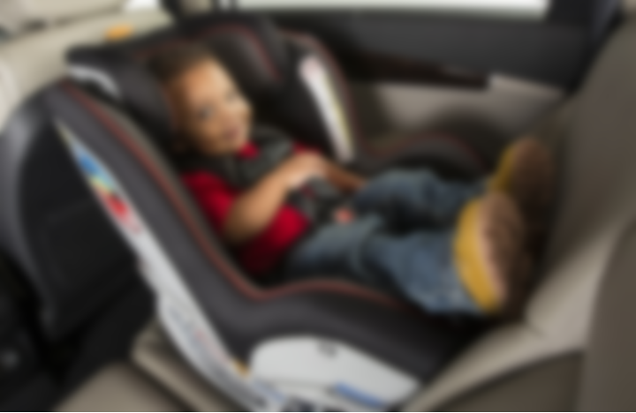
Entrepreneurial Traits/ Characteristics
Entrepreneurial Characteristics/Traits and Skills of the Team Members.
My team members have all the characteristics required to be a successful entrepreneur.
Characteristics
Self-motivated
Takes risks
Good networking capabilities
Money management skills
Flexible
Passionate

Slide 9
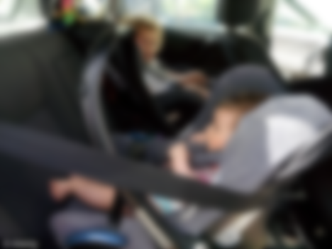
Continued
Members Contribute to the Venture’s Success (Application of Relevant Entrepreneurship Theories)
Entrepreneurship Innovation Theory
Under this theory characteristics such as risk taking and organizational skills are highly important (Kuratko, 2016).
This shows aptitude for conversion of an idea to an innovation.
Psychological Theory of Entrepreneurship
According to this theory characteristics as passion, foresight, and motivation are necessary
These characteristics give a boost to people to pursue entrepreneurship.

Slide 10
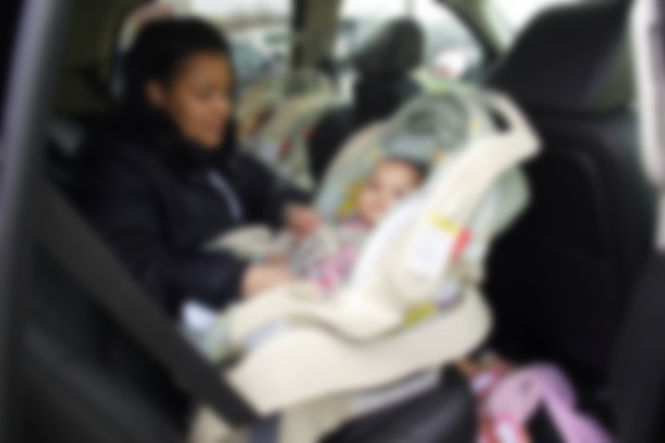
Sustainable Values
Sustainable values tend to integrate the environmental, social and economic dimension of sustainability.
Social Sustainable Values
Car seater will increase awareness regarding mindfulness about presence of the child.
This will prevent the child from being put in a harmful situations
Health Sustainable Values
The child’s life would be less at risk
Deaths due to heat stroke can be prevented.

Slide 11
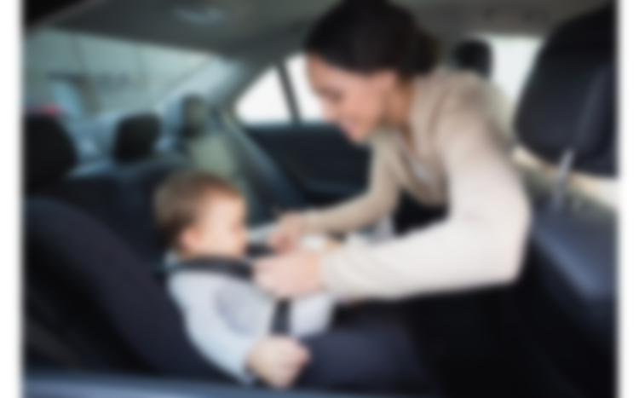
Continued
Economic Sustainable Values
Price wise it is very economical
Does not put too much burden on parents
Gives full value for the amount used.
Environmental Sustainable Values
Prevents an environment of sorrow or pain due to any type of negligence
Environmentally friendly
Easily disposed of
Can be marked as a “Green Product”.

Slide 12
References
Eria, K. and Subramanian, P., 2018. Illustrative BI Solution to Improve Marketing Strategies: Case Study of a Car Baby Seat Manufacturer. Journal of Applied Technology and Innovation (e-ISSN: 2600-7304), 2(1).
Frederiksen, D.L. and Brem, A., 2017. How do entrepreneurs think they create value? A scientific reflection of Eric Ries’ Lean Startup approach. International Entrepreneurship and Management Journal, 13(1), pp.169-189.
Kolko, J., 2015. Design thinking comes of age.

Slide 13
Continued
Kuratko, D.F., 2016. Entrepreneurship: Theory, process, and practice. Cengage Learning.
Nasr, M.D. and Cheraghi, M., 2017. The Study of the Effect of Diversification Strategy, Cost Leader-ship Strategies and Product Differentiation on Business Unit Value.
Sherr, I. (2019). Took long enough: Tech to protect your kid from overheating in the car seat. [online] CNET. Available at: https://www.cnet.com/news/some-truly-useful-tech-a-sense-a-life-sensor-for-your-childs-babies-car-seat/ [Accessed 5 Sep. 2019].

